Slide 1
Directions for this Template
Use the Slide Master to make universal changes to the presentation, including inserting your organization’s logo and the appropriate protective marking (e.g., FOUO)
“View” tab > “Slide Master”
Replace placeholders (indicated by brackets [ ]) with information specific to your exercise
Delete any slides that are not relevant for your workshop
Font size should not be smaller than 22pt
Rev. December 2012
HSEEP-PM02
Notes:
Organizations can modify and augment this briefing as needed.

Slide 2
Training and Exercise Planning Workshop (TEPW)
[Sponsor Organization]
[Date]

Slide 3
Welcome and Introductions
[Name]
[Organization]

Slide 4
Agenda
[Time] Homeland Security Exercise and Evaluation Program (HSEEP) Overview
[Time] Capabilities-based Planning Overview
[Time] Review of Prior Multi-Year Training and Exercise Plan (TEP)
[Time] TEPW Purpose
[Time] Workshop Activities
[Time] Review
[Time] Next Steps
[Time] Closing Remarks

Slide 5
HSEEP Overview
HSEEP doctrine consists of an integrated set of core principles that frame a common approach to exercises
HSEEP Principles:
Guided by elected and appointed officials
Capability-based, objective driven
Whole Community integration
Informed by risk
Common methodology
Progressive planning approach

Slide 6
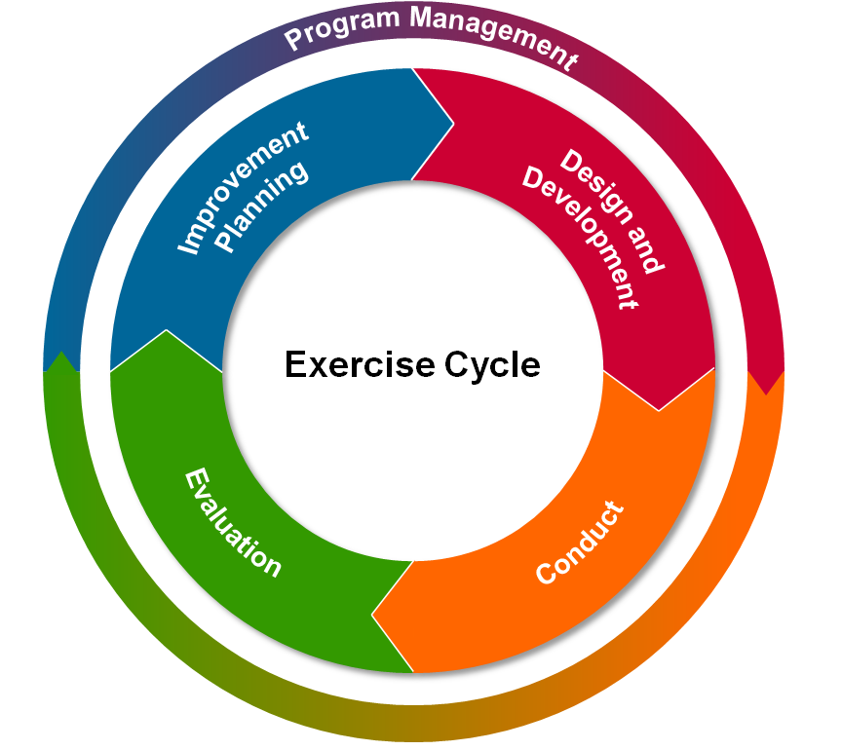
HSEEP Cycle
Establishing multi-year exercise program priorities and developing a multi-year TEP are key pieces of Exercise Program Management within the HSEEP methodology
Notes:
Establishing multi-year exercise program priorities and developing a multi-year TEP are key pieces of Exercise Program Management within the HSEEP methodology.

Slide 7
Capabilities-based Planning Overview
The National Preparedness Goal identifies a series of core capabilities across the prevention, protection, mitigation, response, and recovery mission areas
Through HSEEP, organizations can use exercises as a way to examine current and required core capability levels and identify gaps. Exercises focus on assessing performance against capability-based objectives

Slide 8
Review of Prior Multi-year TEP
[Insert highlights from the previous multi-year TEP and an update on the progress against the program priorities and multi-year schedule]

Slide 9
TEPW Purpose
The purpose of the TEPW is to use the guidance provided by senior officials to identify and set exercise program priorities and develop a multi-year schedule of exercise events and supporting training activities to meet those priorities
Identify Factors for Consideration
Link Factors to Core Capabilities
Develop a Multi-year Schedule
Establish Exercise Program Priorities

Slide 10
Attendee Expectations
Have a working knowledge of HSEEP
Be familiar with the National Preparedness Goal and National Preparedness System
Have access to organizational plans, policies, procedures, and other relevant documents (including After-Action Reports)
Have the authority to establish or revise organizational priorities

Slide 11
Workshop Activities
The TEPW focuses on 4 primary activities and associated tasks:
Activity 1: Identify Factors for Consideration
Task 1.1: Identify threats and hazards
Task 1.2: Identify validated and non-validated areas for improvement
Task 1.3: Identify external sources and requirements
Task 1.4: Identify accreditation standards or regulations
Activity 2: Link Factors to Core Capabilities

Slide 12
Workshop Activities (cont’d)
Activity 3: Establish Exercise Program Priorities
Activity 4: Develop a Multi-year Schedule
Task 4.1: Identify potential exercises
Task 4.2: Identify potential training
Task 4.3: Update/build the draft multi-year schedule

Slide 13
Activity 1
Identify Factors for Consideration
Link Factors to Core Capabilities
Develop a Multi-year Schedule
Establish Exercise Program Priorities
Factors for consideration are they key elements that influence the selection of exercise program priorities
The list of factors is intended to help organizations consider the full range of factors impacting their exercise and preparedness programs

Slide 14
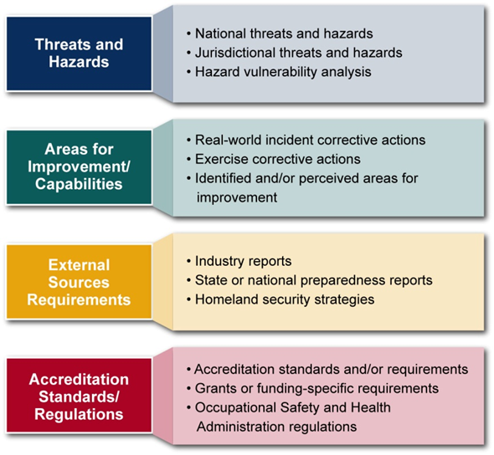
Activity 1 Tasks Overview
During this activity, we will focus on the identifying the following:
Task 1.1:
Task 1.2:
Task 1.3:
Task 1.4:

Slide 15
Task 1.1: Identify Threats and Hazards
Objective: Identify any significant threats and hazards
Consider:
National threats and hazards
Organizational threats and hazards
THIRA and local risk assessments
Hazard vulnerability analysis
Instructions:
Locate the other members of your organization
As a group, develop a list of the top threats and hazards impacting your organization
Record these threats and hazards
Choose a group member to brief the findings

Slide 16
Task 1.2: Identify Areas for Improvement
Objective: Identify any significant strengths and areas for improvement
Consider:
Strengths to be shared with other organizations
Exercise and real-world event corrective actions
Identified and/or perceived areas for improvement
Instructions:
Locate the other members of your organization
As a group, develop a list of your organization’s top strengths and areas for improvement
Record these strengths/areas for improvement
Choose a group member to brief the findings

Slide 17
Task 1.3: Identify External Sources and Requirements
Objective: Identify any significant external sources and requirements
Consider:
Industry reports
State or national preparedness reports
State or national homeland security strategies
Homeland security policy
Instructions:
Locate the other members of your organization
As a group, develop a list of your organization’s key external sources and requirements
Record these sources and requirements
Choose a group member to brief the findings

Slide 18
Task 1.4: Identify Accreditation Standards and Regulations
Objective: Identify any significant accreditation standards and regulations
Consider:
Accreditation standards
Grants or funding-specific requirements
Occupational Safety and Health Administration (OSHA) regulations
Legislative requirements
Instructions:
Locate the other members of your organization
As a group, develop a list of your organization’s key accreditation standards and regulations
Record these standards and regulations
Choose a group member to brief the findings

Slide 19
Activity 2
Identify Factors for Consideration
Link Factors to Core Capabilities
Develop a Multi-year Schedule
Establish Exercise Program Priorities
The National Preparedness Goal outlines district core capabilities across five preparedness mission areas
Organizations can use exercises as a way to examine current and required core capability levels and identify gaps
Linking the factors identified in Activity 1 to core capabilities will help identify the areas most in need of attention

Slide 20
Activity 2: Link Factors to Core Capabilities
Objective: Link the factors identified in Activity 1 to core capabilities
Consider:
Threats and hazards
Strengths and areas for improvement
External sources and requirements
Accreditation standards and regulations
Instructions:
Assign core capabilities to each factor recorded during Activity 1
If multiple core capabilities are associated with a factor, determine which is primary capability
Identify and prioritize the most common core capabilities

Slide 21
Activity 3
Identify Factors for Consideration
Link Factors to Core Capabilities
Develop a Multi-year Schedule
Establish Exercise Program Priorities
Exercise program priorities are the strategic, high-level priorities that guide the overall exercise program
These priorities inform the development of exercise objectives, ensuring individual exercises evaluate and assess core capabilities in a coordinated and integrated fashion

Slide 22
Activity 3: Establish Exercise Program Priorities
Objective: Achieve consensus on the priorities that will guide the exercise program for the next [#] years
Consider:
Factors identified in Activity 1
Priority core capabilities identified in Activity 2
Elected and appointed officials’ guidance
Instructions:
Identify 3-5 priorities on which to focus training and exercises
Priorities should be at the strategic level
Consider priorities from a holistic perspective, not just your individual organization. These priorities are not meant to supersede their organizations’ priorities

Slide 23
Activity 4
Identify Factors for Consideration
Link Factors to Core Capabilities
Develop a Multi-year Schedule
Establish Exercise Program Priorities
The multi-year schedule outlines the exercises and associated training events that will address the exercise program priorities
The multi-year schedule should reflect a progressive approach:
Exercises are aligned to a common set of exercise program priorities
Exercises increase in complexity over time
Exercises should be supported at each step with training resources

Slide 24
Activity 4 Tasks Overview
During this activity, we will focus on the following tasks:
Task 4.1: Identify Potential Exercises
Task 4.2: Identify Training
Task 4.3: Update/Build the Multi-year Schedule

Slide 25
Task 4.1: Identify Potential Exercises
Objective: Identify potential exercises for inclusion in the multi-year schedule
Consider:
Pre-planned exercises
Standing exercise requirements
Additional exercises to address program priorities
Instructions:
Locate the other members of your organization
As a group, identify potential exercises for the multi-year schedule
Record the exercises, including the focus, date, and other known information
Choose a group member to brief the findings

Slide 26
Task 4.2: Identify Potential Training
Objective: Identify potential training events for inclusion in the multi-year schedule
Consider:
Training to support specific exercises
Required training
Additional training to meet capability gaps or address program priorities
Instructions:
Locate the other members of your organization
As a group, identify potential training events
Record the potential training events, including the focus, audience, and date
Choose a group member to brief the findings

Slide 27
Task 4.3: Update/Build the Draft Multi-year Schedule
Objective: Update or build the multi-year training and exercise schedule
Consider:
Exercises that address program priorities and priority core capabilities
Exercises that promote collaboration
Instructions:
Select exercises from the proposed list and identify tentative exercise conduct dates
Select training events and identify tentative conduct dates, scheduling around exercises, as appropriate

Slide 28
Populate the Draft Multi-year Schedule
Year 1: 20xx
Organ-ization | Jan | Feb | Mar | Apr | May | Jun | Jul | Aug | Sep | Oct | Nov | Dec
Org 1
Org 2
Org 3
Org 4
Org 5

Slide 29
Populate the Draft Multi-year Schedule (cont’d)
Year 1: 20xx
Organ-ization | Jan | Feb | Mar | Apr | May | Jun | Jul | Aug | Sep | Oct | Nov | Dec
Org 1
Org 2
Org 3
Org 4
Org 5

Slide 30
Review
The selected exercise program priorities include:
[insert exercise program priorities]
The exercises and trainings selected for inclusion in the TEP include:
[insert exercises and trainings]

Slide 31
Next Steps
Develop and distribute TEPW Summary
Develop Multi-year TEP
[insert additional items as needed]

Slide 32
Conclusion

