Slide 1
Sun Safety
Department of Dermatology
SUNY Stony Brook
Renaissance School of Medicine at Stony Brook University

Slide 2

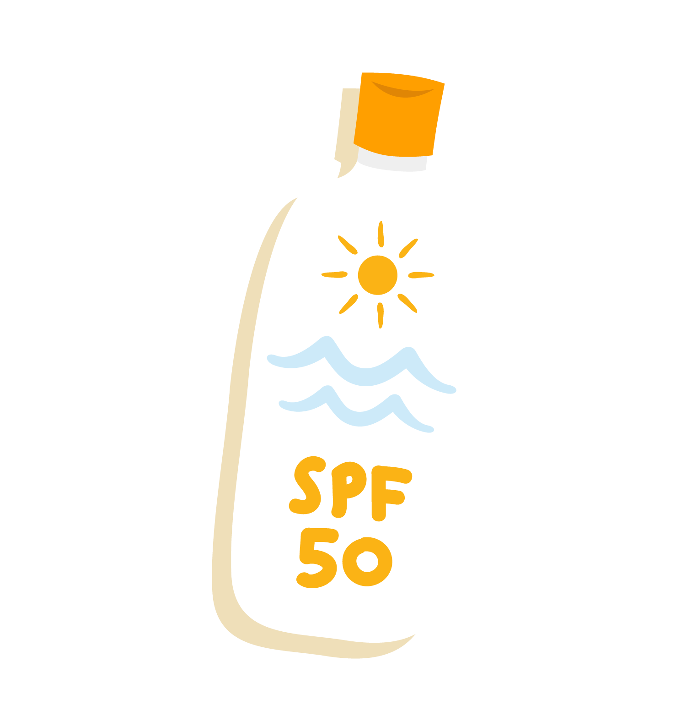
Who Knows Why?
Raise your hand if your parents tell you to put on sunscreen!

Slide 3

Sunburn!

Slide 4
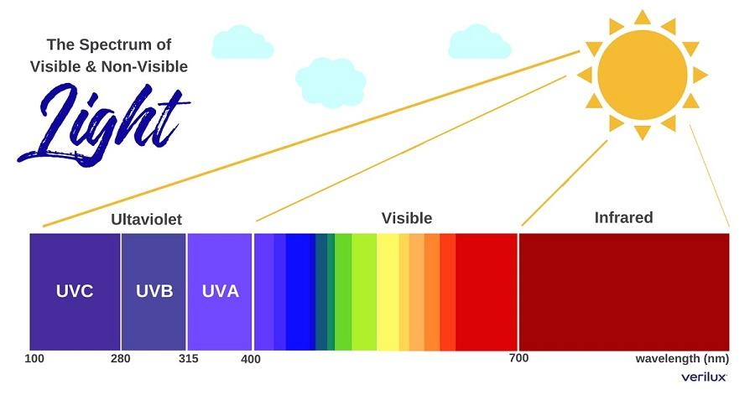
UV / Visible / Infrared Rays

Slide 5

Let’s Learn Healthy Sun Habits!

Slide 6

Why Do We Go To School?

Slide 7




Doing Something for the Long Run!
It’s the same thing with sun protection!

Slide 8

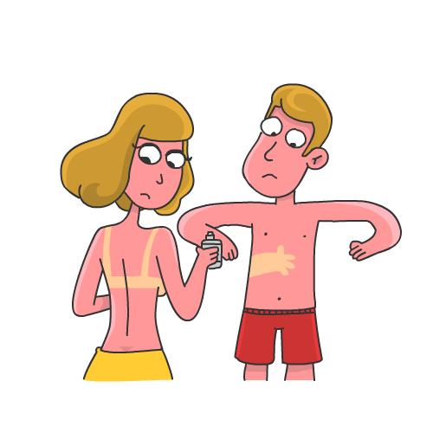
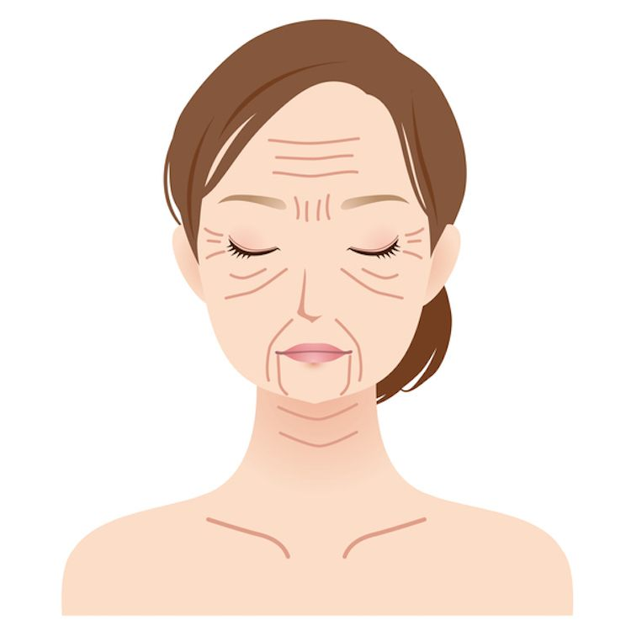
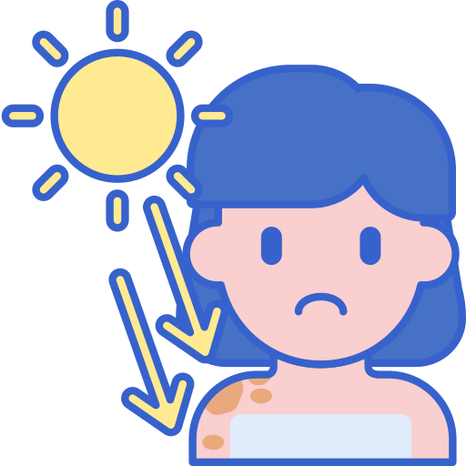
Protecting Your Skin From Sun Damage!
Short Term Damage
Long Term Damage
Sunburns
Wrinkles
Skin Cancer

Slide 9
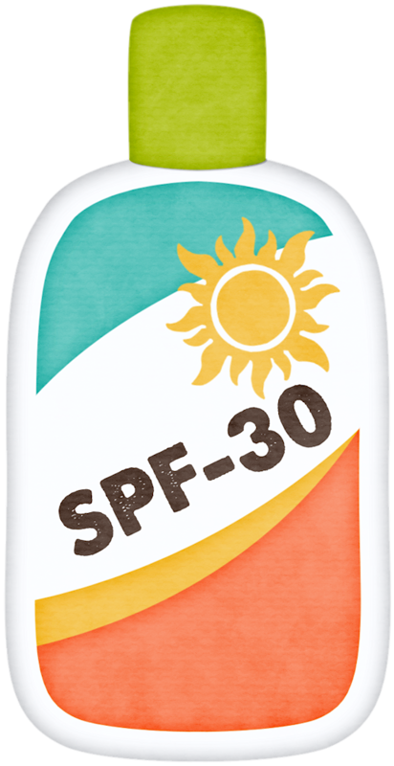
The Six Ways For Sun Safety!
Sunscreen
At least SPF 30 to protect against skin cancer
Wear it every day, even when it's cloudy
Sunrays can get through clouds

Slide 10


The Six Ways For Sun Safety!
Covering up
Sunglasses and hats protect your eyes and face
Long-sleeved shirts and pants protect your body
Light colors reflect the sun

Slide 11


The Six Ways For Sun Safety!
Look for shade
The sun is hottest from 10AM to 2PM
If your shadow is shorter than you, then hang out in the shade
Umbrellas work great

Slide 12


The Six Ways For Sun Safety!
Be careful around water, sand, and snow
Sunrays can reflect off the water, sand, and even snow
Put on extra protection
Yes! You can get a sunburn while skiing!

Slide 13



The Six Ways For Sun Safety!
Vitamin D
Healthy doses from the sun!
Fish
Egg Yolks
Mushrooms

Slide 14
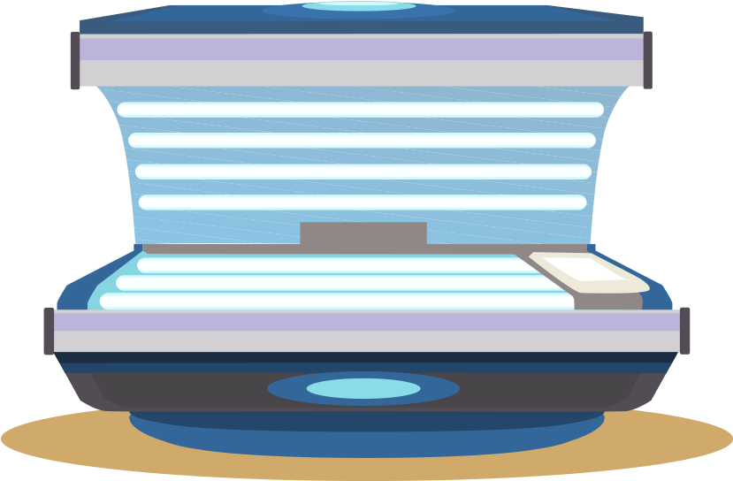

The Six Ways For Sun Safety!
Stay away from tanning beds!
Shines the same harmful sun rays much closer to your body
Skin speeds up skin aging
Much higher chance of skin cancer
There is no such thing as safe tanning!

Slide 15

Myths
Myth #1
You won't get sun damage on windy, cloudy, or cold days
FALSE!
Sun damage is from ultraviolet
(UV) radiation, not temperature (Infrared)

Slide 16
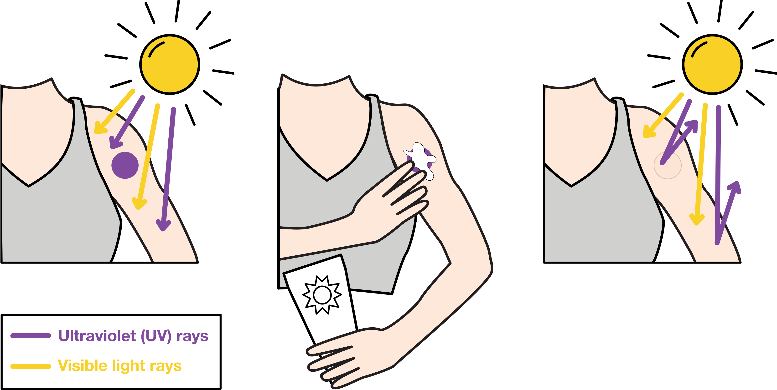
Myths

Slide 17
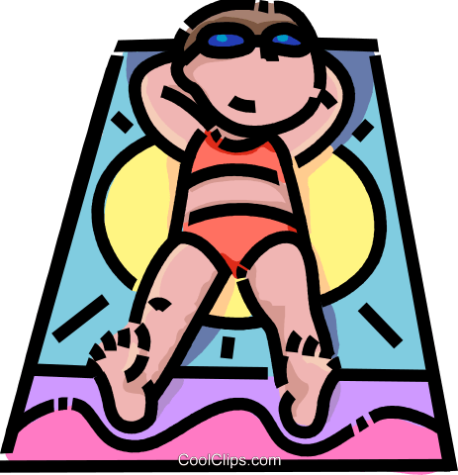
Myths
Myth #2
If you tan but don't burn, you don't
need to bother with sun protection
FALSE!
Darkened skin is a sign of skin cells reacting to injury, even if there is no redness or peeling. You are still at risk of skin cancer!

Slide 18

Myths
Myth #3
You can't get sunburnt in the car through a window.
FALSE!
You are exposed to infrared rays
(heat), visible light (sunlight), and UV rays
through the car window. UV rays give
you the sunburn!

Slide 19
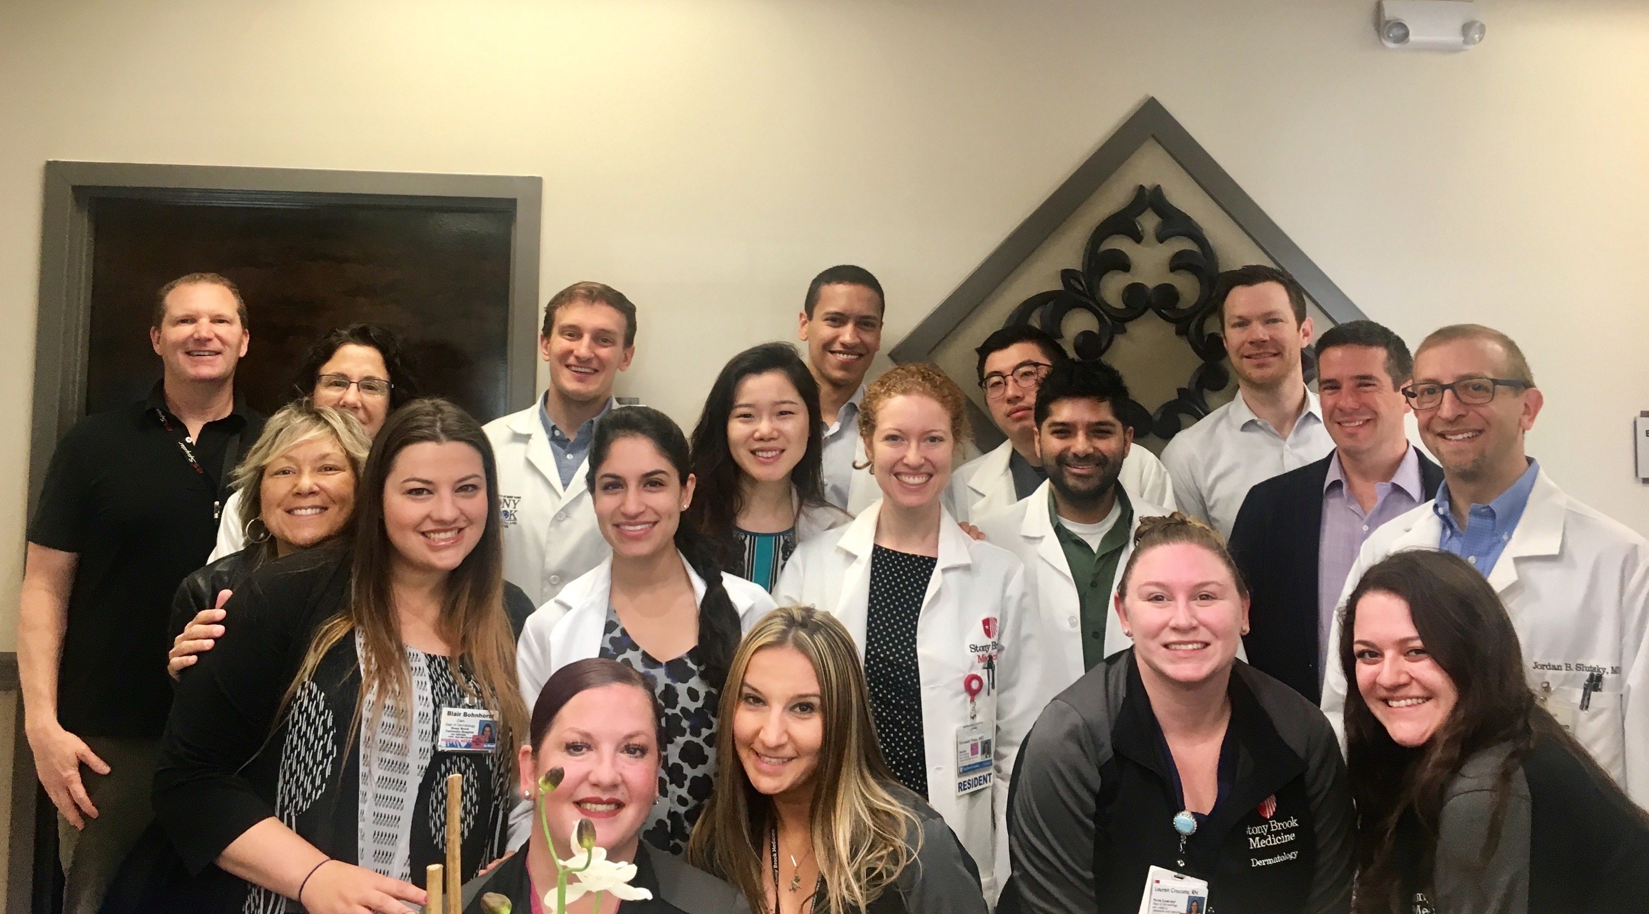
Thank You!
Please submit your
questions to:
dermonlineappointments@stonybrookmedicine.edu
INFORMATION AND APPOINTMENTS
(631) 444- 4200
Department of Dermatology
SUNY Stony Brook
Renaissance School of Medicine at Stony Brook University

