Slide 1
National Cyber Exercise and
Planning Program (NCEPP)
CYBER EXERCISES
Master Exercise Practitioner Program
February 28, 2017

Slide 2
Lisa Beury-Russo
National Cyber Exercise and Planning Program (NCEPP)
National Cybersecurity and Communications Integration Center (NCCIC)
U.S. Department of Homeland Security (DHS)
Notes:
Provide a brief personal introduction and background.

Slide 3
Objectives
Introduce basic cybersecurity concepts and terms
Highlight key differences between cyber exercises and all-hazards exercises
Provide an overview of available resources

Slide 4
Understanding Cybersecurity

Slide 5
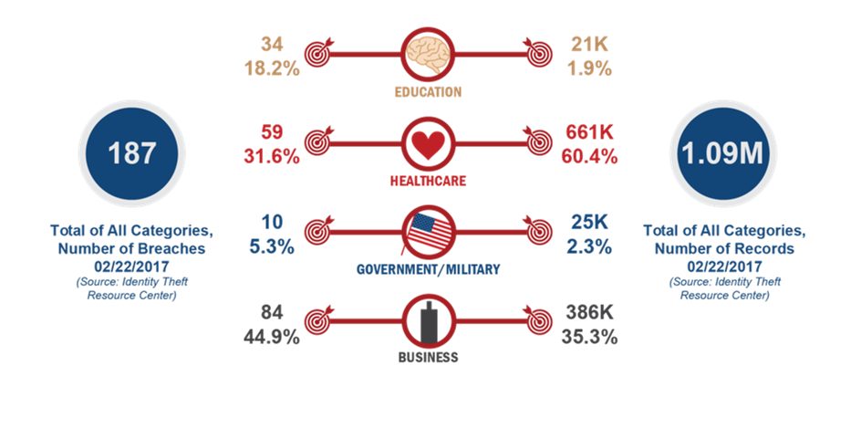
U.S. Data Breaches by Industry: 2017
Notes:
U.S. Data Breaches by Industry 2017
Cyber security is a high priority for our stakeholders
No sector is immune to cyber incidents

Slide 6
Core Capability: Cybersecurity
Mission Area: Protection
Description: Protect (and if needed, restore) electronic communications systems, information, and services from damage, unauthorized use, and exploitation
Cyber in practice
  Confidentiality
  Availability
  Integrity
Notes:
This is the definition of the cybersecurity core capability from the National Preparedness Goal.
Generally, in practice, we think about IT security as maintaining the confidentiality, integrity, and availability of systems and data.

Slide 7
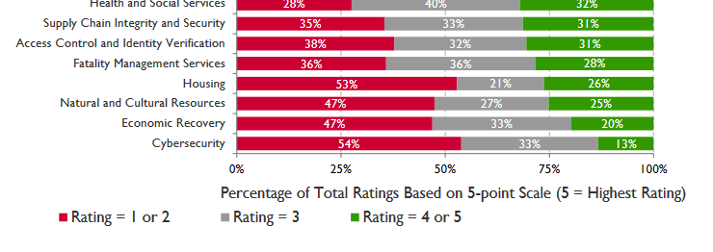
High Priority, Low Capability
According to the 2016 National Preparedness Report:
“Cybersecurity has emerged as one of the most critical preparedness challenges over the past five years.”
Cybersecurity remained the lowest-rated core capability for the fifth year in a row, with jurisdictions reporting only 13 percent proficiency
Notes:
Additionally, previous NPRs identified that:
70% of states view addressing the cybersecurity capability gap as mostly or entirely the state’s responsibility
Only 13% of states indicate proficiency in the cybersecurity core capability
100% of 53 states and territories surveyed: need continued Fed support to augment cyber efforts

Slide 8
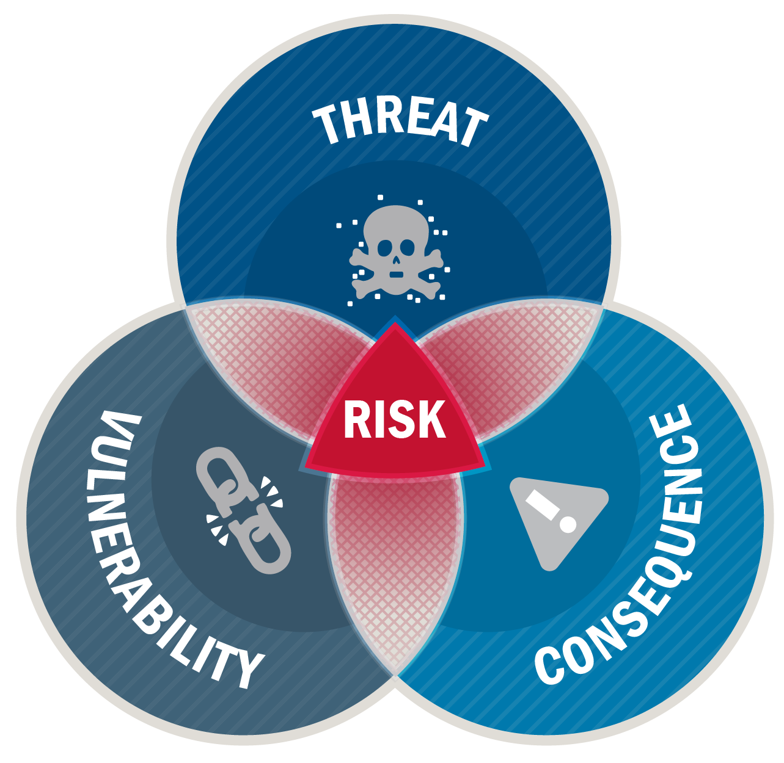
Risk Components of Cybersecurity
Calculating and mitigating cyber risk enhances your security posture
Components of cyber risk:
  Threat
  Vulnerability
  Consequence
Notes:
Discuss any previous cyber risk assessments. If none have been done, let’s take a moment to brainstorm potential:
Threats:
Natural Disasters
Accidents, Failures, Human Error
Human Threat
Insider threat
Hackers and Script Kiddies
Nation States
Cyber criminals
Vulnerabilities:
Software
Hardware
New technologies – focus on innovation over security
Consequences
Confidentiality
Availability
Integrity
Cascading impacts – affect on critical systems or critical infrastructure
Consider cyber AND physical impacts

Slide 9
Cyber Exercises

Slide 10
Why Exercise?
Part of continuous improvement
Identify gaps in policies, plans, and procedures
Test response capabilities
Build and sustain core capabilities
Establish and enhance partnerships
Examine the ways we work with the entire community to prevent, protect, mitigate, respond to, and recover from cyber threats and incidents
Notes:
We conduct cyber exercises for the same reasons we conduct any other exercise.

Slide 11
Cyber Exercises are Unique
All-Hazards Exercises | Cyber Exercises
Well-established exercise culture, response plans, and authorities | Cyber exercise culture is still maturing
Focused on incident response | Assess pre-incident detection capabilities, response efforts and plans, and post-attack recovery
Rehearsal of known coordination processes among first responders, largely from the public sector | Discovery of complex interdependencies, constituencies, and decision processes from cross-sector missions and disciplines
Limited or variable technical content that is easily modeled | Involvement of highly technical players requires technical scenarios to enhance realism; simulations difficult to model
Geographic scope is well understood | Geographic scope is unlimited due to distributed nature of cyber infrastructure
Notes:
Cyber exercises are often more complex in that they deal with interdependencies that all-hazards exercises do not. They must also engage different stakeholders – information technology and information security personnel, public information officers, legal, and often C-suite officers all have key roles in cyber issues.
The next few slides will walk through unique considerations for cyber exercises at each phase of the exercise planning process.

Slide 12
Exercise Types
Any exercise type can focus on cybersecurity
Tabletops are most common
Functional exercises may focus on information sharing or coordination
Full-scale exercises involve “hands-on-keyboard” play and may require specialized facilities or “ranges”
Notes:
Let’s start by looking at your multi-year planning. At the TEPW, you often outline what types of exercises will be conducted over the next year or two. Any exercise type described in HSEEP – seminars, workshops, tabletops, games, drills, functionals, or full-scales – can be a cyber exercise. However, there are some elements that are different in cyber exercises. In discussion-based exercises, difference may be minor, such as the way modules are structured (more on that later). The main differences are in operations-based exercises.
Cyber functional exercises may focus or information sharing or the coordination during cyber incident response. (examples of Prelude and Quantum Breach)
Cyber full-scale exercises look very different than the emergency response exercises that you may be used to. Instead of deploying law enforcement to set up a security perimeter or HazMat personnel to perform decontamination, these are what we call “hands on keyboard” exercises. They often involve red team/blue team play on a “cyber range” or isolate IT network set up specifically for training and exercises. (example Cyber Guard)

Slide 13
Exercise Foundation
Organizational plans and procedures might include:
  IT policies
  Cyber incident response plan
  Cyber annex
National-level guidance includes:
  National Cyber Incident Response Plan (NCIRP)
  Presidential Policy Directive (PPD) 41
  Cybersecurity Framework
Cyber risk assessments
Lessons learned from real world cyber incidents or breaches
Notes:
As we get into the planning of individual exercises, there are additional considerations for cyber exercises. This begins with the exercise foundation.
Following HSEEP guidance, planners should consider key factors to lay the exercise foundation. These are generally similar regardless of the focus of your exercise. However, you may need to look in different places or reach out to different departments when working on a cyber exercise.
At the state, local, or organizational level, you may want to look at IT policies, cyber incident response plans, or a cyber annex to the state EOP. These plans should define items like reporting requirements, incident severity categories, and response resources.
You may also want to consider national level guidance. We’ve long incorporated principles from the National Response Framework into exercises; in the same way, you should be aware of principles in key documents like PPD-41 and the NCIRP.

Slide 14
Stakeholder Identification
Exercises with senior support prove most effective
Suggested exercise planning team organizations include:
  Information technology (IT)
  Law enforcement
  Emergency management
Examples include:
  Chief Information Officer (CIO) or Chief Information Security Officer (CISO)
  Intelligence or Fusion Centers
  Emergency Manager or EOC personnel

Slide 15
Mission Areas and Core Capabilities
Mission Area alignment
  Cybersecurity falls within Protection
  Cyber issues can be addressed in all 5 Mission Areas
Related Core Capabilities
  Planning
  Public Information and Warning
  Operational Coordination
  Intelligence and Information Sharing
  Situational Assessment

Slide 16
Common Cyber Objectives
Increase cyber risk awareness
Identify cyber intelligence and information sharing mechanisms
Identify cyber incident escalation criteria and related notifications
Identify cyber incident management structures
Validate cyber incident response roles and responsibilities
Review cyber resource request and management processes
Discuss public information roles and responsibilities for cyber incidents
Notes:
While these are not SMART objectives, they represent the most frequent topics of cyber exercises.

Slide 17
Exercise Structure
Mission Areas: Prevention, Protection, Mitigation, Response, Recovery
NIST Framework: Identify, Protect, Detect, Respond, Recover
Chronological or Functional: Information Sharing, Incident Management, etc.
Examples:
  Prevention > Protection > Response
  Protect > Detect > Respond
  Information Sharing > Incident Escalation > Incident Management

Slide 18
Scenario Concepts
Cyber-induced Cyber Consequences
  Ransomware locks computers
  Vulnerability leads to data breach
Cyber-induced Physical Consequences
  Malware causes power outage
  Hacker alters chemical levels at water treatment plant
Physical-induced Cyber Consequences
  Flood impacts data center
  Cable cut degrades communications

Slide 19
Exercise Outcomes
Evaluation and improvement planning follow HSEEP guidance
Common findings include:
  Cyber not fully integrated into risk assessment process
  Lack of strategic, operational, and tactical cyber planning
  Lack of cyber integration into information sharing structures
  Lack of cyber integration into incident management structures
  Public information officers require training on cyber issues

Slide 20
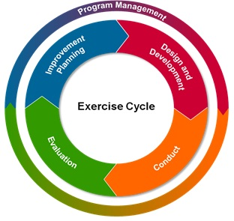
Exercise Program Management
Determine if cyber is integrated in your disaster planning and preparation processes
Ensure cyber considerations are included throughout your Training and Exercise Plan
Check every exercise for cyber impacts

Slide 21
Cyber Exercise Resources

Slide 22
NCEPP Offerings
National Cyber Exercise Events
End-to-End Cyber Exercise Planning and Conduct
Cyber Exercise Consulting and SME Support
Cyber Planning
Off-the-Shelf Resources

Slide 23
National Cyber Exercise Events
Cyber Storm
Flagship, biennial exercise series with extensive state participation
A forum for participants to:
    Simulate discovery of and response to a large-scale, coordinated cyber attack impacting critical infrastructure
    Exercise, evaluate, and improve processes, procedures, interactions, and information sharing mechanisms within their organization or community of interest
  Cyber Storm VI: April 2018
  Information: CyberStorm@hq.dhs.gov
Notes:
The NCEPP team is best known for Cyber Storm. Most recent iteration took place in March 2016, and engaged a broad range of federal, SLTT, and critical infrastructure partners.

Slide 24
National Cyber Exercise Events (cont.)
Cyber Guard Prelude
An environment to exercise information sharing mechanisms, resource allocation, and augmentation processes, plans, and procedures during a national cyber crisis
NCEPP led first-ever Cyber Guard Prelude in June 2015
1500+ participants across federal, SLTT, private sector, and international
Prelude 2017: May 23 - 25, 2017
Information: CEP@hq.dhs.gov
Notes:
Cyber Guard Prelude is a newer national-level exercise, first conducted in 2015. The next iteration is May 2017.

Slide 25
End-to-End Cyber Exercise Planning and Conduct
NCEPP plans, executes, and supports the full spectrum of cyber exercises
Discussion-based
Operations-based
Planning Meetings
Documentation Development
Scenario Building
Facilitation/Exercise Control
After Action Report
Notes:
Our most popular service is the end-to-end support. Here we manage the entire exercise design and development process, from running the planning meetings to facilitating the exercise, to drafting the AAR.

Slide 26
Cyber Exercise Consulting & SME Support
NCEPP offers cyber exercise SMEs to consult on exercise design and development
Scenario review
Participation in planning calls
Exercise controller/observer support
Notes:
For stakeholders who need less support…
A good example of SME support is our work with a US Coast Guard Marine Safety Unit. They have support through the Area Maritime Security Training and Exercise (AMSTEP) program to run the planning meetings and develop exercise material. Our team is participating in the meetings and helping them develop a realistic and relevant cyber scenario.

Slide 27
Cyber Planning
NCEPP assists in developing and revising integrated cyber plans
Cyber Planning Workshops
  Workshop facilitation
  Plan validation exercises
SME support for ongoing planning efforts

Slide 28
Off-the-Shelf Resources
Scenario Library
Cyber Tabletop Exercise Package (CTEP)
Virtual Tabletop Exercise (VTTX) next up April 22-24, 2017
Cyber Capabilities Planning Framework
  Unclassified, high-level framework intended to help entities develop capability lists to support action plans
Cyber Incident Annex Template
  Complements existing organization emergency response planning

Slide 29
Additional Resources
General
  Critical Infrastructure Cyber Community (C3) Voluntary Program: https://www.us-cert.gov/ccubedvp
  DHS resources and programs: https://www.dhs.gov/topic/cybersecurity
  Cyber Security Advisors: cyberadvisor@hq.dhs.gov
Training
  FedVTE: https://fedvte.usalearning.gov/
Notes:
C3 VP: Breakdown of resources by community (Fed, SLTT, Business, etc.) and function (identify, protect, detect, respond)

Slide 30
Questions?

Slide 31
Contact Us
Lisa Beury-Russo
National Cyber Exercise and Planning Program
Lisa.BeuryRusso@hq.dhs.gov
NCEPP
cep@hq.dhs.gov
https://hsin.dhs.gov/collab/NCCIC/NCEPP/

