Slide 1
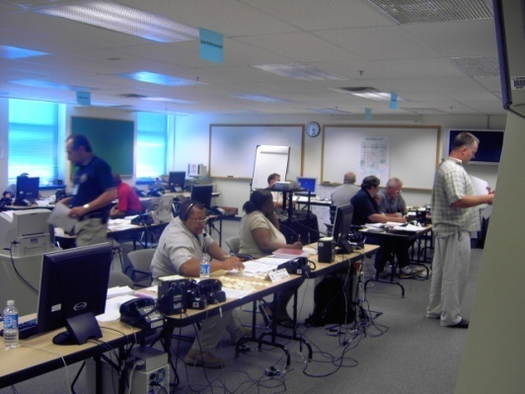
E136: Master Exercise Practitioner
Capstone Course
Unit 4: Course Wrap-Up
PHOTO: Emergency management personnel take part in a SimCell during an exercise.
FEMA News Photo

Slide 2
Unit Objective
By the end of this unit you will be able to:
  Summarize the key points of the E136: Master Exercise Practitioner Capstone Course

Slide 3
Course Review
In Unit 2 you learned about steps 7 and 8 of the eight Exercise Evaluation Steps, including:
  When an AAR/IP is considered final
  That corrective actions captured in the AAR/IP should be tracked and continually reported on until completion

Slide 4
Course Review (cont’d.)
In Unit 3 you learned about FSEs, including:
  The characteristics of an FSE
  How the HSEEP Exercise Cycle applies to an FSE
  Benefits and challenges of an FSE

Slide 5
Course Review (cont’d.)
You completed Proficiency Demonstration #1: Full-Scale Exercise:
  Applied the four phases of the exercise cycle—design and development, conduct, evaluation, and improvement planning to a full-scale exercise (FSE)
  Applied the eight Exercise Design Steps to an FSE
  Applied the eight Exercise Evaluation Steps to an FSE

Slide 6
Questions?
GRAPHIC: A stylized image of a question mark sitting on a puzzle piece.

Slide 7
Course Evaluations
Thoughts? Comments?

Slide 8

Congratulations!
GRAPHIC: A coin with a seal and the words Master Exercise Practitioner on it.

Slide 9

Graduation
GRAPHIC: An image of a graduation cap and diploma.

