Slide 1
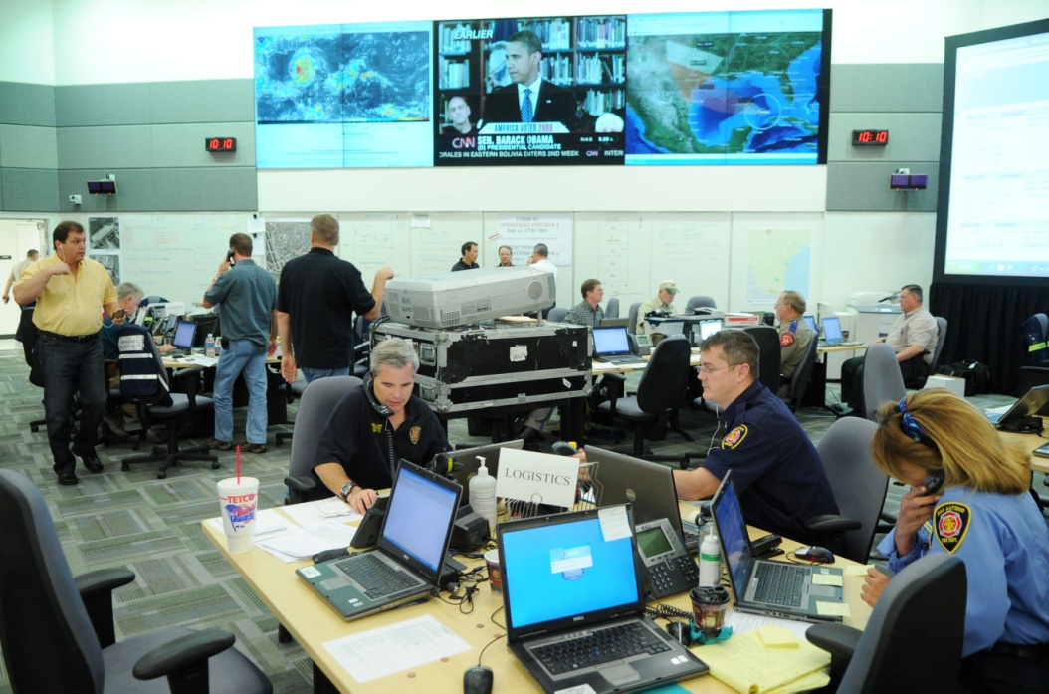
E136: MASTER EXERCISE PRACTITIONER
CAPSTONE COURSE
Unit 3: Full-Scale Exercises and Proficiency Demonstration #1
PHOTO: Emergency management personnel work in an EOC.
FEMA News Photo

Slide 2
Unit Objectives
Describe the characteristics of a full-scale exercise (FSE)
Describe how the HSEEP Exercise Cycle applies to an FSE
Identify the exercise participants utilized in an FSE and their roles/responsibilities
Identify benefits and challenges of an FSE

Slide 3
Unit Objectives (cont’d.)
Apply the roles and responsibilities of players, controllers, simulators, actors, and evaluators in an FSE environment
Develop an AAR/IP for an FSE

Slide 4
What is a Full-Scale Exercise?
FSEs are typically the most complex and resource-intensive type of exercise:
  Involving multiple agencies, organizations, and jurisdictions, and validate many facets of preparedness
  Including many players operating under cooperative systems such as the Incident Command System or Unified Command

Slide 5
What is a Full-Scale Exercise? (cont’d.)
Discussion:
  How do FSEs differ from FEs?

Slide 6
What is a Full-Scale Exercise? (cont’d.)
Players are mobilized/deployed to the designated response area where they respond in a free-play environment
Players use problem solving skills and critical thinking to determine what steps to take

Slide 7
What is a Full-Scale Exercise? (cont’d.)
Players respond as if it were an actual incident with minimal interference from controllers or evaluators
  Responders wear appropriate gear/PPE
There should be minimal simulation
If something is not to be demonstrated, it should be documented in the Exercise Plan (ExPlan), under Assumptions and Artificialities

Slide 8
What is a Full-Scale Exercise? (cont’d.)
SAFETY is a paramount issue!
  Responders can be injured in field response play
  A dedicated Safety Officer should be designated
  Players should also designate a Safety Officer as part of the ICS
  If possible, have a dedicated EMS unit

Slide 9
What is a Full-Scale Exercise? (cont’d.)
The exercise will typically be conducted in multiple locations:
  Command locations (e.g., ICP)
  Field activity locations
  Support locations (e.g., hospitals)
  EOC
Actual locations are preferred, but substitute locations can be used

Slide 10
What is a Full-Scale Exercise? (cont’d.)
Discussion:
  What are some other locations in which an FSE can be conducted?
Video:
  http://link.backlight.tv/innguard/videos/muscatatuck-urban-training-center-information-video-367.html

Slide 11
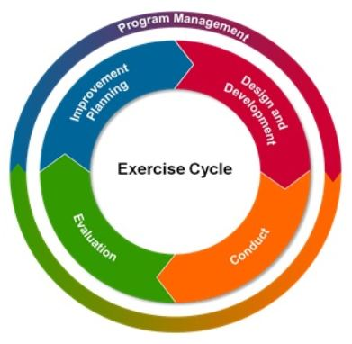
The HSEEP Exercise Cycle and FSEs
GRAPHIC: A graphic showing the HSEEP Exercise Cycle. Design and Development leads to Conduct, which leads to Evaluation, Which leads to Improvement Planning, which leads back to Design and Development.

Slide 12
Design and Development Phase
Base improvements on input from previous exercises
Review exercise needs assessment for accuracy
Assess capability to conduct an FSE
Address costs and liabilities
—usually higher
Gain support and announce
the exercise
GRAPHIC: A graphic showing the HSEEP Exercise Cycle. Design and Development leads to Conduct, which leads to Evaluation, Which leads to Improvement Planning, which leads back to Design and Development.

Slide 13
Design and Development Phase (cont’d.)
Apply the Eight Exercise Design Steps:
  Assess needs
  Define the scope
  Write a statement of purpose
  Define objectives
  Compose a narrative
  Write major and detailed events
  List expected actions
  Prepare messages

Slide 14
Design and Development Phase (cont’d.)
Conduct exercise planning meetings
  Concept and Objectives (C&O) Meeting
  Initial Planning Meeting (IPM)
  Midterm Planning Meeting (MPM)
  Master Scenario Events List (MSEL) Meeting (optional—can be done during MPM)
  Final Planning Meeting (FPM)
  NOTE: Multiple site visits and additional meetings may also be necessary

Slide 15
Design and Development Phase (cont’d.)
Develop the necessary documentation for
an FSE:
  Exercise Plan (ExPlan)
  Controller/Evaluator Handbook (C/E Handbook)
  MSEL
  Exercise Evaluator Packets (EEGs, plans, maps)
  Communication plan
  Briefing materials
  Participant feedback forms

Slide 16
Design and Development Phase (cont’d.)
Identify exercise participants:
  Players
  Actors
  Exercise Director
  Senior Controller
    Controller
    Venue Controller (Field)
    Safety Controller
    Simulator
  Evaluators

Slide 17
Design and Development Phase (cont’d.)
Players
  Individuals who have an active role in responding to the simulated emergency and perform their regular roles and responsibilities during the exercise
  Initiate actions that will respond to and mitigate the simulated emergency

Slide 18
Design and Development Phase (cont’d.)
Actors
  Exercise participants who act or simulate specific roles during exercise play
  Typically volunteers who have been recruited to play the role of victims or other bystanders

Slide 19
Design and Development Phase (cont’d.)
Exercise Director
  Plans, coordinates, and oversees all exercise functions
  Manages the exercise activities
  Maintains a close dialogue with the Senior Controller regarding the status of play and the achievement of the exercise design objectives

Slide 20
Design and Development Phase (cont’d.)
Senior Controller
  Is responsible for the overall organization of the exercise and exercise setup
  Takes direction from the Exercise Director
  Monitors exercise progress and coordinates decisions regarding deviations or significant changes to the scenario
  Is the “eyes and ears” for the Exercise Director

Slide 21
Design and Development Phase (cont’d.)
Senior Controller (cont’d.)
  Monitors actions by individual controllers/simulators and ensures they implement all designated and modified actions at the appropriate time
  Debriefs the controllers and evaluators after the exercise and oversees the setup and takedown of the exercise

Slide 22
Design and Development Phase (cont’d.)
Controllers
  Plan and manage exercise play
  Set up and operate the exercise incident site
  When necessary, take on the roles of individuals and agencies not actually participating in the exercise
  Direct the pace of exercise play
  Provide key data to players
  May prompt or initiate certain player actions and injects to ensure exercise continuity

Slide 23
Design and Development Phase (cont’d.)
Controllers (cont’d.)
  Issue exercise materials to players as required
  Monitor the exercise timeline
  Supervise the safety of all exercise participants
  Are the only participants who should provide information or direction to players
  Are accountable to one Senior Controller

Slide 24
Design and Development Phase (cont’d.)
Venue Controller (Field)
  Assists the Senior Controller in the overall organization of the exercise
  Is a direct report to the Senior Controller
  Monitors exercise progress and coordinates decisions to the Senior Controller regarding deviations or significant changes to the scenario caused by field venue during the exercise

Slide 25
Design and Development Phase (cont’d.)
Discussion:
  What are the potential consequences if scenario deviations or changes are not communicated to the Senior Controller?

Slide 26
Design and Development Phase (cont’d.)
Safety Controller
  Reports to Exercise Director
  Monitors exercise safety during setup, conduct, and cleanup of the exercise
  All exercise participants will assist the Safety Controller by reporting any safety concerns

Slide 27
Design and Development Phase (cont’d.)
Simulators
  Role-play as nonparticipating organizations or individuals
  Provide injects to the players as described in the MSEL, at the direction of the Senior Controller
  Function semi-independently under the supervision of SimCell controllers
  Are ultimately accountable to the Exercise Director and Senior Controller

Slide 28
Design and Development Phase (cont’d.)
Discussion:
  From where do you get evaluators?

Slide 29
Design and Development Phase (cont’d.)
Evaluators
  Work as a team with control staff
  Can come from the exercise planning team
  Can be subject-matter experts
  Record events and submit documentation for review and inclusion in the After-Action Report (AAR)
  Should not have any direct interaction with the players
  Specific evaluator responsibilities are addressed in the C/E Handbook

Slide 30
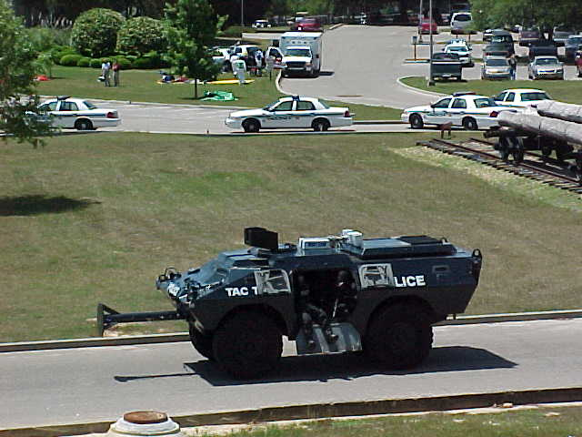
Design and Development Phase (cont’d.)
Plan for community impact
  Street closures
  Business disruptions
  Misinformation and rumors
    “Main Street is on fire!”
Always include
“This is an exercise”
PHOTO: A police department holds a full-scale exercise that utilizes an armored personnel carrier.
FEMA News Photo

Slide 31
Design and Development Phase (cont’d.)
Discussion:
  What negative impacts could be anticipated if the disclaimer statement, “This is an exercise,” is not included in public communications?
  In addition to street closures and potential business disruptions, what are some other aspects of the exercise about which you may want to inform the public?

Slide 32
Design and Development Phase (cont’d.)
Other Considerations:
Weather conditions
  Real world vs. simulated
  Wind direction and speed may need to be simulated
Date and time
  Exercise date and time affect exercise play
  Population demographics
    Weekday vs. weekend
    Morning vs. night

Slide 33
Design and Development Phase (cont’d.)
Discussion:
  How can you accommodate for weather conditions that do not sync with your testing needs?

Slide 34
Design and Development Phase (cont’d.)
Other Considerations (cont’d.):
Exercise assembly area
Deployment timetable
  Developed before the exercise
  Used to release emergency response units according to their actual travel time from their home stations
  Allows for exercise artificialities

Slide 35
Design and Development Phase (cont’d.)
Exercise site management:
  SAFETY!
  Logistics: water, restroom facilities, parking, etc.
  Exercise assembly areas, props, etc.
  Simulator (victim) staging, rehab
  Simulator management of props (smoke, sound effects, etc.)
  Check-in/check-out system
  Badging, as appropriate

Slide 36
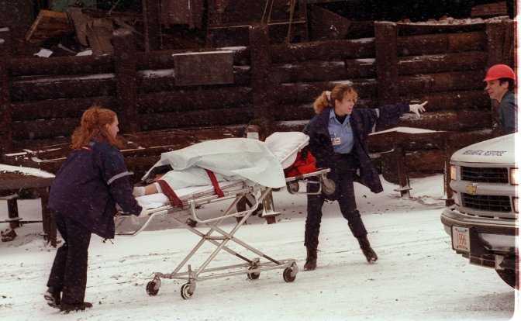
Design and Development Phase (cont’d.)
Safety
  Define role of Safety Officers
    ICS Safety Officer responsibilities
    Ensure they are identified (vests, arm bands, etc.)
    Ensure they are familiar
    with the exercise scenario
    Place in high-risk area
    Have a communications
    safety network in place for
    reporting safety issues
PHOTO: Rescue workers transport a person on a stretcher during an exercise.
FEMA News Photo

Slide 37
Design and Development Phase (cont’d.)
Emergency Call-Off
  Real-world emergencies can and do occur during exercises
  Real-world emergencies are a first priority
  Could be on-site or off-site
  Exercise may be cancelled or put on hold until situation is resolved
  A pre-arranged code word should be briefed to all exercise participants

Slide 38
Design and Development Phase (cont’d.)
Discussion:
  What code words have you used to cancel or call
  off an exercise?

Slide 39
Exercise Conduct Phase
To conduct a successful exercise:
  Show up on time
  Read briefing materials
  Understand roles/responsibilities
  Foster realism
  Test communications
  Test equipment and gear
  Stay in your role
GRAPHIC: A graphic showing the HSEEP Exercise Cycle. Design and Development leads to Conduct, which leads to Evaluation, Which leads to Improvement Planning, which leads back to Design and Development.

Slide 40
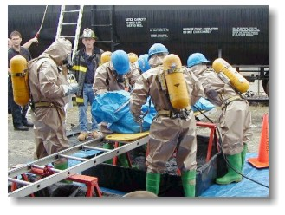
Exercise Conduct Phase (cont’d.)
Exercise play rules:
Establish the parameters that participants follow
Describe appropriate
behavior when:
  Physical contact is
  necessary
  Participant actions
  become overemotional
  or excessive
Do not fight the scenario
PHOTO: Emergency responders practice in full HAZMAT gear.
FEMA News Photo

Slide 41
Exercise Conduct Phase (cont’d.)
Exercise play rules (cont’d.):
Established before the exercise to prevent physical harm and property damage
Written rules should be provided to all parties in advance when victim/actor play is involved

Slide 42
Exercise Conduct Phase (cont’d.)
Exercise play rules (cont’d.):
  Documented in Extent of Play Agreements (XPAs)
XPAs:
  Are formed between exercise participants and the exercise sponsor
  Define the organizations participating in the exercise as well as their extent of play
  Are vital to the planning of the exercise, recruitment of evaluators, and development of support requirements
Sample XPA – Handout, shared drive

Slide 43
Design and Development Phase (cont’d.)
Discussion:
  Who has worked with outside agencies/departments that required an XPA?
  What was your experience?

Slide 44
Exercise Conduct Phase (cont’d.)
Exercise Staff
  All staff (Controllers, Simulators, and Evaluators) should keep logs
    Exercise packets should be issued
    Radios and recording devices may be issued
    All should have distinctive identification
      Badges, armbands, hats, T-shirts, etc.

Slide 45
Exercise Evaluation Phase
Player Hot Wash
  Should occur immediately after exercise conduct
  Includes completing the participant feedback forms
Controller/Evaluator Debriefing
  Should occur as soon as possible after EndEx
  No player involvement
Draft AAR
GRAPHIC: A graphic showing the HSEEP Exercise Cycle. Design and Development leads to Conduct, which leads to Evaluation, which leads to Improvement Planning, which leads back to Design and Development.
Notes:
.

Slide 46
Improvement Planning Phase
Follow up on AAR corrective actions that are listed in the Improvement Plan (IP)
GRAPHIC: A graphic showing the HSEEP Exercise Cycle. Design and Development leads to Conduct, which leads to Evaluation, Which leads to Improvement Planning, which leads back to Design and Development.

Slide 47
Improvement Planning Phase (cont’d.)
Discussion:
  If the agency responsible for a corrective action is outside of your area of control/responsibility, what strategies can be implemented to inquire about progress or completion of an improvement?

Slide 48
FSE Benefits
Realism; simulates real-world response
Fully validates plans/policies/procedures
Tests equipment
Validates lessons learned from previous exercises
Strengthens whole community relationships
Creates public awareness
Verifies capabilities

Slide 49
Improvement Planning Phase (cont’d.)
Discussion:
  What are some other benefits of an FSE?

Slide 50
FSE Challenges
Exercise can take a life of its own
  Go into left field
  Deal with issues not intended
Weather does not always cooperate
  Rain
  Wind direction
  Extreme temperature
    Safety concerns
Time conducted (daytime vs. nighttime)

Slide 51
FSE Challenges (cont’d.)
Personnel, equipment, and response capabilities
  May not be available and may be simulated
  May need to leave for an actual emergency
  Budget/cost
  Obtaining adequate facilities/space to accommodate the footprint of the exercise
FSEs can be hard to manage
  Information flow back to the SimCell can be delayed
  Expected actions are variable—exercise play cannot be predicted or easily controlled

Slide 52
Activity #1:
Mitigating FSE Challenges

Slide 53
Tips for FSE Success
Prior experience with other types of exercises
Support and commitment from officials and emergency service organizations
Appropriate physical facilities
Adequate communication and location for Exercise Control Staff
Adequate funding, labor, time, and commitment from participating agencies

Slide 54
Tips for FSE Success (cont’d.)
Discussion:
  What are some other tips for a successful FSE?

Slide 55
Panel Discussion:
Functional and Full-Scale SimCells

Slide 56
Unit Summary
In this unit you learned:
  The characteristics of an FSE
  How the HSEEP Exercise Cycle applies to FSEs
  The participants in an FSE
  The benefits and challenges of an FSE

Slide 57
Questions?
GRAPHIC: A stylized image of a question mark sitting on a puzzle piece.

Slide 58
Proficiency Demonstration #1:
Full-Scale Exercise

Slide 59
Proficiency Demonstration #1: FSE
Proficiency Demonstration #1 instruction sheets:
  Located in your PGs
  Provide all the instructions and information you need for completing the Proficiency Demonstration, including all the information we are about to go over
  Take the instruction sheets with you when you go to your breakout rooms

Slide 60
Proficiency Demonstration #1: FSE (cont’d.)
Purpose:
  Apply the Eight Exercise Design Steps and the Eight Exercise Evaluation Steps to design, develop, conduct, and evaluate an FSE
This Proficiency Demonstration is composed of
two parts:
  In Part 1 you will design, develop, and conduct an FSE
  In Part 2 you will analyze the FSE evaluator’s data, develop an AAR/IP, and present a briefing on the findings and recommendations

Slide 61
Proficiency Demonstration #1: FSE (cont’d.)
Total time: 17 hours
  PART 1: Design, develop, and conduct an FSE:
    5 hours to develop the FSE
    8 hours to conduct the FSE:
      Four 2-hour rounds—each round comprises:
        15 minutes to conduct player and actor briefings
        15 minutes to set up
        1 hour to conduct the exercise
        15 minutes to conduct a Hot Wash
        15 minutes to reset for next round and take a break

Slide 62
Proficiency Demonstration #1: FSE (cont’d.)
Total time (cont’d.)
  PART 2: Data analysis, AAR/IP development, and presentation:
    2 hours to analyze data, develop AAR/IP, and develop briefing of AAR/IP findings
    2 hours (four 30-minute presentations: 20 minutes for briefing, 10 minutes for Q&A) to present findings

Slide 63
Proficiency Demonstration #1: FSE (cont’d.)
Deliverables
  PART 1: Design, develop, and conduct an FSE:
    ExPlan (Word)
    MSEL (format may vary)
    Resource/decision tracking system (format may vary)
    Inject tracking system (format may vary)
    C/E Handbook (Word)
    C/E Briefing (PPT)
    Player briefing (PPT)
    Actor briefing (PPT)

Slide 64
Proficiency Demonstration #1: FSE (cont’d.)
Deliverables (cont’d.)
    Exercise Evaluator Packets (EEGs, plans, maps) (Word)
    Participant Feedback Forms (Word)
    Communication directory, based on the list of position assignments you choose (format may vary)
    Any data collection/analysis materials (formats may vary)

Slide 65
Proficiency Demonstration #1: FSE (cont’d.)
Deliverables (cont’d.)
  PART 2: Data analysis, AAR/IP development, and presentation:
    AAR/IP (Word)
    20-minute briefing of AAR/IP findings (PPT)

Slide 66
Proficiency Demonstration #1: FSE (cont’d.)
Provided Materials—Located on the shared drive:
  Maps of venue

Slide 67
Proficiency Demonstration #1: FSE (cont’d.)
Scenario
  PART 1: Design, develop, and conduct an FSE:
    Liberty County wants an FSE that builds on the core capabilities and scenario you developed during your Functional Exercise in E0133

Slide 68
Proficiency Demonstration #1: FSE (cont’d.)
FSE Participants
The group in Control/Simulation will be responsible for assigning roles to memebers of the other three groups. These can be anything that fit your exercise needs.
  Actors
  EOC Staff

Slide 69
Proficiency Demonstration #1: FSE (cont’d.)
FSE Participant Identification
  All FSE participants will receive badges identifying their assigned roles
  These badges will be provided by the Group in Control/Simuation/Evaluation

Slide 70
Proficiency Demonstration #1: FSE (cont’d.)
FSE Progression
  Four 2-hour rounds of exercising—each round
  consists of:
    15 minutes to conduct player, C/E, and actor briefings
    15 minutes to set up
    1 hour to conduct the exercise
    15 minutes to conduct a Hot Wash
    15 minutes to reset for next round and take a break

Slide 71
Proficiency Demonstration #1: FSE (cont’d.)
Rounds will progress in Group order
Round 1:
  Group 1 is Control/Simulation/Evaluation

Slide 72
Proficiency Demonstration #1: FSE (cont’d.)
FSE Venues
  S Building: SimCell and EOC (if needed)
  Gym (H Building)
  Command Post Pub (B Building)
  Toms Cabin
GRAPHIC: A map of the EMI Campus showing the location of the SimCell and EOC in Building S at top center, the Hospital in Building H at lower right, and the Incident Site/Triage at lower left.

Slide 73
Proficiency Demonstration #1: FSE (cont’d.)
Assumptions/Artificialities
  The following assumptions/artificialities should be included in your exercise design:
    Any transportation needed will be simulated (ex: busses, ambulances, etc.)

Slide 74
Proficiency Demonstration #1: FSE (cont’d.)
Supplies
  Radios
  Traffic Cones
  Triage Tarps (if using)
  Easel pads/markers for Hot Washes
  Clipboards for evaluators and controllers
  Vests

Slide 75
Proficiency Demonstration #1: FSE (cont’d.)
Scenario (cont’d.)
  PART 2: Data analysis, AAR/IP development, and presentation:
    After the four rounds of FSEs are completed,
    you will:
      Develop an AAR/IP using root cause analysis to analyze the data your evaluators collected during
      the FSE
      Create a 20-minute briefing about your AAR/IP, including your findings and recommendations

Slide 76
Proficiency Demonstration #1: FSE (cont’d.)
Group Roles
  Each group must fill the following roles:
    Group Leader (at least one)
    Scribe (at least one)
    Player/Actor Briefing Facilitator (only one)
    C/E Briefing Facilitator (only one)
    Hot Wash Facilitator (only one)

Slide 77
Final Note: Safety
Safety takes priority over exercise events
Professional health and safety ethics should guide all participants to operate in their assigned roles in the safest manner possible
Instructors will serves as Safety Officers, but you should assign your own during exercise conduct
If you plan to ‘hide’ actors, you must pre-determine their location for accountability purposes.

