Slide 1

E136: MASTER EXERCISE PRACTITIONER
CAPSTONE COURSE
Unit 2: Exercise Evaluation
PHOTO: An injured person is loaded into a helicopter for transport to a hospital.
FEMA News Photo

Slide 2
Unit Objective
Describe the tasks that occur in steps 7 and 8 of the eight Exercise Evaluation Steps

Slide 3
Eight Exercise Evaluation Steps
Plan/organize the evaluation
Observe the exercise and collect data
Analyze data
Develop the draft After-Action Report (AAR)
Conduct an After-Action Meeting (AAM)
Identify improvements to be implemented
Finalize the AAR/Improvement Plan (IP)
Track implementation

Slide 4
Step 7: Finalize the AAR/
Improvement Plan (IP)
Finalized after the AAM
The AAR/IP is considered final once all corrective actions have been consolidated in the final IP, and the IP is included as an appendix to the AAR
  Make sure the information in your final IP mirrors
  what is in the AAR
Distribute to preparedness stakeholders/ partners, exercise planners, and other participants as appropriate

Slide 5
Step 8: Track Implementation
Conducting exercises and documenting the strengths, areas for improvement, and associated corrective actions are important for a jurisdiction’s overall preparedness
Over time, exercises should yield observable improvements in preparedness

Slide 6
Step 8: Track Implementation (cont’d.)
Corrective actions captured in the AAR/IP should be tracked and continually reported on until completion
Organizations should assign points of contact responsible for tracking and reporting on their progress

Slide 7
Step 8: Track Implementation (cont’d.)
Tracking corrective actions to completion, allows stakeholders to demonstrate that exercises have yielded tangible improvements in preparedness
Stakeholders should also ensure a system is in place for validating previous corrective actions that have been successfully implemented

Slide 8
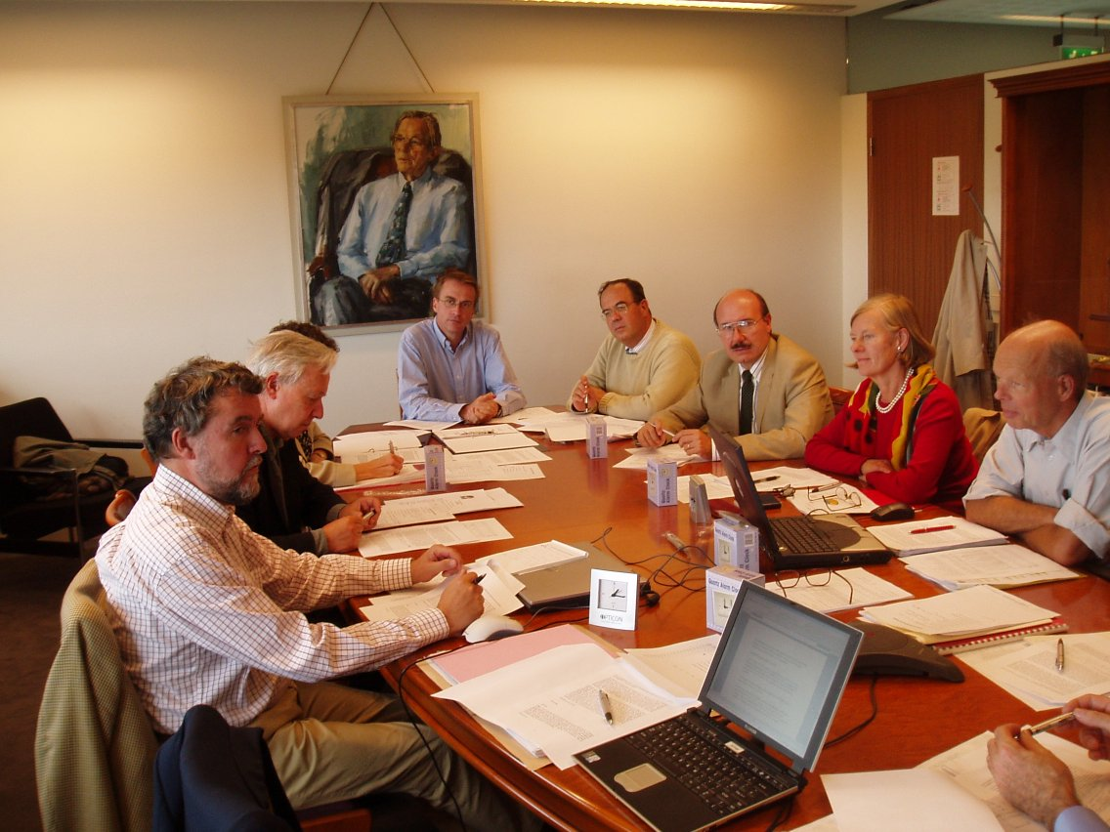
Step 8: Track Implementation (cont’d.)
When planning your next exercises, previous AARs/IPs should be part of your exercise
needs assessment
PHOTO: Emergency management officials take part in a planning meeting.
FEMA News Photo

Slide 9
Step 8: Track Implementation (cont’d.)
Considerations when tracking corrective actions:
  Tracking should be an ongoing process
  Progress reports should be compiled to track status of corrective actions
  IPs should continually be assessed for relativity and current operational picture
  IPs should be updated if progress is not being made
  Corrective actions should be addressed and recommendations implemented prior to being
  re-evaluated

Slide 10
Discussion—Tracking Corrective Actions
Discussion:
  How do you track corrective actions?
  What are the benefits of tracking corrective actions?
  What are some lessons learned about tracking corrective actions?

Slide 11
Unit Summary
In this unit you learned:
  When an AAR/IP is considered final
  That corrective actions captured in the AAR/IP should be tracked and continually reported on until completion

Slide 12
Questions?
GRAPHIC: A stylized image of a question mark sitting on a puzzle piece.

