Slide 1
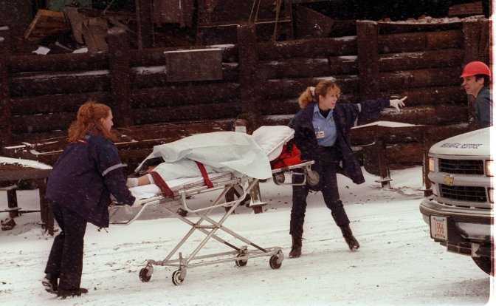
E136: MASTER EXERCISE PRACTITIONER
CAPSTONE COURSE
Unit 1: Course Overview
PHOTO: Rescue workers transport a person on a stretcher during an exercise.
FEMA News Photo

Slide 2
Unit Objectives
By the end of this unit you will be able to:
  Describe the agenda for the E136: Master Exercise Practitioner Capstone Course
  Identify appropriate course conduct and facility policies

Slide 3
Introductions
In 15 seconds or less:
  Name
  Position title and organization
  Work location
  Exercise experience—select all that apply:
    Planner
    Controller
    Player
    Evaluator

Slide 4
E136 Course Goals
The goals of this course are for participants to demonstrate mastery of the:
  Four phases of the HSEEP exercise cycle—design and development, conduct, evaluation, and improvement planning
  Eight exercise Design Steps to an FSE
  Eight exercise Evaluation Steps to an FSE

Slide 5
E136 Course Objective
Upon completion of this course, you will be
able to:
  Apply principles and associated resources of HSEEP as it relates to full-scale exercises

Slide 6
E136 Course Materials
Participant Guide
ESSD
Radios
Vests

Slide 7
E136 Course Agenda
E136 Master Exercise Practitioner Capstone Course Units:
    1: Course Overview
    2: Exercise Evaluation
    3: Full-Scale Exercise and Proficiency Demonstration
    4: Course Wrap-Up

Slide 8

Campus Administration Reminders
Class registration
Classrooms
Parking
Meals
Emergency procedures
Walking around campus
Recreation
NETC evaluations
PHOTO: Photo of EMI campus buildings.
FEMA/Jocelyn Augustino

Slide 9
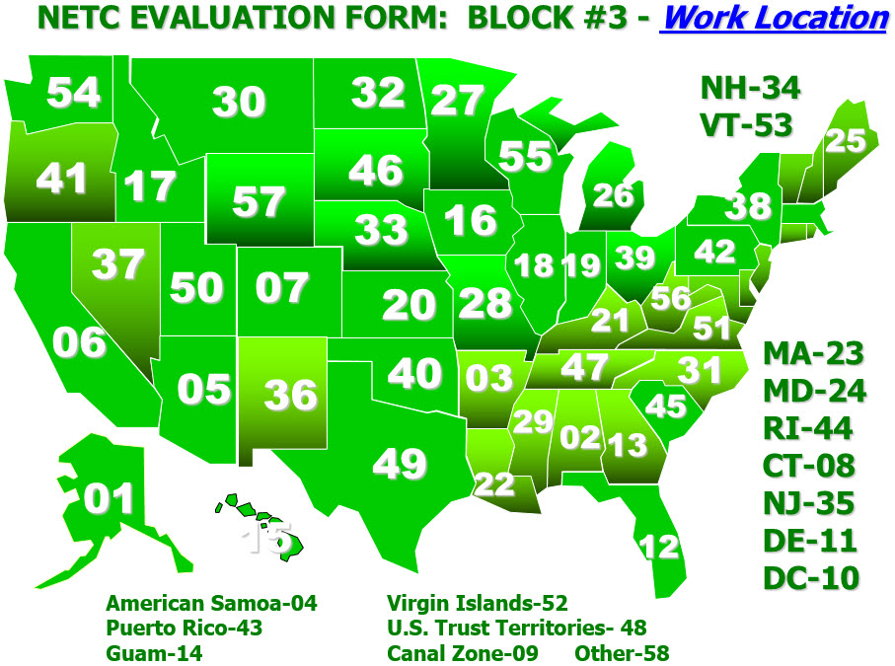
NETC Evaluation Form: Block #3 - Work Location
GRAPHIC: NETC Evaluation Form: Block #3: Work Locations.
A map of the United States indicating the 58 work locations, counting all states, territories, and other regions:
01 – Alaska
02 – Alabama
03 – Arkansas
04 – American Samoa
05 – Arizona
06 – California
07 – Colorado
08 – Connecticut
09 – Canal Zone
10 – District of Columbia
11 – Delaware
12 – Florida
13 – Georgia
14 – Guam
15 – Hawaii
16 – Iowa
17 – Idaho
18 – Illinois
19 – Indiana
20 – Kansas
21 – Kentucky
22 – Louisiana
23 – Massachusetts
24 – Maryland
25 – Maine
26 – Michigan
27 – Minnesota
28 – Missouri
29 – Mississippi
30 – Montana
31 – North Carolina
32 – North Dakota
33 – Nebraska
34 – New Hampshire
35 – New Jersey
36 – New Mexico
37 – Nevada
38 – New York
39 – Ohio
40 – Oklahoma
41 – Oregon
42 – Pennsylvania
43 – Puerto Rico
44 – Rhode Island
45 – South Carolina
46 – South Dakota
47 – Tennessee
48 – U.S. Trust Territories
49 – Texas
50 – Utah
51 – Virginia
52 – Michigan
53 – Vermont
54 – Washington
55 – Wisconsin
56 – West Virginia
57 – Wyoming
58 – Other
Visual 1.9

Slide 10
Shared Drive Reminders
Resources
Save Proficiency Demonstration materials to your group folder
Shared Drive Quick Reference in PG
Thumb Drives – 8 GB max

Slide 11
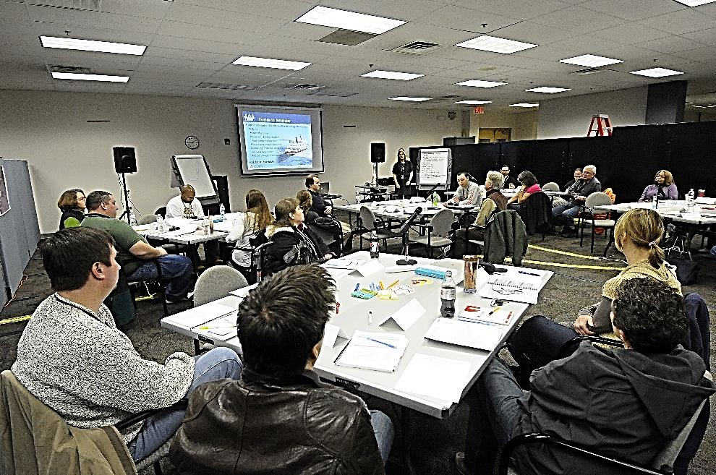
Course Conduct Reminders
Attendance
Technology courtesy
Sharing knowledge
Lunch and breaks
PHOTO: Participants sit around tables in a classroom.
FEMA/Hans Pennink

Slide 12
Presentations
E133 Proficiency Demonstration #4: Functional Exercise, Take-Home

Slide 13
Unit Summary
In this unit you learned:
  About the objectives, materials, and agenda for the E136 course
  About the campus administration, including parking, meals, and recreation
  About the course conduct, including attendance, cellphone/pager/computer courtesy, and lunch/breaks

Slide 14
Questions?
GRAPHIC: A stylized image of a question mark sitting on a puzzle piece.

