Slide 1
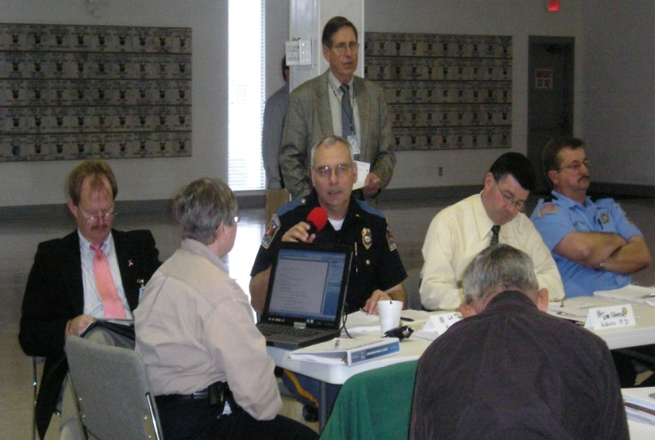
E133: OPERATIONS-BASED EXERCISE DESIGN
AND EVALUATION COURSE
Unit 5: Exercise Evaluation and Proficiency Demonstration #3
FEMA News Photo

Slide 2
Unit Objectives
By the end of this unit you will be able to:
  Describe the tasks that occur in steps 4 through 6 of the Eight Exercise Evaluation Steps
  Develop an After-Action Report (AAR) and Improvement Plan (IP)
  Prepare for and conduct an After-Action Meeting (AAM)

Slide 3
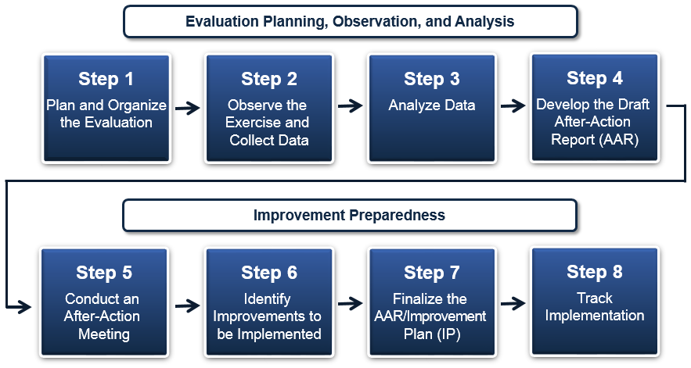
Eight Exercise Evaluation Steps

Slide 4
Step 1: Plan/Organize the Evaluation
Occurs during the exercise design and development process:
  Exercise planning team determines what information is collected, who collects it, and how it is collected
  Evaluators are identified, recruited, and trained
  Exercise evaluation guides (EEGs) are created

Slide 5
Step 2: Observe the Exercise and
Collect Data
Step 2 occurs during conduct of the exercise:
  Evaluators record discussions/observations as they progress during the exercise
  After the exercise is over, a Hot Wash is held to collect player feedback on what occurred during the exercise

Slide 6
Step 3: Analyze Data
Tasks include:
  Reconstructing exercise events
  Reconstructing exercise timelines
  Developing initial conclusions that may require further research
Root cause analysis is used to get to the source of an identified issue
The data from the analysis is then used to develop the AAR

Slide 7
Step 4: Develop the Draft AAR
The After-Action Report (AAR) is a tool used to provide feedback to participating jurisdictions on their performance during an exercise
The main focus of the AAR is the analysis of core capabilities

Slide 8
The AAR
The AAR:
  Provides a snapshot of the exercise
  Summarizes what happened during the exercise
  Analyzes core capabilities
  Analyzes the performance of essential tasks
  Analyzes demonstrated capacity to accomplish overall mission outcomes
  Highlights strengths
  Identifies areas needing improvement
  Documents corrective actions resulting from systematic exercise evaluation analysis

Slide 9
The AAR (cont’d.)
Think about your experiences with AARs:
  What elements make up a good AAR?
  What do you expect to see in a good AAR?
Discussion…

Slide 10
Step 5: Conduct an After-Action Meeting
AAMs serve as forums to review the draft AAR/IP
Should be conducted within approximately
45-60 days of exercise conduct
The draft AAR/IP should be distributed to all stakeholders at least one week in advance of the AAM
AAMs often require an entire day

Slide 11
Step 5: Conduct an After-Action Meeting (cont’d.)
Attendees:
  Each organization’s elected and appointed officials
  Senior agency decision makers
  Exercise planners
AAM participants should:
  Seek to reach final consensus on strengths and areas for improvement
  Revise and gain consensus on draft corrective actions
  Develop concrete deadlines for implementation of corrective actions
  Identify specific corrective action owners/assignees

Slide 12
Step 6: Identify Improvements to be Implemented
Improvement plans (IPs) should:
  Take into account the current operational picture
  Address both short- and long-term goals
  Be targeted to a specific timeframe
    Split large/time intensive improvements into steps
  Stress improvements that have the highest
  impact-to-cost ratio

Slide 13
Finalizing the AAR/IP
The completed IP may be included as an appendix to the AAR
The AAR/IP is then considered final and may be distributed as appropriate to:
  Exercise planners
  Participants
  Other preparedness stakeholders

Slide 14
Unit Summary
In this unit you learned:
  How steps 1-6 of the Eight Exercise Evaluation Steps apply to operations-based exercises
  About the AAR/IP

Slide 15
Questions?

Slide 16
Proficiency Demonstration #3:
AAR/IP

Slide 17
Proficiency Demonstration #3:
AAR/IP
Purpose
  Develop an AAR/IP for the FE from Proficiency Demonstration #2, using notes from the FE’s Player Hot Wash, C/E debriefing, and EEGs as references
Total time: 4 hours 30 minutes
  1 hour 30 minutes to complete the draft AAR
  45 minutes to complete the draft IP
  30 minutes to prepare for the AAM
  1 hour to conduct AAMs (two rounds of 30-minute meetings)
  15 minutes to incorporate AAM results into the AAR/IP
  20 minutes for peer/instructor feedback
  10 minutes for internal group feedback

Slide 18
Proficiency Demonstration #3:
AAR/IP (cont’d.)
Deliverable:
  Completed After-Action Report (AAR)/Improvement Plan (IP) (HSEEP template)

Slide 19
Proficiency Demonstration #3:
AAR/IP (cont’d.)
Scenario:
  After completing your functional exercise, your next steps are to create the draft AAR/IP and conduct an After-Action Meeting (AAM)
  The AAM will be attended by the policy review committee
  To develop your draft AAR/IP, you will work with the group you exercised in Proficiency Demonstration #2. Both of you will take on two roles: exercise planning and agency.

Slide 20
Proficiency Demonstration #3:
AAR/IP (cont’d.)
Scenario (cont’d.):
  Exercise planning role—Complete your draft AAR and submit it to your agency group. In turn, that group will submit their draft AAR to your group, and you will act as their agency.
    Group 1 (planning) submits their draft AAR to Group 2 (agency)
    Group 2 (planning) submits their draft AAR to Group 1 (agency)
    Group 3 (planning) submits their draft AAR to Group 4 (agency)
    Group 4 (planning) submits their draft AAR to Group 3 (agency)
  Agency role—Review the planning group’s draft AAR, develop recommendations, and create a draft IP

Slide 21
Proficiency Demonstration #3:
AAR/IP (cont’d.)
Scenario (cont’d.):
  After the draft AAR/IP is completed, conduct an AAM with another group who will be acting as the policy review committee:
    Group 1 (planning) will conduct the AAM with Group 4 (policy)
    Group 2 (planning) will conduct the AAM with Group 3 (policy)
    Group 3 (planning) will conduct the AAM with Group 2 (policy)
    Group 4 (planning) will conduct the AAM with Group 1 (policy)
  There will be two 30-minute rounds of meetings

Slide 22
Proficiency Demonstration #3:
AAR/IP (cont’d.)
Scenario (cont’d.):
  Determine which members of the Liberty County Policy Group will be at your AAM
    Refer to Handout 3-1—Exercise Roles and Descriptions
  Each member of the group that will be acting as policy personnel must be assigned a Policy Group role

Slide 23
Proficiency Demonstration #3:
AAR/IP (cont’d.)
Scenario (cont’d.):
  After the AAM is concluded, incorporate the outcomes of the meeting into your draft AAR/IP
  Submit to your group instructor for approval

Slide 24
Proficiency Demonstration #3:
AAR/IP (cont’d.)
Example of Proficiency Demonstration Flow
  Group 1 (planning) writes draft AAR
  Group 1 submits draft AAR to Group 2 (agency)
  Group 2 writes draft IP for Group 1’s
  draft AAR
  Group 1 gets draft AAR/IP back from Group 2
  Group 1 facilitates AAM with Group 4 (policy)
  Group 1 incorporates meeting outcomes into AAR/IP

Slide 25
Proficiency Demonstration #3:
AAR/IP (cont’d.)
Group Roles
  Each group must select the following roles:
    Group Leader (at least one)
    Scribe (at least one)
    Presenter/Facilitator (no more than two)

