Slide 1
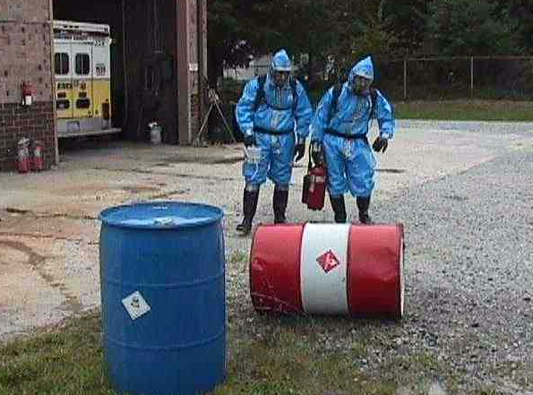
E133: OPERATIONS-BASED EXERCISE DESIGN
AND EVALUATION COURSE
Unit 4: Proficiency Demonstration #2
FEMA News Photo

Slide 2
Unit Objectives
By the end of this unit you will be able to:
  Apply the Eight Exercise Design Steps to design
  and develop a functional exercise and all required materials, including a MSEL, ExPlan, and
  C/E Handbook
  Facilitate exercise preparation briefings: Player and C/E briefings
  Facilitate exercise wrap-up activities: C/E debriefing and player Hot Wash

Slide 3
Proficiency Demonstration #2:
Functional Exercise

Slide 4
Proficiency Demonstration #2:
Functional Exercise
Purpose:
  Design, develop and conduct a functional exercise (FE)
Total time: 10 hours 15 minutes
  5 hours 30 minutes to prepare for the FE and complete all deliverables
  2 hours to complete Round 1 of the FE (includes C/E and Player Briefings, exercise conduct, C/E debrief, and Player Hot Wash)
  2 hours to complete Round 2 of the FE (includes C/E and Player Briefings, exercise conduct, C/E debrief, and Player Hot Wash)
  30 minutes for two feedback sessions (peer/instructor feedback and internal group feedback)
  15 minutes for a large-group discussion on the MSEL flaws

Slide 5
Proficiency Demonstration #2:
Functional Exercise (cont’d.)
Deliverables:
  MSEL (format may vary)
  Resource/decision tracking system (format may vary)
  Inject tracking system (format may vary)
  ExPlan (HSEEP template)
  C/E Handbook (HSEEP template)
  EEGs (HSEEP template)
  Player briefing (HSEEP template)
  C/E briefing (HSEEP template)
  Controller and evaluator packets (Word documents)
  Participant Feedback Forms (HSEEP template)
  Telephone directory

Slide 6
Proficiency Demonstration #2:
Functional Exercise (cont’d.)
Scenario:
  Based on the findings of its needs assessment, Central City has decided to conduct an FE to exercise the Operations Section (including dispatch/communications) of the Central City Emergency Operations Center (EOC)
  You will need to design, develop, and conduct this FE
  The FE area of focus is your group’s selected disaster category from E132

Slide 7
Proficiency Demonstration #2:
Functional Exercise (cont’d.)
Scenario (cont’d.):
  The needs assessment revealed the following issues, with the root cause of each being insufficient or lack
  of training:
    Less than half of the assigned EOC Operations Section staff have experience with exercises or actual events in the EOC
    A lack of understanding about the EOC activation levels/staffing
    Communication problems between the EOC and the Field Operations/Incident Command Post

Slide 8
Proficiency Demonstration #2:
Functional Exercise (cont’d.)
Scenario (cont’d.):
    Branches within EOC Operations occasionally did not fulfill resource requests from the field forces, due to the request not being clearly communicated
    EOC Operations Section Management did not fully coordinate the activities of each EOC Operations branch
    Emergency public information did not effectively provide citizens with critical information they needed to protect themselves or avoid the incident area

Slide 9
Proficiency Demonstration #2:
Functional Exercise (cont’d.)
Scenario (cont’d.):
  You will participate as a SimCell staff member—either a controller or simulator
  You will conduct the FE with another group who will be acting as the players, specifically, members of the EOC. There will be two rounds of exercising:
    Round 1: Group 1 is SimCell, Group 2 is EOC
    Round 1: Group 3 is SimCell, Group 4 is EOC
    Round 2: Group 2 is SimCell, Group 1 is EOC
    Round 2: Group 4 is SimCell, Group 3 is EOC

Slide 10
Proficiency Demonstration #2:
Functional Exercise (cont’d.)
Group Roles
  Each group must select the following roles:
    Group Leader (at least one)
    Scribe (at least one)
    Player Briefing Facilitator (only one)
    C/E Briefing Facilitator (only one)
    Hot Wash Facilitator (only one)

Slide 11
Proficiency Demonstration #2:
Functional Exercise (cont’d.)
FE Roles:
  Each group will need to select its roles for the FE:
    For when a group is the SimCell, designate the SimCell roles, including Senior Controller
    For when a group is the EOC, designate the EOC roles
  Refer to Handout 3-1—Exercise Roles and Descriptions for a list of suggested roles

Slide 12
Proficiency Demonstration #2:
Functional Exercise (cont’d.)
FE Development Guidelines:
  Use the core capabilities your group selected in E132
    Other core capabilities may be added as appropriate
  The FE must exercise the Operations Section of the Central City EOC, including dispatch and communications
    Other sections of the EOC can be exercised if necessary

Slide 13
Proficiency Demonstration #2:
Functional Exercise (cont’d.)
FE Development Guidelines (cont’d.):
  When the FE begins, the operations section of the EOC (including dispatch) is already activated as a result of alert and notification activities
    The remainder of the EOC is NOT activated at this time but is represented by the SimCell

Slide 14
Proficiency Demonstration #2:
Functional Exercise (cont’d.)
Player and C/E Briefings:
  As part of your deliverables, you will develop player and C/E briefings to introduce the players, controllers, and evaluators to the exercise and their roles/responsibilities
  These briefings should be conducted before the FE begins

Slide 15
Proficiency Demonstration #2:
Functional Exercise (cont’d.)
C/E Debriefing:
  After each round of exercising, the Senior Controller for the SimCell group will conduct the C/E debriefing
  This is an opportunity for controllers and evaluators to identify areas that require clarification or additional information, and to de-conflict information
  This is also an opportunity for controllers to identify for evaluators areas that are intended for evaluation, but which either did not occur, or there was no opportunity for them to occur due to exercise design
  The C/E debriefing should not be conducted in front of
  the players

Slide 16
Proficiency Demonstration #2:
Functional Exercise (cont’d.)
Player Hot Wash:
  After the C/E debriefing, the Player Hot Wash Facilitator for the SimCell group will facilitate the player Hot Wash
  The Hot Wash should focus on player performance, NOT exercise design
    This is an opportunity for players to provide feedback on their performance

Slide 17
Proficiency Demonstration #2:
Functional Exercise (cont’d.)
Player Hot Wash (cont’d.):
  Evaluators:
    Quietly observe and use this as an opportunity to fill in areas that need additional information
    Take notes (this will serve as valuable data in the analysis for the AAR/IP development you’ll be doing in the next Proficiency Demonstration)

Slide 18
Proficiency Demonstration #2:
Functional Exercise (cont’d.)
Feedback:
  After both rounds the FE have been completed, there will be two feedback sessions:
    Peer/instructor feedback (SimCell group and EOC group together)
      Focus is on exercise design
    Internal group feedback (individual groups alone)
      Focus is on all aspects of your group’s execution of the Proficiency Demonstration

Slide 19
Proficiency Demonstration #2:
Functional Exercise (cont’d.)
Gentle Reminders:
  Very few of us are subject-matter experts in the various roles that we are tasked to fulfill in this Proficiency Demonstration (e.g., Operations Section, SimCell, etc.)
    Be patient
    Help each other out
  The Proficiency Demonstration is about the process of designing, conducting, and evaluating an exercise
    Your job is to provide an opportunity for the SimCells to experience and learn from the process

Slide 20
Proficiency Demonstration #2:
Functional Exercise (cont’d.)
After completion of the Proficiency Demonstration, return to the plenary classroom for a group discussion.

Slide 21
Proficiency Demonstration #2:
Functional Exercise (cont’d.)
What were the MSEL best practices?
What were the MSEL issues?
Discussion…

Slide 22
Unit Summary
In this unit you learned:
  How to design, develop, and conduct an FE
  How to complete all documentation/tools necessary for an FE

Slide 23
Questions?

