Slide 1
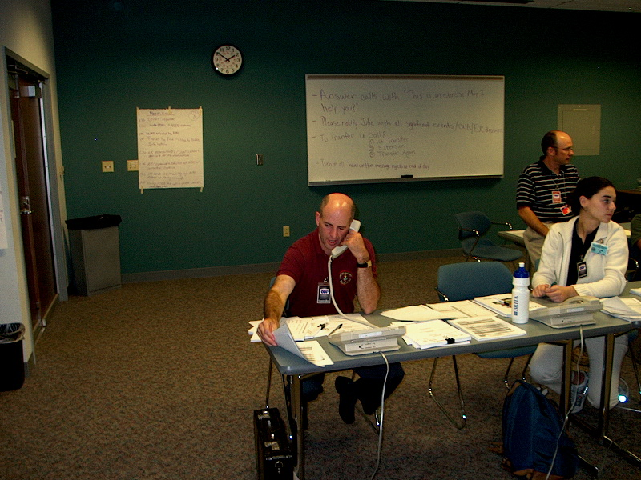
E133: OPERATIONS-BASED EXERCISE DESIGN
AND EVALUATION COURSE
Unit 3: Exercise Control System (ECS) and Proficiency Demonstration #1
FEMA News Photo

Slide 2
Unit Objectives
By the end of this unit you will be able to:
  Describe the Simulation Cell (SimCell) structure, including staff, communication, and setup
  Describe the roles and responsibilities of controllers and simulators
  Describe options for inject delivery
  Describe the lifecycle of an inject in a simulated operations-based exercise

Slide 3
Exercise Control
The control structure for an operations-based exercise describes how controllers communicate and coordinate with one another and how they track exercise information
These procedures should be detailed in the
C/E Handbook
During exercise play, controllers carry out these responsibilities and closely monitor exercise play to ensure a safe and effective exercise

Slide 4
Exercise Control (cont’d.)
Exercise control synchronizes:
  Control staff structure
  Exercise scenario
  Inject delivery
  Player responses
FEMA News Photo

Slide 5
Exercise Control (cont’d.)
During FE play, SimCell control is particularly important
FEs require a robust and detailed MSEL and close communication between the site controller(s) and the SimCell
Controllers should advise the SimCell on the pace of exercise play, and request more or fewer injects as necessary to maintain an appropriate pace

Slide 6
Tools for Exercise Control
Resource/decision tracking system
  Means of keeping track of the decisions made and the resources available or dispatched/deployed
Inject tracking system
  Ensures injects are reaching their destination and players/controllers are appropriately “closing the loop”

Slide 7
Tools for Exercise Control (cont’d.)
Who has experience with an inject tracking system?
What kind of system did you use?
Discussion…

Slide 8
What Is a SimCell?
HSEEP:
    “A SimCell is used to generate injects for, receive player responses for, and provide information in place of nonparticipating organizations that would likely participate actively if exercise events were real. Physically, the SimCell is a working location for a number of qualified professionals who portray these nonparticipating organizations.”

Slide 9

SimCell Staff
Controllers and simulators
Both deliver planned injects or create new injects to prompt player actions
FEMA News Photo

Slide 10
SimCell Staff (cont’d.)
Senior Controller:
  All controllers should be accountable to one Senior Controller
  Primary responsibility is to manage the delivery of the disaster to the players
  Also responsible for the overall organization of the exercise

Slide 11
SimCell Staff (cont’d.)
Senior Controller (cont’d.):
  Monitors actions by controllers and exercise progress
  Coordinates decisions regarding deviations or significant changes to the scenario caused by unexpected developments during play
  Debriefs controllers and evaluators after the exercise
  Oversees the setup and takedown of the exercise

Slide 12
SimCell Staff (cont’d.)
Controllers:
  Plan and manage exercise play
  Set up and operate the exercise incident site
  Take the roles of individuals and agencies not actually participating in the exercise, if necessary
  Have the authority to modify or control the exercise per direction from the Senior Controller
  Communicate identified issues to the Senior Controller in regard to pace, key events, player activities, etc.

Slide 13
SimCell Staff (cont’d.)
Controllers (cont’d.):
  Monitor the pace of exercise play
  Provide key data to players
  Prompt or initiate certain player actions and injects to the players as described in the MSEL to ensure exercise continuity, if necessary
  Provide exercise materials to players as required
  Monitor the exercise timeline
  Supervise the safety of all exercise participants

Slide 14
SimCell Staff (cont’d.)
Controllers (cont’d.):
  Must be able to view the exercise as a whole and to think quickly on his or her feet
  Are the only participants who should provide information or direction to players
  Are the only participants the players should reach out to if they have questions about the exercise conduct expectations and mechanics

Slide 15
SimCell Staff (cont’d.)
Simulators:
  Are control staff personnel who role play as nonparticipating organizations or individuals
  Most often operate out of the SimCell, but they may occasionally have face-to-face contact with players
  Function semi-independently under the supervision of the Lead Simulator, enacting roles in accordance with instructions provided in the MSEL
  Are ultimately accountable to the Exercise Director and Senior Controller

Slide 16
SimCell Staff (cont’d.)
Simulators (cont’d.):
  Administer the exercise scenario (deliver the disaster!)
  Introduce injects that represent events, resource requests, critical information, etc.
  Respond to players’ feedback on decisions made and actions taken
  Simulate reality external to the player in the response arena
  Serve as relay to the players, informing them of everything that occurs in the field
  Develop the inject tracking system (Lead Simulator)

Slide 17
SimCell Staff (cont’d.)
Simulators (cont’d.):
  May be required to think on the fly, develop new information, and ad lib injects as needed—therefore the SimCell must stay in communication with the Senior Controller, and must immediately inform controllers of any actual or potential deviations from the planned scenario or MSEL
  Use the MSEL to know when an inject/communication should be sent to the players, but not deliver injects until directed by the Lead Simulator
  Should be familiar with the organizations they are simulating

Slide 18
SimCell Staff (cont’d.)
The general roles of the SimCell staff include everything the players are not:
  All field personnel and equipment
  Agencies, departments, individuals not physically in the player areas
  Private companies and resources needed for the emergency
  All citizens of the community

Slide 19
SimCell Staff (cont’d.)
For MEPP purposes, the specific roles within the SimCell should represent the whole community:
  Government (G)
  Media/Public Information (M)
  Emergency Management (EM)
  Law Enforcement (LE, P, S/SP)
  Fire Service (F)
  Health and Medical (EMS, PH, H)
  Public Works/Utilities (PWU)
  Community/Human Services (CS)
  Concerned citizens and others (CC)

Slide 20
SimCell Staff (cont’d.)
Government (G)
  Mayors
  County Commissioners/Supervisors
  City/County Managers
  Finance Directors
  Human Resource Directors
  City/County attorneys
  Other elected officials
  Public administration
  Functions (i.e., management players)

Slide 21
SimCell Staff (cont’d.)
Media/Public Information (M)
  Public affairs officers
  Departmental public information officials
  Citizen information centers
  Media affairs officials
  Local/national media outlets (print, radio, and video)
  Social media

Slide 22

SimCell Staff (cont’d.)
Emergency Management (EM)
  Emergency Managers
  Public Safety Directors
  Risk Managers
  National Guard
  Military
  Information Technology
    Geographic Information
    System (GIS)
FEMA News Photo

Slide 23

SimCell Staff (cont’d.)
Law Enforcement (P, LE, S/SP)
  Police departments
  Sheriff’s offices
  State police/patrols
  Federal law enforcement agencies (e.g., FBI, ATF, CBP)
  Other “security” resources
FEMA News Photo

Slide 24
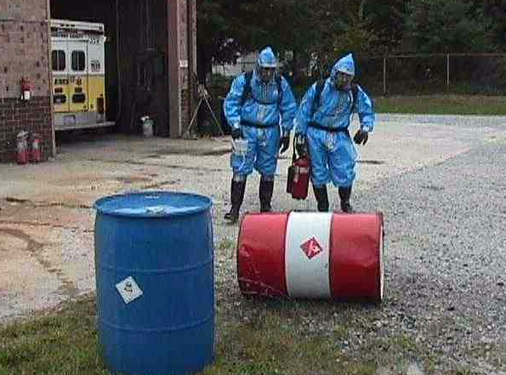
SimCell Staff (cont’d.)
Fire Service (F)
  Fire departments
  Fire Marshals
  HAZMAT
  Fire prevention
  Industrial fire brigades
  U.S. Forestry Service
FEMA News Photo

Slide 25
SimCell Staff (cont’d.)
Health and Medical (EMS, PH, H)
  Emergency medical services (EMS)
  Public health (PH)
    Environmental health
    Epidemiology
  Hospitals (H)
  Health care providers
  Mental health

Slide 26
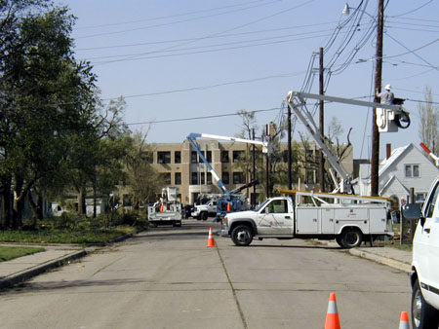
SimCell Staff (cont’d.)
Public Works/Utilities (PWU)
  Public Works departments
  Streets and traffic engineering
  Water and sewer
  Gas and electric
  Sanitation services
  Building and ground maintenance
  Code administration
FEMA News Photo

Slide 27
SimCell Staff (cont’d.)
Community/Human Services (CS)
  Social service agencies
  Public housing authority
  Public transportation services
  Schools and universities
  Volunteer agencies, etc.
  Faith-based organizations
  Civic and professional associations
  Animal advocate groups
  Community Organizations Active in Disasters (COAD)
  Voluntary Organizations Active in Disasters (VOAD)

Slide 28
SimCell Staff (cont’d.)
Concerned citizens and others (CC)
  All businesses, all citizen groups
  Can be handled by any controller/simulator
  Specialized groups (Girl Scouts, Boy Scouts)

Slide 29
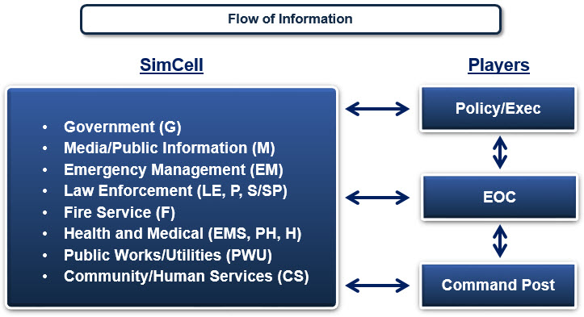
SimCell Communication

Slide 30
SimCell Communication (cont’d.)
Players must contact the SimCell to:
  Deploy any and all equipment
  Order supplies or materials
  Request mutual aid
  Disseminate information to field personnel
  Find out what is going on in the field
  Get a description of the incident
Bottom line: If a needed resource is NOT physically participating in the exercise, players must contact the SimCell to acquire it

Slide 31
SimCell Communication (cont’d.)
Communication directory:
  Before the exercise, develop a directory that contains:
    Telephone and fax numbers
    Radio frequencies/talk groups
    Communications procedures

Slide 32
SimCell Setup
The SimCell setup should be large enough to hold all participants and allow simulators to contact players in the way they would typically receive and send information
Ensure all means of communications are working properly, including:
  Telephones
  Radios
  Computers/Internet
  Email
  Texting
  Social media sites
  Fax machines

Slide 33
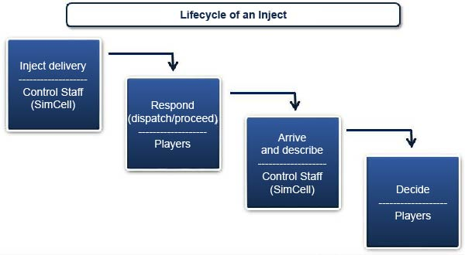
Inject Flow

Slide 34
Inject Flow (cont’d.)
To be as realistic as possible, real-time will typically be utilized during a functional exercise
Skip-time elements should typically not be introduced during an exercise
  If you must implement a skip-time, do it overnight during a multi-day exercise

Slide 35
Inject Delivery
Use various means of communication between and among players and SimCell, including:
  Verbal
  Telephone
  Radio
  Fax
  Computer/Internet
Clearly identify all communication as exercise-related
  Email
  Texting
  Social media
  Television/video

Slide 36
Inject Delivery (cont’d.)
What are other means of communication you use in your jurisdiction during exercises?
Discussion…

Slide 37
Panel Discussion:
SimCell Best Practices

Slide 38
Unit Summary
In this unit you learned:
  About SimCell staff, communication, and setup
  About the roles/responsibilities of controllers and simulators
  About exercise control
  About inject flow and the lifecycle of an inject
  SimCell best practices

Slide 39
Questions?

Slide 40
Proficiency Demonstration #1:
SimCell

Slide 41
Proficiency Demonstration #1:
SimCell
Proficiency Demonstration Instruction Sheets:
  Are located in Participant Guide (PG)
  Provide all of the instructions and information needed for completing the Proficiency Demonstration, including all the information that is about to be presented on the slides
  Take the instruction sheets with you when you go to your breakout rooms
  Provided for every Proficiency Demonstration

Slide 42
Proficiency Demonstration #1:
SimCell (cont’d.)
Purpose:
  Apply ECS concepts and principles in a SimCell environment
Total time: 3 hours
  10 minutes to tour SimCell and EOC rooms
  1 hour to prepare for the functional exercise
  1 hour 20 minutes to conduct the functional exercise (two 40-minute rounds)
  20 minutes for peer/instructor feedback
  10 minutes for internal group feedback

Slide 43
Proficiency Demonstration #1:
SimCell (cont’d.)
Scenario:
  You will participate in a functional exercise as a SimCell staff member—either a controller or simulator
  You will conduct the functional exercise with another group who will be acting as the players, specifically, members of the Emergency Operations Center (EOC)

Slide 44
Proficiency Demonstration #1:
SimCell (cont’d.)
Scenario (cont’d.):
  There will be two rounds of exercising, with the first round addressing the first half of the exercise injects and the second round addressing the second half of the injects:
    Round 1: Group 1 is SimCell, Group 3 is players
    Round 1: Group 2 is SimCell, Group 4 is players
    Round 2: Group 3 is SimCell, Group 1 is players
    Round 2: Group 4 is SimCell, Group 2 is players

Slide 45
Proficiency Demonstration #1:
SimCell (cont’d.)
Functional Exercise Roles:
  Each group will need to select their roles for the FE. Select from the roles provided on the telephone directory:
    If your group is the SimCell, designate the SimCell roles, including Senior Controller
    If your group is the EOC, designate the EOC roles
  Do not deviate from the roles provided on the phone list. Don’t delete or add roles to phone list. If the role is not on the list, don’t assign it.

Slide 46
Proficiency Demonstration #1:
SimCell (cont’d.)
Functional Exercise Preparation (prepare for both roles: SimCell and EOC):
  Tour the SimCell and EOC rooms with your instructor
  Do your preparation work in the room in which your group will be starting
  Complete a communications check
  Review the MSEL (there are errors that need to corrected)
  Review the Controller Notes
  Review the telephone directories

Slide 47
Proficiency Demonstration #1:
SimCell (cont’d.)
Functional Exercise Preparation (cont’d.):
  When your group is the SimCell:
    Designate the SimCell roles, including Senior Controller
    Develop a method to track resources and decisions
    Senior Controller: Develop an inject tracking system
  If your group is the EOC:
    Designate the EOC roles
NOTE: A list of exercise roles/responsibilities is provided in Handout 3-1—Exercise Roles and Descriptions

Slide 48
Proficiency Demonstration #1:
SimCell (cont’d.)
Tips for All Participants:
  Roll with the exercise—don’t fight it
    You don’t need to agree with the events in the MSEL, how other players react, etc.
    The goal of this exercise is to illustrate how a SimCell works, and therefore, it may not always be in line with a real life functional exercise
  Your Senior Controller may temporarily halt the SimCell activity—be prepared for this interruption in exercise flow

Slide 49
Proficiency Demonstration #1:
SimCell (cont’d.)
Tips for SimCell Members:
  Don’t feel overwhelmed, the instructor is there to work with you
  Keep accurate notes on resource decisions made, particularly if you’re the SimCell in the first round, because the next SimCell needs to know the status of resources and decisions
  Controllers need to ensure contingency injects aren’t put in without the Senior Controller’s approval/
  go ahead

Slide 50
Proficiency Demonstration #1:
SimCell (cont’d.)
Tips for EOC Members:
  Follow along in the MSEL
  Keep track of the exercise progression
After completion of the Proficiency Demonstration, return to the plenary classroom for a group discussion.

Slide 51
Proficiency Demonstration #1:
SimCell (cont’d.)
Controllers: What issues did you experience with player responses?
  What actions did you take?
Was the exercise paused or stopped?
  Who did it and how?
  How did you restart?
Discussion…

Slide 52
Proficiency Demonstration #1:
SimCell (cont’d.)
Was the MSEL representative of the “whole community?”
Was the MSEL representative of EOC Operations Section?
  Were all players engaged?
Did each inject flow from the SimCell to the EOC as expected?
Discussion…

Slide 53
Proficiency Demonstration #1:
SimCell (cont’d.)
Talk about the formatting.
  Was it easy to follow as a controller?
  Was the lack of indicated timing an issue?
What would you change about this MSEL?
  Would additional documentation be helpful?
Discussion…

Slide 54
Proficiency Demonstration #1:
SimCell (cont’d.)
What flaws did you find in the MSEL?
Discussion…

