Slide 1
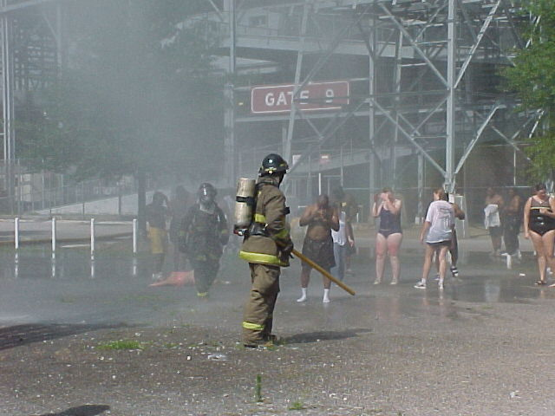
E133: OPERATIONS-BASED EXERCISE DESIGN
AND EVALUATION COURSE
Unit 2: MSEL Development
FEMA News Photo

Slide 2
Unit Objectives
By the end of this unit you will be able to:
  Explain the Eight Exercise Design Steps with regard to operations-based exercises
  Develop major and detailed events, expected actions, and injects for an operations-based exercise
  List the information contained in a MSEL
  Describe the documentation and tools used with operations-based exercises

Slide 3
Eight Exercise Design Steps
Assess needs
Define the scope
Write a statement of purpose
Define objectives
Compose a narrative
Write major and detailed events
List expected actions
Prepare injects
E133 picks up with Step 4

Slide 4
Step 4: Define Objectives
A description of the capabilities in which you expect the participants to possess competence
Objectives must be clear, concise, and focused on player performance. They should contain:
  An action, stated in observable terms
  The conditions under which the action will be performed
  Identification of who should perform the action
  Standards of performance

Slide 5
Step 4: Define Objectives (cont’d.)
Use the SMART system
  Specific
  Measurable
  Achievable
  Relevant
  Time-bound

Slide 6
Step 4: Define Objectives (cont’d.)
Objectives for operations-based exercises typically focus on:
  Integration of multiple entities
  Systems-level and tactical-level issues that are physically demonstrated either in an EOC or in
  the field
Sample objectives for operations-based exercises in Participant Guide (PG)

Slide 7
Objectives and Evaluation
Writing objectives is the beginning of the exercise evaluation process:
  The process of identifying evaluation criteria happens when objectives are written
  Evaluators use objectives to evaluate performance
  The AAR/IP is based on the objectives
To ensure objectives provide useful evaluation measures, include specific critical tasks in the EEGs
  Example of objective/tasks in an EEG in PG

Slide 8
Objectives and Evaluation (cont’d.)
How would the objective and corresponding EEG look different if this was for a discussion-based exercise?
Discussion…

Slide 9
Objectives and Evaluation (cont’d.)
Are the critical tasks in the EEG clearly tied back to the exercise objective?
Discussion…

Slide 10
Activity #1:
FE Preparation: Objectives

Slide 11
Activity #1:
FE Preparation: Objectives (cont’d.)
Refer to Activity #1: FE Preparation Worksheet, in your PG
Complete the “Objectives” row
  Develop three objectives for your FE
  Use your group’s disaster category, priority, and core capabilities from E132
  Remember to first conduct a needs assessment and develop a scope and purpose. Use the information provided in the ESSD, Section 3.0, Hazard/Vulnerability Analysis (HVA)

Slide 12
Activity #1:
FE Preparation: Objectives (cont’d.)
Work in your Proficiency Demonstration groups
Submit your objectives to your group instructor for review and acceptance
  Your goal is to get your group instructor’s approval to progress with your objectives and use them for your FE
You have 30 minutes to complete the activity
  Ensure your objectives are reviewed early enough to allow time to implement feedback and get acceptance

Slide 13
Step 5: Compose a Narrative
A brief description of the events that have occurred up to the minute the exercise begins
Provided in the Controller/Evaluator (C/E) Handbook and MSEL, and briefed to the exercise participants at StartEx
Sample narrative in PG

Slide 14
Step 6: Write Major and Detailed Events
Events are:
  Occurrences that happen as a result of the emergency described in the narrative
  Problems requiring actions that will meet the objectives
The goal is to provide a structure that will:
  Link the simulated event to the expected player actions
  Provide unity to the exercise
Careful scripting is required to:
  Produce a convincing, unified scenario
  Create an exercise governed by objectives

Slide 15
Developing Major Events
To develop major events:
  Identify major occurrences that might follow the narrative events
  Select those that will likely generate situations to test the objectives
In discussion-based exercises, a major event is usually introduced in a new module; in operations-based exercises, major events can be injects as part of the overall MSEL

Slide 16
Developing Major Events Example
What are some major events that might follow from the airplane crash narrative?
  Fuselage breaks apart and hits buildings below
  Jet fuel ignites several homes in the area
  About 60 survivors are thought to be trapped in the front section of the aircraft
  Several bystanders are injured on the ground
  A crowd convenes around the crash site
  Family members of victims begin to gather at the crash site
  Estimates of passenger casualties rise to 200 to 220 deaths and at least 70 severe burn victims

Slide 17

Use Your Purpose Statement
Because your goal is to develop an exercise that will test certain functions and organizations, major events should be developed from your purpose statement.
FEMA News Photo

Slide 18
Use Your Purpose Statement Example
Airplane crash example:
Major Event | Core Capabilities Tested
Fuselage breaks apart and hits buildings below | Operational Coordination
Jet fuel ignites several homes in the area | On-Scene Security and Protection Public and Private Services and Resources
About 60 survivors are thought to be trapped in the front section of the aircraft | Mass Search and Rescue Operations

Slide 19
Developing Detailed Events
Detailed events:
  Specific problem situations that will prompt one or more expected actions
To develop detailed events:
  List specific problems likely to occur in connection with each major event
  Identify actions that would be expected to address them
  Develop the detailed events in chronological order of expected occurrence

Slide 20
Detailed Events Example
Airplane crash major event #7:
      “Estimates of passenger casualties rise to 200 deaths and at least 70 severe burn victims”
Possible detailed events:
  Mortuary cannot accept so many remains
  Local hospitals lack specialized facilities and personnel to treat large numbers of severe burn victims
  The Red Cross has agreed to set up an information center to link victims and their families

Slide 21
Hazard Networks
A useful tool for helping develop major and detailed events is FEMA’s hazard networks
  They represent the potential cascading effects of a hazard in a visual, network-style format
The hazard networks come from FEMA’s discontinued Full-Spectrum Risk Knowledgebase
  Copies of the hazard networks are provided on the Shared Drive, and a copy of the hazard network for an airplane crash is provided in your Participant Guides

Slide 22
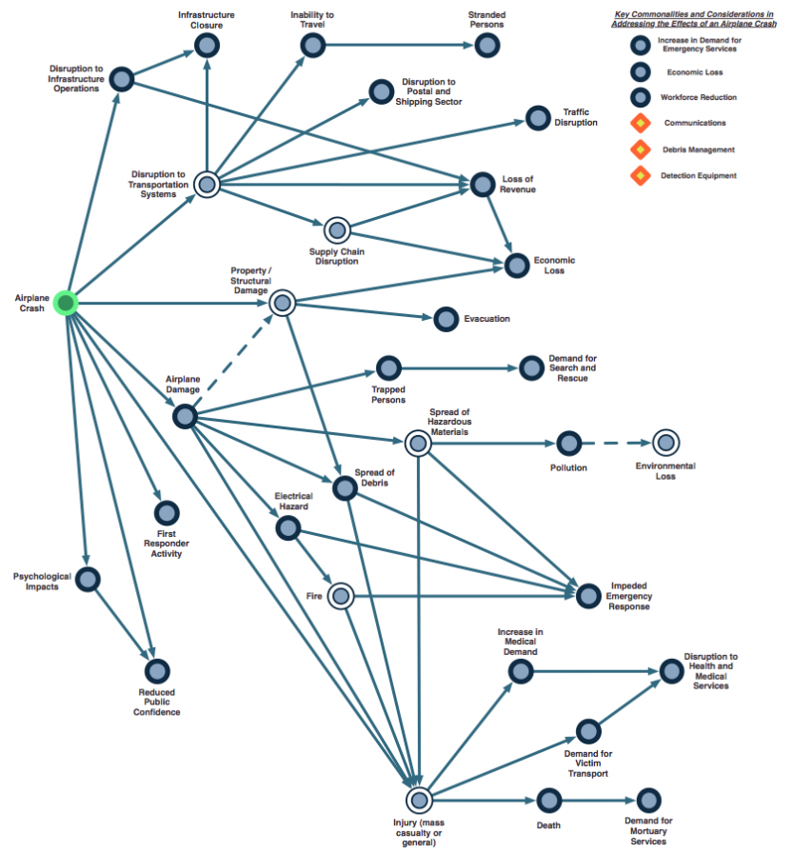
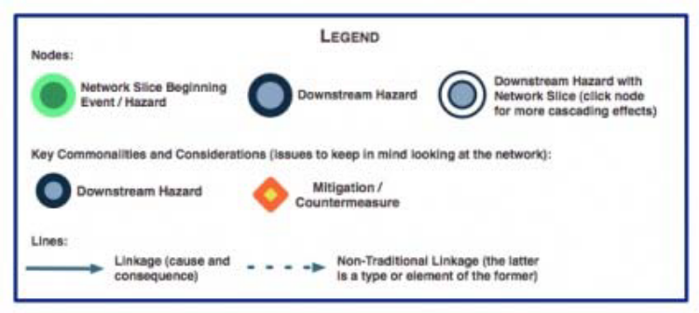
Hazard Network Example: Airplane Crash

Slide 23
Activity #2:
FE Preparation: Major and Detailed Events

Slide 24
Activity #2: FE Preparation:
Major and Detailed Events (cont’d.)
Refer back to Activity #1: FE Preparation Worksheet, in your PG
Complete the Major Events and the Detailed Events rows:
  Write one major event for each objective
  Write two detailed events for each major event
Work in your groups

Slide 25
Activity #2: FE Preparation:
Major and Detailed Events (cont’d.)
Submit your major and detailed events to your group instructor for review and acceptance
You have 30 minutes to complete the activity
  Ensure your major and detailed events are reviewed early enough to allow time to implement feedback and get acceptance

Slide 26
Step 7: List Expected Actions
Expected actions: Actions or decisions you want participants to carry out in order to demonstrate competence
Necessary for injects and evaluation
Types of actions:
  Verification
  Consideration
  Deferral
  Decision

Slide 27
Step 7: List Expected Actions (cont’d.)
How do you know what actions are appropriate in response to a given inject?
Discussion…

Slide 28
Relationship to Objectives
Expected actions are closely tied to objectives
  Objectives state general desired actions
  “Expected actions” are a breakdown of objectives—the actions that would be taken by an organization or an individual to meet the objective
Example of the relationship between expected actions and objectives in PG

Slide 29
What to List
Generally, every detailed event results in one or more expected actions
List only those actions that involve the participating organizations
List expected actions for all participating organizations
  It is not necessary for each detailed event to generate responses from all players

Slide 30
Step 8: Prepare Injects
Injects are used to communicate detailed events to exercise participants
Characteristics
  Purpose: Evoke a response (decision or action) to meet objectives
  Transmission: Phone, radio, note, fax, in person, etc.
  Credibility: Must come from credible source, through credible channels
Sample injects provided in PG

Slide 31
Injects, Events, and Actions
Injects and events
  One inject may represent one event, or several injects may be needed to notify participants of the event
Injects and expected actions
  Each inject is designed to generate one or more expected actions
Examples of injects that could achieve the expected actions in PG
Sample inject planning sheet in PG

Slide 32
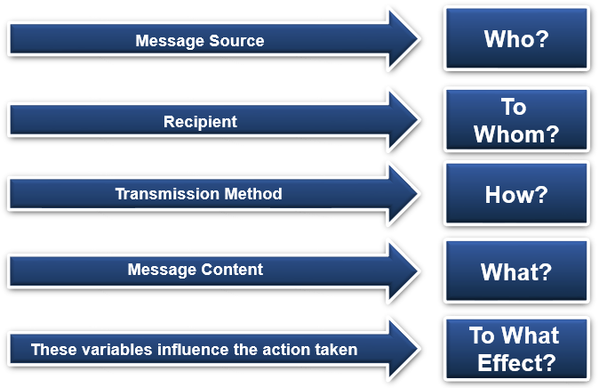
Inject Variables
Who sends what to whom, how, with what effect?

Slide 33
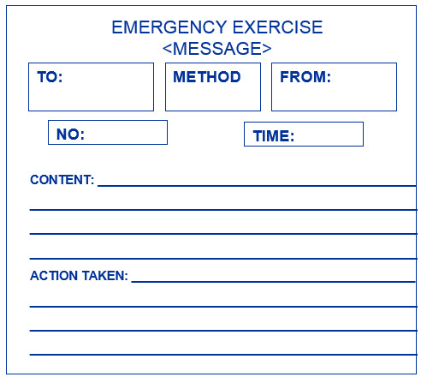
Inject Format

Slide 34
Composing an Inject
Injects should be developed by subject matter experts
The starting point is the expected action
Decide:
  What should the inject say? What would provide the desired expected action?
  Who will send it?
  How will the inject be transmitted?
  Who will receive it?
  Does it provide all of the necessary information?
Keep it realistic!

Slide 35
Pulling It Together:
The Master Scenario of Events List (MSEL)
A chronological listing of scripted events and injects that generate activity in specific functional areas in support of exercise objectives
  Provides the framework for monitoring and managing the flow of exercise activities
  The primary document used by Controllers to manage the exercise
Not utilized for discussion-based exercises
Can be used for drills if the exercise planning team determines it to be appropriate

Slide 36
MSEL Development
MSEL development process is simple—use the Eight Exercise Design Steps
There is no standard MSEL format
  Format depends on the scale and scope of the exercise
Example of MSEL format in PG

Slide 37
MSEL Development (cont’d.)
In the MSEL format example, notice the column for delivery time, and notice that it was left blank.
What are your thoughts for including times in a MSEL?
Discussion…

Slide 38
MSEL Development (cont’d.)
MSEL events:
  Contextual injects
  Expected action events (milestones)
  Contingency injects
MSEL types
  Short: Inject, delivery time, short description, identifies responsible controller, and recipient player
  Long: Detailed description, exact quotes and formats for inject, and includes description of expected action.

Slide 39
MSEL Development (cont’d.)
How do you develop your MSEL document in your jurisdiction?
Discussion…

Slide 40
MSEL Development (cont’d.)
Review capabilities
Identify chronology of key actions
Anticipate Player actions
Identify information resources
Compile all MSEL events into single list
Refine selected MSEL events; create detailed long version.

Slide 41
MSEL Development (cont’d.)
Different ways to develop a MSEL:
Chronological
Threads
“Sticky Note” Method taught in HSEEP (Timeline Development)

Slide 42
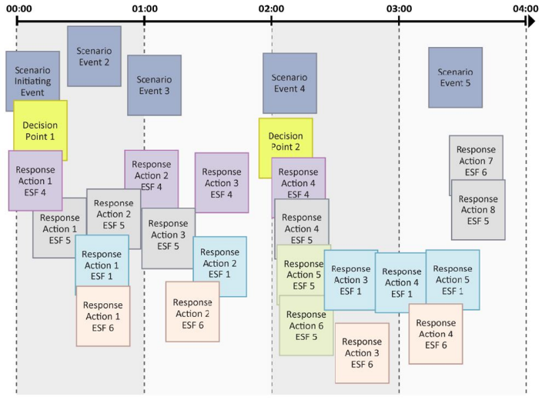
MSEL “Timeline” Development

Slide 43
MSEL Best Practices
  Review scenario and exercise objectives
  Identify chronology of major/detailed events
  Develop a timeline of anticipated player actions
  Every agency/organization will not necessarily have a role in every major and detailed event
  Identify chronology of key actions
  Use an electronic MSEL program
  Compile all MSEL events into a single list
  Ensure no injects go to non-participants
  Refine selected MSEL events
  DO NOT show MSEL to participants!

Slide 44
MSEL Best Practices (cont’d.)
Share your best practices for developing a MSEL:
  What works for you?
Discussion…

Slide 45
MSEL Injects
MSEL injects are representative actions and scenario elements that drive exercise play
They do three things:
  Link simulation to action
  Enhance exercise
  experiences for players
  Reflect an incident or
  activity that will prompt
  players to implement
  the policy or procedure
  being tested
FEMA News Photo

Slide 46
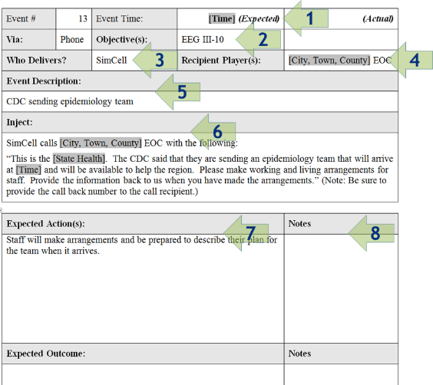
Inject Information
Each inject should specify:
  Designated scenario time
  Objective to be demonstrated
  Controller responsible for delivering inject and input method
  Intended player
  Event description
  Inject
  Expected action (player response)
  Notes
Example provided in PG

Slide 47
Contingency Injects
Players do not always respond as you expect
It may become necessary for the controller and simulators to improvise injects
  Usually, the Senior Controller will decide on an appropriate response
  A contingency inject should not impact future injects or other expected participant actions—it should move play forward in a manner that will permit Evaluators to determine if tasks were completed successfully
  A contingency inject should not be entered until approved by the Senior Controller

Slide 48
FE vs. FSE
MSEL use during FE
  Monitors the progress of the exercise to keep it on schedule and on track
  Drives participant play
MSEL use during FSE
  Supplements active play

Slide 49
Activity #3:
FE Preparation: Expected Actions and Injects

Slide 50
Activity #3: FE Preparation:
Expected Actions and Injects (cont’d.)
Refer back to Activity #1: FE Preparation Worksheet in your PG
Complete the Expected Actions and Injects rows:
  Write one expected action for each detailed event
  Write one inject for each expected action
Work in your groups

Slide 51
Activity #3: FE Preparation:
Expected Actions and Injects (cont’d.)
Submit your expected actions and injects to your group instructor for review and acceptance
You have 45 minutes to complete the activity
  Ensure your expected actions and injects are reviewed with enough time to implement feedback and get acceptance

Slide 52
Documentation for
Operations-Based Exercises
Document Title | Exercise Type | Distribution Audience
Exercise Plan (ExPlan) | Drill, FE, FSE | Players and Observers
Controller and Evaluator (C/E) Handbook | Drill, FE, FSE | Controllers, Evaluators, and Simulators
Master Scenario Events List (MSEL) | Drill, FE, FSE, Complex TTX (optional), Game (optional) | Controllers, Evaluators, and Simulators
Extent of Play Agreement (XPA) | FE, FSE | Exercise Planning Team and participating agencies and organizations
Exercise Evaluation Guides (EEGs) | Drill, FE, FSE, TTX, Game | Evaluators
Participant Feedback Form | All exercises | All Participants

Slide 53
ExPlan
Provides a synopsis of the exercise
Published and distributed to the participating organizations (players and observers)

Slide 54
ExPlan (cont’d.)
Addresses exercise objectives and scope
Assigns activities and responsibilities for exercise planning, conduct, and evaluation
Provides the exercise safety plan
Intended to be seen by the exercise players and observers
  It does NOT contain detailed scenario information

Slide 55
ExPlan (cont’d.)
Refer to Handout 2.1—Sample EOC Response ExPlan
  In what areas of the ExPlan
  do you notice a expansion
  from the HSEEP Template?
  From a players perspective,
  do you think this contains the appropriate amount of information you need to participate?
  General comments?
Discussion…

Slide 56
ExPlan (cont’d.)
An ExPlan can be supplemented with a
Player Handout
  Provides players with a quick-reference guide to logistics, agenda or schedule, and key contact information for players

Slide 57
C/E Handbook
Describes roles and responsibilities of exercise controllers, evaluators, and simulators and the procedures they should follow
Distributed ONLY to exercise staff because it contains detailed scenario information

Slide 58
C/E Handbook (cont’d.)
The C/E Handbook can supplement the ExPlan or be a standalone document:
  When used as a supplement, it points readers to the ExPlan for more general exercise information
  When used as a standalone document, it should include the basic information contained in the ExPlan, and detailed scenario information

Slide 59
C/E Handbook (cont’d.)
The C/E Handbook usually contains the following sections:
  Assignments, roles, and responsibilities of group or individual controllers, evaluators, and simulators
  Detailed scenario information
  Exercise safety plan
  Controller communications plan
  Evaluation instructions

Slide 60
C/E Handbook (cont’d.)
Controller portion provides controllers with:
  Guidelines for control and simulation support and establishes a management structure for these activities
  Guidance for controllers, simulators, and evaluators on procedures and responsibilities for exercise control, simulation, and support
Evaluation portion provides evaluators with:
  Guidance and instructions on evaluation or observation methodology to be used
  Essential materials required to execute their specific functions

Slide 61
Extent of Play Agreement (XPA)
Used to define the organizations participating in the exercise as well as their extent of play
A negotiated document that details the organizations’ commitments to the exercise
Example: One fire station will play for 8 hours, county EOC activation level and duration of activation (24/7 exercise operations)
HSEEP XPA template in PG

Slide 62
EEGs
Help evaluators collect relevant exercise observations
EEGs are aligned to objectives, and document the related core capability, capability target(s), and critical tasks

Slide 63
Participant Feedback Forms
A means to solicit player input on the exercise
At a minimum, the questions on the Participant Feedback Form should solicit the following:
  Strengths and areas for improvement pertaining to the implementation of participating agencies and organizations’ policies, plans, and SOPs
  Impressions about exercise conduct and logistics

Slide 64
Participant Feedback Forms (cont’d.)
Information collected from feedback forms contributes to the issues, observations, recommendations, and corrective actions in the AAR/IP
Feedback forms can be supplemented by the conduct of a player Hot Wash

Slide 65
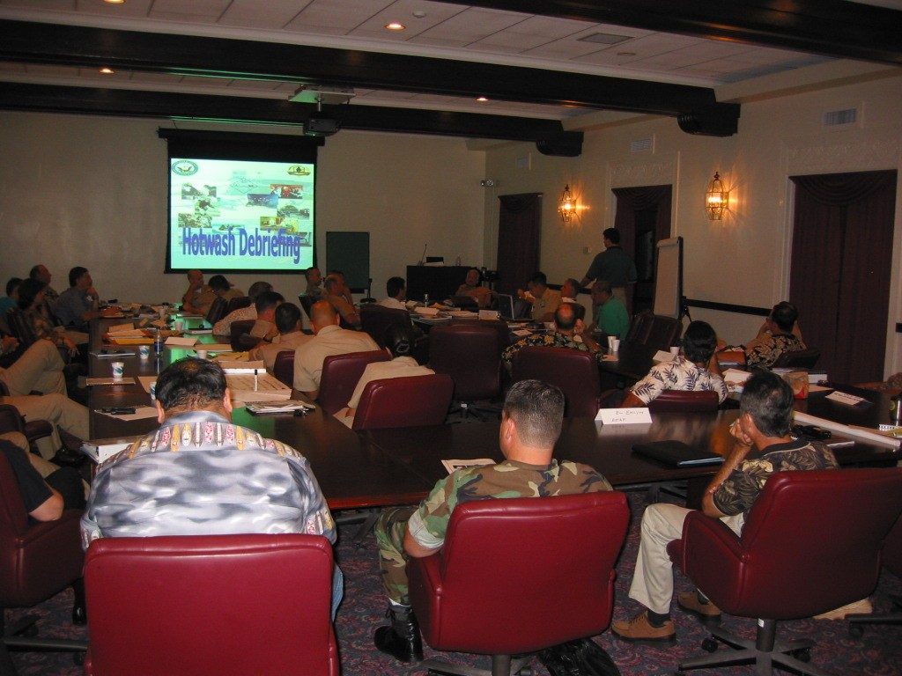
Tools for Operations-Based Exercises
Pre-exercise briefings:
  Elected and Appointed Official Briefing
  Controller/Evaluator Briefing
  Actor Briefing
  Player Briefing
  Observer Briefing
FEMA News Photo

Slide 66
Tools for Operations-Based Exercises (cont’d.)
Controller and evaluator packets:
  Controller/evaluator materials should be placed in a packet for easy use during the exercise
  The packet should contain everything controllers and evaluators need to perform their required tasks

Slide 67
Tools for Operations-Based Exercises (cont’d.)
The controller packet should contain:
  Essential C/E Handbook information:
    Scenario and threat/hazard information
    Communications and safety plans
    Exercise staff organization
  MSEL:
    Including injects for each responsible controller
  Maps and directions

Slide 68
Tools for Operations-Based Exercises (cont’d.)
The evaluator packet should contain:
  All the same information as the controller packets,
  plus EEGs

Slide 69
Tools for Operations-Based Exercises (cont’d.)
Post-exercise tools:
  Player Hot Wash
  Controller/Evaluator Debriefing
  Exercise Planning Team Debriefing

Slide 70
Unit Summary
In this unit you learned:
  How the Eight Exercise Design Steps apply to operations-based exercises
  About major and detailed events, expected actions, and injects
  About the MSEL and MSEL injects
  The documentation for operations-based exercises
  The tools for operations-based exercises

Slide 71
Questions?

