Slide 1

E133: OPERATIONS-BASED EXERCISE DESIGN
AND EVALUATION COURSE
Unit 1: Course Overview

Slide 2
Unit Objectives
By the end of this unit you will be able to:
  Describe the agenda for the E133: Operations-Based Exercise Design and Evaluation Course
  Identify appropriate course conduct and facility policies

Slide 3
Introductions
In 15 seconds or less:
  Name
  Position title and organization
  Work location
  Exercise experience — select all that apply:
    Planner
    Controller
    Player
    Evaluator

Slide 4
E133 Course Goals
The goals of this course are for you to better:
  Apply the four phases of the exercise cycle—design and development, conduct, evaluation, and improvement planning—to operations-based exercises
  Apply the Eight Exercise Design Steps to an operations-based exercise
  Apply the first 6 steps of the Eight Exercise Evaluation Steps to operations-based exercises

Slide 5
E133 Course Objectives
Upon completion of this course, you will be
able to:
  Apply the principles and associated resources of the HSEEP as it relates to operations-based exercises
  Apply exercise control and simulation to operations-based exercises in your jurisdiction

Slide 6
E133 Course Materials
Participant Guide (PG)
Liberty County/Central City Exercise Simulation System Document (ESSD)

Slide 7
E133 Course Agenda
E133 Operations-Based Exercise Design and Evaluation
  Course units and Proficiency Demonstrations
  Schedule variations may occur

Slide 8
Proficiency Demonstration Reminders
Proficiency Demonstrations build across the three MEPP courses, following a progressive exercise approach
In this course, you will build on your E132 materials (using your disaster category, priorities, and TEP)
You will complete several Proficiency Demonstrations during this course, and another take-home Proficiency Demonstration will be assigned at the end of the course

Slide 9
Peer Review Reminders
MEPP centers on learning and growing from eachother
You will be given opportunities to provide feedback to your peers:
  Treat others as you want to be treated
  Be professional in everything you say and do
  Be prepared to provide a possible solution to any item you identify as needing improvement
  Be prepared to explain your position and be open to suggestions

Slide 10

Campus Administration Reminders
Class registration
Classrooms
Parking
Meals
Emergency procedures
Walking around campus
Recreation
NETC evaluations
FEMA/Jocelyn Augustino

Slide 11
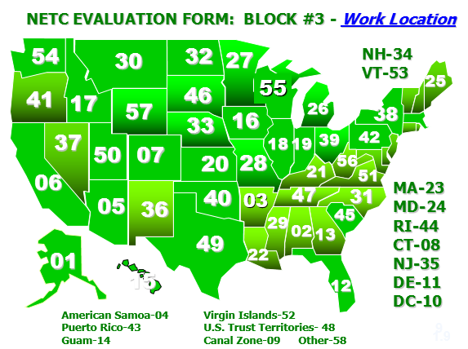
NETC Evaluation Form: Block #3 – Work Location

Slide 12
Shared Drive Reminders
Resources
Proficiency Demonstration materials
Folder in which to save your Proficiency Demonstration deliverables
  Saving documents in the proper location is critical
  Assignments will be considered incomplete if documents are not uploaded to the correct location
Shared Drive Quick Reference in PG
  Saving files and naming conventions

Slide 13
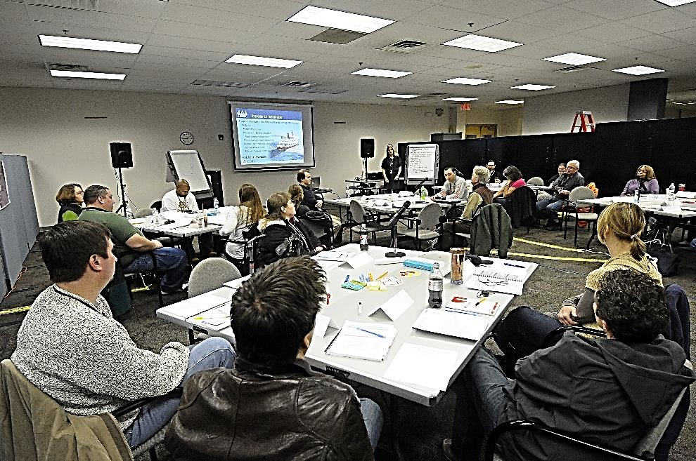
Course Conduct Reminders
Attendance
Technology courtesy
Sharing knowledge
Lunch and breaks
FEMA/Hans Pennink

Slide 14
Selected Examples—
E132 Proficiency Demonstration #5: Tabletop Exercise, Take-Home

Slide 15
E132 Proficiency Demonstration #5: Tabletop Exercise, Take-Home
Share your experience with completing your TTX:
  What were your successes, challenges, etc.?
Discussion…

Slide 16
Unit Summary
In this unit you learned:
  About the objectives, materials, and agenda for the E133 course
  About the campus administration, including parking, meals, and recreation
  About the course conduct, including attendance, cell/pager/computer courtesy, and lunch/breaks

Slide 17
Questions?

