Slide 1
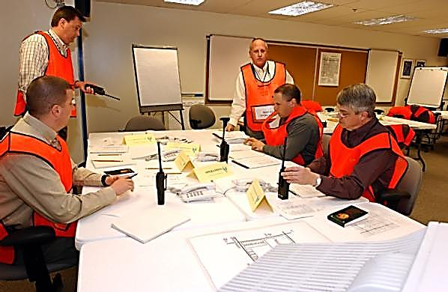
E132: DISCUSSION-BASED EXERCISE DESIGN
AND EVALUATION COURSE
Unit 7: Course Wrap-Up and Proficiency Demonstration #5
FEMA/Jocelyn Augustino

Slide 2
Unit Objectives
By the end of this unit you will be able to:
  Summarize the key points of the E132: Discussion-Based Exercise Design and Evaluation Course
  Explain how to successfully complete Proficiency Demonstration #5: Tabletop Exercise, Take-Home

Slide 3
Course Review
In the E132 course, you learned how to better:
  Develop a Multi-year Training and Exercise Plan
  Apply the four phases of the exercise cycle—design and development, conduct, evaluation, and improvement planning—to discussion-based exercises
  Apply the eight steps of exercise design to a discussion-based exercise
  Evaluate a discussion-based exercise
  Apply the first three steps of the eight exercise evaluation steps to discussion-based exercises

Slide 4
Course Review (cont’d.)
In Units 1 and 2 you learned about the E132 course and the fictional exercise community, including:
  The requirements for the MEPP certificate title
  The State of Columbia, Central City/Liberty County, and the ESSD

Slide 5
Course Review (cont’d.)
In Unit 3 you learned about a progressive exercise program, including:
  The policy that guides the creation of the Multi-year TEP:
  Guidance for creating a Multi-year TEP, including determining priorities, exercises, evaluation, and the TEP schedule
You completed Proficiency Demonstration #1: Multi-year TEP

Slide 6
Course Review (cont’d.)
In Unit 4 you learned about discussion-based exercises, including:
  The four types of discussion-based exercises
  The eight exercise design steps
You completed Proficiency Demonstration #2: Seminar

Slide 7
Course Review (cont’d.)
In Unit 5 you learned about facilitation, including:
  What makes an effective facilitator
  Preparing to be a facilitator
  Strategies to get participants involved
  Facilitation tips
  About wrap-up activities
You completed Proficiency Demonstration #3: Tabletop Exercise

Slide 8
Course Review (cont’d.)
In Unit 6 you learned about exercise evaluation, including:
  The eight exercise evaluation steps
  The evaluation tasks performed at each stage of the exercise cycle
  How to plan and organize an exercise evaluation
  How to observe an exercise and collect data
  How to analyze TTX evaluation data using root cause analysis
You completed Proficiency Demonstration #4: Tabletop Exercise Evaluation

Slide 9
Course Evaluations
Thoughts? Reactions?
Let us know!

Slide 10
Proficiency Demonstration #5:
Tabletop Exercise, Take-Home

Slide 11
Proficiency Demonstration #5:
Tabletop Exercise, Take-Home
Purpose:
  Design, develop, and if possible, conduct a TTX specific to your agency or community
Deliverables (see rubric):
  SitMan (HSEEP template)
  TTX for your agency or community
  (PowerPoint document)
  EEGs (HSEEP template)
  Participant Feedback Form
  Any job aids or resources necessary for the players of the TTX (formats may vary)

Slide 12
Proficiency Demonstration #5:
Tabletop Exercise, Take-Home
Submitting Your Deliverables:
  Save as PDF
  Send via email to Course Manager
  Due no later than 3 weeks before the start date of the E133 course
  If you’re not able to conduct the TTX, you still need to provide evaluation materials

