Slide 1
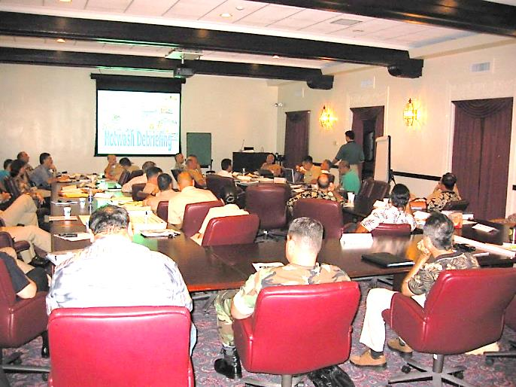
E132: DISCUSSION-BASED EXERCISE DESIGN
AND EVALUATION COURSE
Unit 6: Exercise Evaluation and Proficiency Demonstration #4
FEMA News Photo

Slide 2
Unit Objectives
By the end of this unit you will be able to:
  Describe the tasks that occur in steps 1-3 of the eight exercise evaluation steps
  Describe the rationale for a systematic exercise evaluation process
  Identify exercise evaluator attributes and pitfalls

Slide 3
Unit Objectives (cont’d.)
  Revise, conduct, and evaluate a tabletop
  exercise (TTX), using the TTX developed earlier in the course
  Develop exercise evaluation support material
  Observe a TTX and collect evaluation data
  Analyze TTX evaluation data using root cause analysis

Slide 4
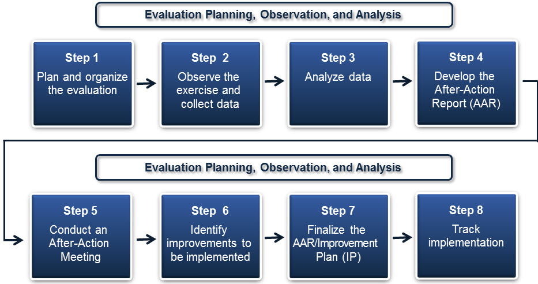
Eight Exercise Evaluation Steps

Slide 5
The Case for Systematic
Exercise Evaluation
Cost vs. benefit
  If we don’t evaluate exercises and track corrective actions and improvements, we’re setting ourselves up to make the same mistakes over and over
  If our evaluations are not honest, we are wasting people’s time and money

Slide 6
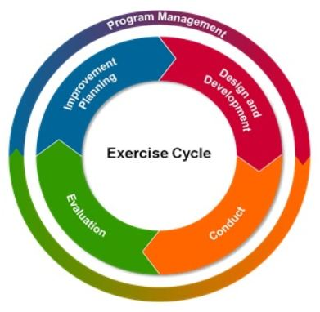
Evaluation Tasks and the Exercise Cycle
HSEEP Exercise Cycle

Slide 7
Evaluation Tasks and the Exercise Cycle (cont’d.)
HSEEP Exercise Cycle Phases | Evaluation Tasks
Design and Development | Select Lead Evaluator Develop evaluation plan Select, organize, and train evaluators
Conduct | Observe and document player actions
Evaluation | Participate in post-exercise critiques and meetings Develop evaluation reports
Improvement Planning | Track completion of corrective actions* *May not be an evaluator responsibility

Slide 8
Step 1: Plan and Organize the Evaluation
Part of the exercise design and development process
The Exercise Planning Team determines:
  What information is collected
  Who collects it
  How it is collected
Evaluators are identified,
recruited, and trained
Step 1
Plan and organize
the evaluation

Slide 9
Step 1: Plan and Organize the Evaluation (cont’d.)
Evaluation Plan
  The Lead Evaluator works with the planning team members to:
    Define evaluation requirements
    Prepare a plan for evaluating the exercise
    Develop evaluation tools
    Recruit, assign, and train facilitators and evaluators
    Finalize the plan for evaluation

Slide 10
Step 1: Plan and Organize the Evaluation (cont’d.)
Evaluation Plan (cont’d.)
  The evaluation plan should consider:
    Exercise-specific information
    Plans, policies, procedures, and agreements
    Evaluator assignments
    Evaluator instructions
    Evaluation tools

Slide 11
Step 1: Plan and Organize the Evaluation (cont’d.)
Recruiting Evaluators
  Occurs after the Lead Evaluator has determined:
    The number and type of evaluators needed
    The types of skills required
    The attributes sought

Slide 12
Step 1: Plan and Organize the Evaluation (cont’d.)
Who makes a
good evaluator?
Discussion…

Slide 13
Step 1: Plan and Organize the Evaluation (cont’d.)
Evaluators – What to Look For
  Experts in the tasks they evaluate
  Knowledgeable of the jurisdiction/organization’s plans, policies, procedures, and agreements
  Familiar with the evaluation system
  Free from other exercise responsibilities
NOTE: Evaluators should not interfere with the exercise. They should step in only for safety issues.

Slide 14
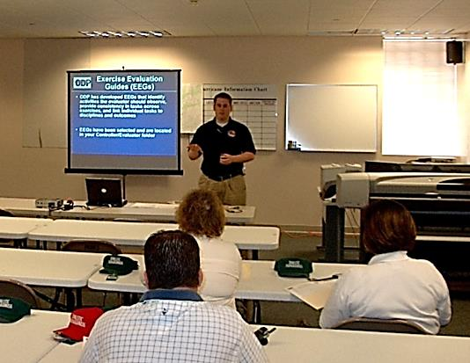
Step 1: Plan and Organize the Evaluation (cont’d.)
Evaluator Time Requirements
  Evaluators must be available for:
    Pre-exercise training/briefing
    The exercise itself
    Post-exercise Hot Wash
    Facilitator and evaluator
    debriefing
    After-Action Meeting
FEMA News Photo

Slide 15
Step 1: Plan and Organize the Evaluation (cont’d.)
Evaluators – Errors and Pitfalls
  Error of Leniency
  Error of Central Tendency
  Halo Effect
  Hypercritical Effect
  Contamination
Tip Sheet for avoiding evaluator pitfalls in your Participant Guide

Slide 16
Step 1: Plan and Organize the Evaluation (cont’d.)
Share your experiences with evaluator pitfalls.
  Have you encountered them while conducting an exercise?
  Were you able to mitigate them?
  How did they affect your exercise and your evaluation product?
Discussion…

Slide 17

Step 1: Plan and Organize the Evaluation (cont’d.)
Exercise Objectives
  Your exercise objectives are the basis for the evaluation of the exercise

Slide 18
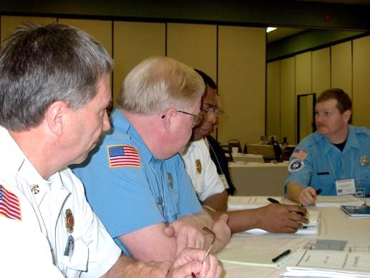
Step 1: Plan and Organize the Evaluation (cont’d.)
Exercise Evaluation Guides
  Help evaluators document exercise activities and determine if objectives are met
  Generally, one packet is
  used for each objective
  or core capability being
  evaluated
FEMA News Photo

Slide 19
Step 1: Plan and Organize the Evaluation (cont’d.)
When should you begin to develop your EEGs?
Discussion…

Slide 20
Step 1: Plan and Organize the Evaluation (cont’d.)
Developing EEGs
  Composed of four elements:
    Core capabilities
    Organizational capability target(s)
    Critical task(s)
    Target rating(s)

Slide 21
Step 1: Plan and Organize the Evaluation (cont’d.)
Developing EEGs (cont’d.)
  Pre-Planning
    Reference C&O meeting
    Can identified capability targets and critical tasks be tested during the exercise?
  Research
    Capability gaps from current threat and hazard assessments
    Previous/current AAR/IPs
    Current plans/policies/procedures

Slide 22
Step 1: Plan and Organize the Evaluation (cont’d.)
Developing EEGs (cont’d.)
  Select appropriate EEG template (divided by mission area and core capability)
  Identify capability targets
  Develop critical tasks (from plans)
    Number of critical tasks depends on the scope and time allocated for exercise

Slide 23
Step 1: Plan and Organize the Evaluation (cont’d.)
Will critical tasks (taken from plans) be different in a TTX vs. a functional or full-scale exercise?
Discussion…

Slide 24
Step 1: Plan and Organize the Evaluation (cont’d.)
Example of critical tasks for discussion-based exercises versus operations-based exercises
Discussion-based critical task
“Describe actions taken to communicate and talk across responding agencies”
Operations-based critical task
“Establish the ability to talk across responding first responding agencies”

Slide 25
Step 1: Plan and Organize the Evaluation (cont’d.)
Evaluation Form Design
  Critical tasks are used to determine if objectives are successfully demonstrated
  To develop critical tasks, take the task identified in the objectives and break it into its component steps – these steps are the critical tasks
  Keep the form manageable
    Try to limit the form to a maximum of 15-20 critical tasks

Slide 26
Step 1: Plan and Organize the Evaluation (cont’d.)
Evaluation Form Design
  Keep questions short and simple
  Do not ask questions the evaluator cannot answer

Slide 27
Activity #4:
Critical Tasks

Slide 28
Activity #4:
Critical Tasks (cont’d.)
Refer to Activity #4: Critical Tasks in your Participant Guide
Select a capability/objective, and then create two discussion-based exercise, critical tasks for that capability/objective
Record your answers on the worksheet
Work in groups of two to three
You have 15 minutes to complete the activity

Slide 29
Step 2: Observe the Exercise and Collect Data
Observing the exercise and recording the information is only one part
Evaluators collect other data, they:
  Review EOPs, SOPs, SOGs, etc.
  Record observations and discussions that occur during the exercise
  Attend the player Hot Wash
  Collect additional data from
  records and logs
Step 2
Observe the
exercise and
collect data

Slide 30
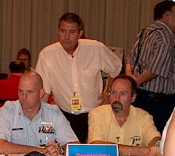
Step 2: Observe the Exercise and Collect Data (cont’d.)
Evaluators should record:
  Identified issues
  How decisions are made
  Roles and responsibilities
  Coordination and
  cooperation issues
  Recommendations from the group
FEMA News Photo

Slide 31
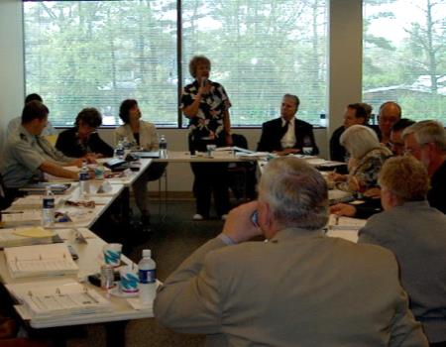
Step 2: Observe the Exercise and Collect Data (cont’d.)
Player Hot Wash
  After the actual exercise discussions are over, a Hot Wash is held to collect player feedback
  Hot Wash attendees should include:
    Exercise players
    Exercise planning team
    Facilitators
    Evaluators
  Establish rules before start
  (e.g., respectful environment)
FEMA News Photo

Slide 32
Step 2: Observe the Exercise and Collect Data (cont’d.)
Player Hot Wash (cont’d.)
  Hot Wash serves to collect observations and thoughts about what occurred during the exercise and how participants thought it went
  This provides evaluators an opportunity to clarify points or collect missing information
  Example Hot Wash data in Participant Guide
    Before we go over it, let’s do some brainstorming (no peeking)…

Slide 33
Step 2: Observe the Exercise and Collect Data (cont’d.)
What should evaluators record during the Hot Wash?
Discussion…

Slide 34
Step 2: Observe the Exercise and Collect Data (cont’d.)
Player Hot Wash (cont’d.)
  Structure the Hot Wash to manage the collection of information you want to get:
    Ask specific questions
    Consider branching away from the 3 up/3 down approach
    Frame questions around selected core capabilities or objectives (did we meet X objective?)

Slide 35
Step 2: Observe the Exercise and Collect Data (cont’d.)
How do you structure a Hot Wash in your jurisdiction?
Discussion…

Slide 36
Step 2: Observe the Exercise and Collect Data (cont’d.)
Player Hot Wash Pitfalls
  Players who perform badly criticize the exercise instead of their own performance
  Players provide feedback on exercise design and exercise facility (that is what the participant feedback form is for)
  “3 up/3 down” allows participants to freely tell you what is wrong—guarantees you will end at the fault of the exercise
  Players may unintentionally begin to re-exercise the exercise by rehashing issues discussed during the exercise

Slide 37
Step 1: Plan and Organize the Evaluation (cont’d.)
How can you mitigate player Hot Wash pitfalls?
Discussion…

Slide 38
Step 2: Observe the Exercise and Collect Data (cont’d.)
In addition to a Hot Wash, other ways to collect data after an exercise are:
  Participant Feedback Forms
  Facilitator/Evaluator Debriefing (discussion-based exercises) or C/E Debriefing (operations-based exercises)

Slide 39
Step 2: Observe the Exercise and Collect Data (cont’d.)
Participant Feedback Forms
  As you learned in Unit 4, Participant Feedback Forms capture the following information from the exercise players:
    Input regarding observed strengths and areas for improvement
    Constructive criticism about the design, control, or logistics of the exercise to help enhance the planning of future exercises

Slide 40
Step 2: Observe the Exercise and Collect Data (cont’d.)
What are the differences between a Participant Feedback Form and a Hot Wash?
Discussion…

Slide 41
Step 2: Observe the Exercise and Collect Data (cont’d.)
Participant Feedback Forms vs. Hot Wash
  Hot Wash:
    Does not discuss exercise design
    Discusses position performance based on plans
  Participant Feedback Form:
    Can be anonymous
    Can be delivered in print or electronically via things like Survey Monkey, email, etc.
    Addresses exercise design

Slide 42
Step 2: Observe the Exercise and Collect Data (cont’d.)
C/E Debriefing
  a.k.a., Facilitator/Evaluator Debriefing for discussion-based exercises
  Provides a forum for functional area controllers and evaluators to review the exercise
  Facilitated by the exercise planning team leader
  During the debriefing, controllers and evaluators complete and submit their Participant Feedback Forms
  Debriefing results are captured and may be included in the AAR/IP

Slide 43
Step 2: Observe the Exercise and Collect Data (cont’d.)
Following the Discussion-Based Exercise
  Data gaps will occur—evaluators should make every attempt to resolve them
  Sources for additional data to fill gaps include:
    Facilitator notes
    Evaluation/Participant Feedback Forms

Slide 44
Step 3: Analyze Data
Analyze the collected data by:
  Reconstructing exercise events
  Reconstructing exercise timelines
  Developing initial conclusions that may require further research
Step 3
Analyze data

Slide 45
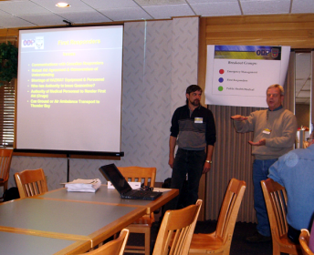
Step 3: Analyze Data (cont’d.)
The evaluation of
tabletop exercises (TTXs)
focuses on assessing
the adequacy of, and
familiarity with, existing
policies, plans,
and procedures
FEMA News Photo

Slide 46
Step 3: Analyze Data (cont’d.)
Root Cause Analysis
Root cause is the source of an identified issue
It occurs after Hot Wash
Evaluators identify discrepancies between what happened and what was supposed to happen, and then, they explore the source of these discrepancies
A root cause with an actionable solution should be determined for each issue

Slide 47
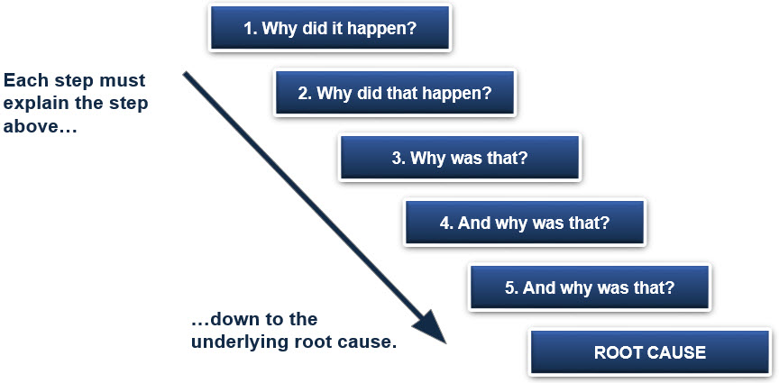
Step 3: Analyze Data (cont’d.)
Root Cause Analysis (cont’d.)
The “Why Staircase”

Slide 48
Step 3: Analyze Data (cont’d.)
Developing Recommendations
  Evaluation team recommendations are only one possible suggestion to remedy a problem
  The participating jurisdiction/organization is responsible for developing the recommendation that will address the problem appropriately

Slide 49
Step 3: Analyze Data (cont’d.)
How could you get participating jurisdictions to include recommendations?
Discussion…

Slide 50
Step 3: Analyze Data (cont’d.)
Capturing Lessons Learned
  Knowledge gained from an experience that provides valuable evidence—positive or negative—leading to recommendations on how to approach a similar problem in the future
  Lessons learned should not be just a summary of what went right or wrong, they should provide insight about a change that was made to address a particular issue

Slide 51
Activity #5:
Root Cause Analysis

Slide 52
Activity #5:
Root Cause Analysis (cont’d.)
Refer to Activity #5: Root Cause Analysis Worksheet in your Participant Guide
Select one core capability from the AAR/IP with a rating of “Performed with Some Challenges (S)” or “Performed with Major Challenges (M)” and complete a root cause analysis for that capability
Record your answers on the worksheet
Work in groups of two to three
You have 15 minutes to complete the activity

Slide 53
Unit Summary
In this unit you learned:
  The eight exercise evaluation steps
  Which evaluation tasks are performed at which stage of the exercise cycle
  How to plan and organize an exercise evaluation
  (Step 1)
  How to observe an exercise and collect data
  (Step 2)
  How to analyze TTX evaluation data using root cause analysis (Step 3)

Slide 54
Questions?

Slide 55
Proficiency Demonstration #4:
Tabletop Exercise Evaluation

Slide 56
Proficiency Demonstration #4:
Tabletop Exercise Evaluation
Purpose:
  Apply steps 1 through 3 of the eight exercise evaluation steps to your TTX
This Proficiency Demonstration is composed of two parts:
  In Part 1 participants will revise, conduct, and evaluate their TTXs from Proficiency Demonstration #3
  In Part 2 participants will analyze the TTX evaluator’s data and present a briefing on their findings and data analysis process

Slide 57
Proficiency Demonstration #4:
Tabletop Exercise Evaluation (cont’d.)
Total time: 7 hours 20 minutes
  PART 1: Revise, conduct, and evaluate your TTX:
    2 hours to revise your tabletop exercise and SitMan, and develop evaluation materials
    1 hour 30 minutes (two 45-minute rounds) for the presentations
    20 minutes for peer/instructor feedback
    10 minutes for internal group feedback

Slide 58
Proficiency Demonstration #4:
Tabletop Exercise Evaluation (cont’d.)
Total time (cont’d.)
  PART 2: Data analysis and presentation:
    1 hour 30 minutes to analyze data and prepare briefing
    1 hour 20 minutes (four 20-minute presentations, including questions) for the PPT presentations
    20 minutes for peer/instructor feedback
    10 minutes for internal group feedback

Slide 59
Proficiency Demonstration #4:
Tabletop Exercise Evaluation (cont’d.)
Deliverables
  PART 1: Revise, conduct, and evaluate your TTX:
      Revised 45-minute TTX, using your TTX from Proficiency Demonstration #3 (HSEEP template)
      Revised Situation Manual (SitMan) (HSEEP template)
      Any job aids or resources necessary for the players of your TTX (formats may vary)
      EEGs, one per objective (HSEEP template)
      Participant feedback forms (HSEEP template)
      Sign-in sheets (optional) (Word)

Slide 60
Proficiency Demonstration #4:
Tabletop Exercise Evaluation (cont’d.)
Deliverables (cont’d.):
  PART 2: Data analysis and presentation:
    Any data collection/data analysis materials (formats may vary)
    Data analysis briefing (PowerPoint)

Slide 61
Proficiency Demonstration #4:
Tabletop Exercise Evaluation (cont’d.)
Scenario:
  PART 1: Revise, conduct, and evaluate your TTX:
    You will be conducting and evaluating a revised version of your TTX from Proficiency Demonstration #3
    Revisions should be based on feedback/lessons learned from the original presentation of your TTX
    The revised TTX should be 45 minutes in duration
    All members of your group, other than the presenter/facilitator, will serve as evaluators during your group’s TTX conduct

Slide 62
Proficiency Demonstration #4:
Tabletop Exercise Evaluation (cont’d.)
Scenario (cont’d.):
  You will conduct your TTX with another group who will be acting as the players in the TTX:
    Group 4 will present to Group 1
    Group 3 will present to Group 2
    Group 1 will present to Group 4
    Group 2 will present to Group 3

Slide 63
Proficiency Demonstration #4:
Tabletop Exercise Evaluation (cont’d.)
Scenario (cont’d.):
  Determine which of the following members of the Policy Group will be the players in their TTX
  Each member of the group that will be acting as the TTX players must be assigned a Policy Group role

Slide 64
Proficiency Demonstration #4:
Tabletop Exercise Evaluation (cont’d.)
Scenario (cont’d.):
  PART 2: Data analysis and presentation:
    After the TTXs are completed, you will use root cause analysis to analyze the data your evaluators collected during the TTX, and then you will give a presentation to the class about your findings and the data analysis process

Slide 65
Proficiency Demonstration #4:
Tabletop Exercise Evaluation (cont’d.)
Group roles:
Each group must select the following roles:
  Group Leader (at least one)
  Scribe (at least one)
  Presenter/Facilitator (no more than two)

