Slide 1
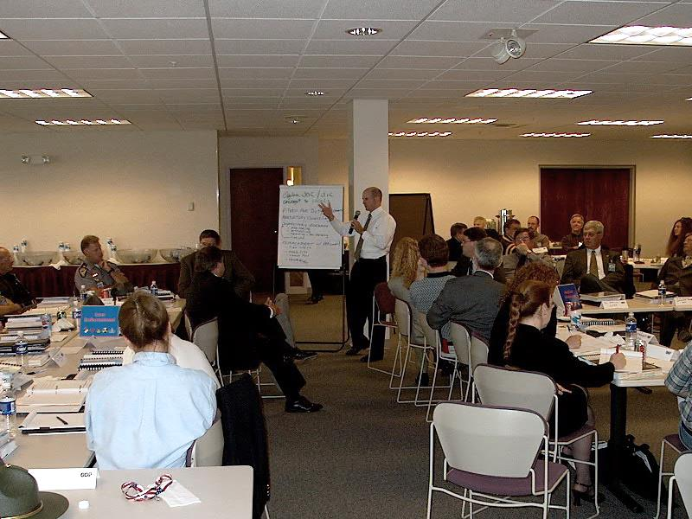
E132: DISCUSSION-BASED EXERCISE DESIGN
AND EVALUATION COURSE
Unit 5: Facilitation and Proficiency Demonstration #3
FEMA News Photo

Slide 2
Unit Objectives
By the end of this unit you will be able to:
  Describe strategies for effectively facilitating discussion-based exercises
  Design, develop, and conduct a tabletop exercise (TTX) for the policy/executive section of the Central City/Liberty County Emergency Operations Center (EOC)

Slide 3
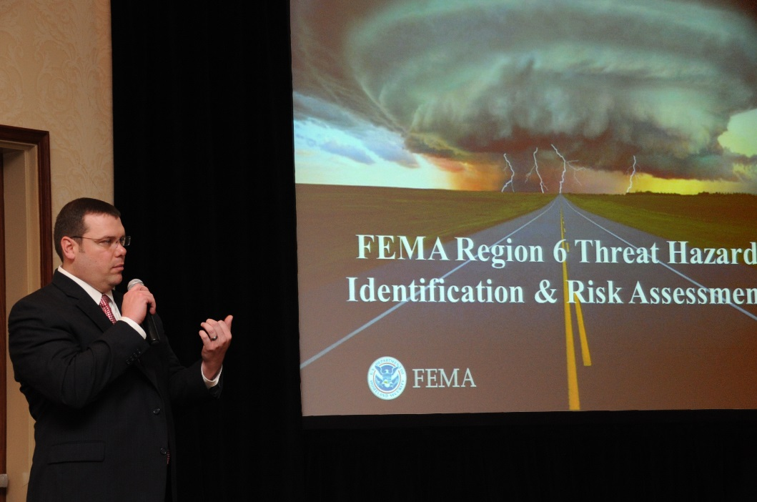
Effective Facilitators
To be an effective facilitator, you should be:
  Flexible
  Adaptive
  Proactive
  Responsive
  Resilient
  Prepared
FEMA/Earl Armstrong

Slide 4
Facilitator Preparation
Know the five Ws about the exercise you are facilitating:
Why?
Who?
When?
Where?
What?

Slide 5
Involvement Strategies
Organize messages
Encourage dialog/participation
Elicit—do not provide—responses and solutions
Make eye contact
Provide positive reinforcement
Redirect, if necessary

Slide 6
Facilitation Tips
Start with easy-to-answer questions
Know your audience and the topic
Keep discussion focused on how critical tasks would be performed
Record all ideas and facts (ask for a participant to keep notes on an easel)
Use opened-ended questions

Slide 7
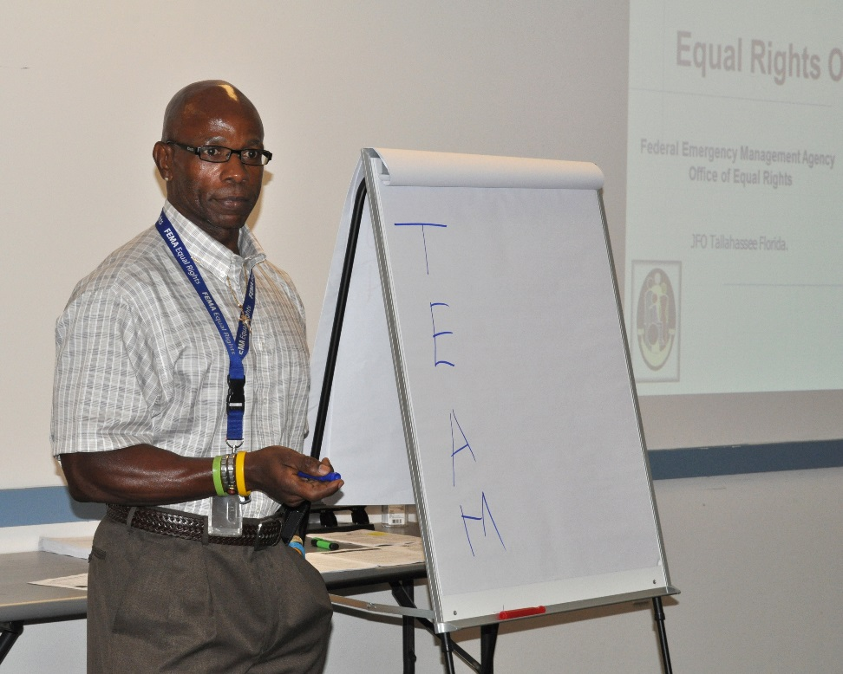
Facilitation Tips (cont’d.)
Face the group
Involve the participants whenever possible
Honor break, lunch, and quitting times
Be prepared
FEMA/Marilee Caliendo

Slide 8
Facilitation Tips (cont’d.)
Encourage group members to speak to each other, not you
Incorporate physical movement
  Use the space you are in (move around)
Manage side conversations
If appropriate, break a large group down into smaller ones for discussion

Slide 9
Facilitation Tips (cont’d.)
Use the silence (do not answer too many questions)
Do not allow the group to transfer ownership of the process, problem, or recommendation to you
Read the group and respond
Always remain neutral, objective, and fair

Slide 10
Facilitation Tips (cont’d.)
Call people by their first name (unless protocol dictates otherwise)
Use courteous language
Never say “I told you so”
Do not be afraid to interrupt people who are rambling or who are attempting to dominate the discussion
Do not embarrass
Don’t shy away from conflict

Slide 11
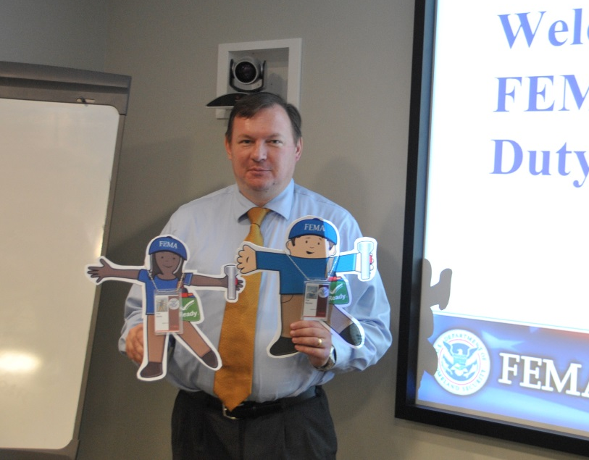
Facilitation Tips (cont’d.)
Preserve the integrity of the group and every individual
Learn to laugh at yourself
BE POSITIVE; when something negative occurs, turn it around
Be enthusiastic
Follow the Golden Rule by showing proper respect to all participants
FEMA/Brittany Trotter

Slide 12
Wrap-Up Activities
Have participants and observers complete participant feedback forms
  Use this feedback to improve future facilitation
Also conduct a debrief/Hot Wash

Slide 13
Unit Summary
In this unit you learned:
  What makes an effective facilitator
  Preparing to be a facilitator
  Strategies to get participants involved
  Facilitation tips
  About wrap-up activities

Slide 14
Questions?

Slide 15
Proficiency Demonstration #3:
Tabletop Exercise

Slide 16
Proficiency Demonstration #3:
Tabletop Exercise
Purpose:
  Practice facilitation skills, and design, develop, and conduct a TTX for Central City/Liberty County
Total time: 3 hours 45 minutes:
  2 hours 15 minutes to prepare the TTX
  1 hour (two 30-minute rounds) for the presentations
  20 minutes for peer/instructor feedback
  10 minutes for internal group feedback

Slide 17
Proficiency Demonstration #3:
Tabletop Exercise (cont’d.)
Deliverables:
  30-minute TTX (HSEEP template)
  Situation Manual (SitMan) (HSEEP template)
  Participant feedback forms (HSEEP template)
  Any job aids or resources necessary for the players of the TTX (formats may vary)
  Sign-in sheets (optional) (Word)

Slide 18
Proficiency Demonstration #3:
Tabletop Exercise (cont’d.)
Scenario:
  Conduct a TTX for the members of the Policy Group of the Liberty County Emergency Operations Center (EOC)
  Base your TTX on your core capabilities from your Multi-Year TEP
  Reminder: This should be a policy level TTX

Slide 19
Proficiency Demonstration #3:
Tabletop Exercise (cont’d.)
Scenario (cont’d.):
  You will conduct your TTX with another group who will be acting as the players in the TTX (i.e., the members of the Liberty County Policy Group):
    Group 1 will present to Group 2
    Group 3 will present to Group 4
    Group 2 will present to Group 1
    Group 4 will present to Group 3

Slide 20
Proficiency Demonstration #3:
Tabletop Exercise (cont’d.)
Scenario (cont’d.):
  Determine which members of the Liberty County Policy Group will be the players in your TTX
    A list of Policy Group members is provided in the ESSD
    Get name tents from instructor
  Each member of the group that will be acting as the TTX players must be assigned a Policy Group role

Slide 21
Proficiency Demonstration #3:
Tabletop Exercise (cont’d.)
Recommendations
  Treat your time in the breakout rooms as a compressed version of the TTX-applicable planning meetings outlined in HSEEP:
    First half of your time: accomplish the tasks from the IPM
    Second half of your time: accomplish the tasks from the FPM
  Consider using the IPM and FPM outcomes listed in HSEEP as a checklist to guide your efforts and help you manage time

Slide 22
Proficiency Demonstration #3:
Tabletop Exercise (cont’d.)
Group roles:
Each group must select the following roles:
  Group Leader (at least one)
  Scribe (at least one)
  Presenter/Facilitator (no more than two)

