Slide 1
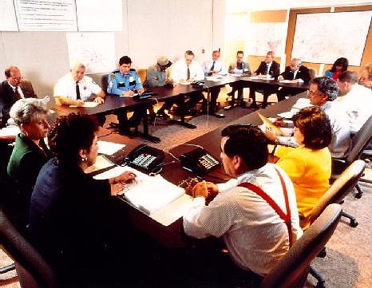
E132: DISCUSSION-BASED EXERCISE DESIGN
AND EVALUATION COURSE
Unit 4: Discussion-Based Exercises Overview
FEMA News Photo

Slide 2
Unit Objectives
By the end of this unit you will be able to:
  Describe the types of discussion-based exercises
  Describe the eight exercise design steps
  Develop SMART objectives
  Design, develop, and conduct a seminar for the Liberty County Policy Group

Slide 3
Types of Discussion-Based Exercises
There are four types of discussion-based exercises:
  Seminars
  Workshops
  Tabletop exercises
  Games

Slide 4
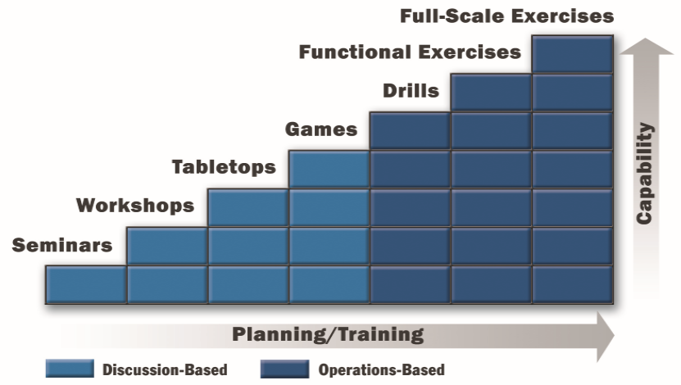
Progressive Approach
  Discussion-based exercises are the first step in the progressive approach to exercises

Slide 5
Eight Exercise Design Steps
Assess needs
Define the scope
Write a statement of purpose
Define objectives
Compose a narrative
Write major and detailed events
List expected actions
Prepare messages
Modified for discussion-based exercises

Slide 6
Eight Exercise Design Steps
Why use the Eight Exercise Design Steps?
  The process is critical to having a systematic exercise design
  They make the exercise process much simpler and smoother
  They are one way of implementing HSEEP
  They are a FEMA and exercise industry best practice
  They improve exercises
  This is where the “mastery” comes in

Slide 7
Step 1: Assess Needs
The best way to determine whether you need an exercise—and what kind of exercise is needed—is to conduct an exercise needs assessment
An exercise needs assessment:
  Defines problems
  Establishes reasons to do an exercise
  Identifies capabilities to be exercised

Slide 8
Begin With Your Plan
An exercise needs assessment should begin with a review of the emergency plan and should address:
  Hazards
  Secondary hazards
  Hazard priority
  Area
  Plans and procedures
  Capabilities
  Players
  Program areas
  Past exercises

Slide 9
Lessons Learned
Learn from past exercises:
  Who participated?
  To what extent were objectives achieved?
  What lessons were learned?
  What problems were revealed, and what is needed to resolve them?
  What improvements have been made since, and have they been tested?

Slide 10
Needs Assessment Results
Primary and secondary hazards
Problems, weak capabilities
Skills requiring practice
Improvements requiring testing
Untested facilities, personnel, equipment
Weaknesses in emergency plan or SOPs
Need for role clarification
Need for certain types of exercises

Slide 11
Needs Assessment Results (cont’d.)
Did you cover the topics listed on the prior slide when assessing the needs for your Multi-year TEP?
Discussion…

Slide 12
Step 2: Define the Scope
Defining the scope = Setting realistic limits
Factors that help define scope:
  Expense
  Availability of personnel and other resources
  Seriousness of the problem
  Capacity of the exercise to address the problem
  Planning team’s skills and experience
  Exercise length

Slide 13
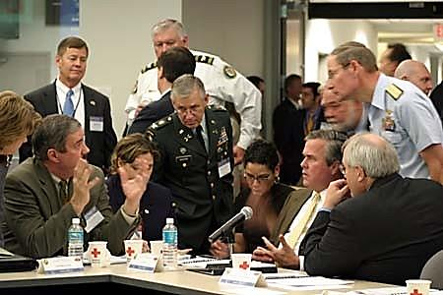
Six Key Elements
Scope includes the:
  Type of emergency/hazard
  Location
  Capabilities
  Participants
  Exercise type
  Duration
FEMA News Photo

Slide 14
Six Key Elements (cont’d.)
When defining the scope of your exercise, what are some factors you would consider in choosing the type of emergency/hazard?
Discussion…

Slide 15
Six Key Elements (cont’d.)
Type of Emergency/Hazard
  In choosing the type of emergency, ask yourself:
    What emergencies will generate the types of actions that need to be practiced?
    What are the high-priority hazards the organization faces?
    What hazards have not been recently exercised?
    Are there problems that have recently developed?
    Are there policy concerns surrounding the hazard/scenario?
    What plans are involved with this hazard/scenario?
    What secondary events might develop as the scenario develops?

Slide 16
Six Key Elements (cont’d.)
Location
  Identify the location where the simulated event will occur
  Consider the logistics of the chosen site

Slide 17
Six Key Elements (cont’d.)
Capabilities
  List the capabilities that the players will exercise (should be supported by the TEP)
  List the operations or functions that the participants will discuss
  Be sure that the procedures within a certain function are clear and narrowly defined

Slide 18
Six Key Elements (cont’d.)
Participants
  Narrow the list to those organizations and individuals who are required to hold a good discussion or carry out the actions
  More is not always better

Slide 19
Six Key Elements (cont’d.)
Exercise Type
  What exercises are most needed?
  What experience have personnel had with various types of exercises?
  What stress level do we want?
  What types of exercises are mandated by regulatory requirements?

Slide 20
Step 3: Write a Statement of Purpose
Purpose statement: A broad statement of the exercise goal
  Governs objectives, which determine subsequent steps
  Clarifies reasons for the exercise
  Is useful for communicating with media and community

Slide 21
Developing the Purpose Statement
Incorporate the scope decisions (type of emergency, location, capabilities, organizations, and exercise type) into a single sentence
Include a date
Sample purpose statements in Participant Guide

Slide 22
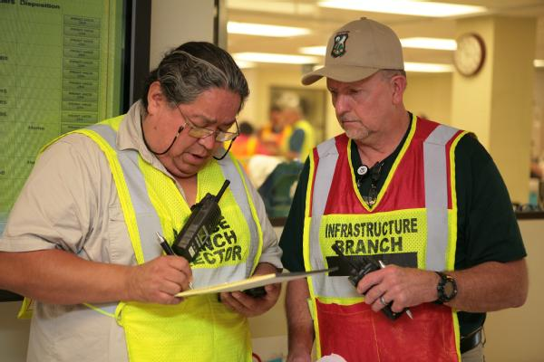
Step 4: Define Objectives
A description of the capabilities and expected actions that should occur
  What the exercise is intended to accomplish
FEMA News Photo

Slide 23
Why Define Objectives?
Objectives are essential for:
  Design process
  Exercise conduct
  Evaluation
  Improvement planning

Slide 24
How are Objectives Determined?
Many objectives become evident at the time of the exercise needs assessment
Objectives are also arrived at by breaking down a purpose statement into its logical components

Slide 25
How Many Objectives?
Typically:
  Tabletop exercises between 3 to 5
  Functional exercises between 4 to 7
  Full-scale exercises 8+
The number of objectives selected for an exercise should be limited

Slide 26
What Makes a “Good” Objective?
Clear, concise, focused on performance
Should contain:
  Action, stated in observable terms
  The entity (agency/jurisdiction) performing that action
  Conditions under which the action will be performed
  Standards (or level) of performance
Should state who should do what under
what conditions according to what standards

Slide 27
Example of a “Good” Objective
Specific action
Discuss the plans for
Central City’s incident command activation of essential HAZMAT personnel during a chemical incident in Central City in accordance with existing standard operating procedures (SOPs).
Who
Condition
Standard

Slide 28
Example of a “Good” Objective (cont’d.)
Standard
Condition
Within 15 minutes
after the evacuation notice is given,
Who
members of the EOC
will complete notification procedures to
school administrators.
Specific action

Slide 29
SMART Objectives
Specific
Measurable
Achievable
Relevant
Time-bound

Slide 30
Writing SMART Objectives
How do you write SMART objectives for a TTX?
Discussion…

Slide 31
Writing SMART Objectives (cont’d.)
Objectives for discussion-based exercises typically focus on strategic, policy-oriented issues
Objectives for operations-based exercises typically focus on the integration of multiple entities and systems-level and tactical-level issues that are physically demonstrated either in an EOC or in the field

Slide 32
Writing SMART Objectives (cont’d.)
Discussion-based exercise example:
  Restoration of Lifelines
    Evaluate Central City’s recovery plan to manage clearing and restoration activities, including the restoration of essential gas, electric, oil, communications, water, sewer, transportation/transportation infrastructure, and other utilities in the aftermath of a catastrophic incident

Slide 33
Writing SMART Objectives (cont’d.)
Share an example of an objective from an exercise you have designed.
Discussion…

Slide 34
Word Choice
Use concrete words
Pay attention to the verb that describes participant performance
  Use action verbs
  Avoid vague verbs

Slide 35
Word Choice (cont’d.)
Useful action verbs include:
  Assess
  Clarify
  Define
  Determine
  Demonstrate
  Establish
  Evaluate
Additional verbs provided in Participant Guide
  Examine
  Explain
  Identify
  Inspect
  List
  Notify
  Operate
  Prepare
  Record
  Report
  Show
  Test

Slide 36
Is This a Useful Objective?
To demonstrate an understanding
of the procedures necessary in protecting responder health and safety

Slide 37
Activity #2:
Good or Poor Objectives?

Slide 38
Activity #2:
Good or Poor Objectives? (cont’d.)
Refer to Activity #2: Example: Good or Poor Objectives? Worksheet in your Participant Guide
Review the objectives and determine if they are good or poor
Record your answers on the worksheet
Work individually
You have 10 minutes to complete the activity

Slide 39
Activity #3:
TTX Objectives

Slide 40
Activity #3: TTX Objectives (cont’d.)
We will run through an example first, then it will be your turn

Slide 41
Activity #3: TTX Objectives
Example
  Who: Central City Policy Group
  What: Long-term housing
  Conditions: Post-catastrophic dam failure
  Standards: National Long Term Housing Strategy

Slide 42
Activity #3: TTX Objectives (cont’d.)
SMART Objective
  The Central City Policy Group will discuss long-term housing strategies and options in response to a catastrophic dam failure in accordance with the National Long Term Housing Strategy.

Slide 43
Activity #3: TTX Objectives (cont’d.)
Refer to Activity #3: TTX Objectives Worksheet in your Participant Guide (2 pages)
    Part One: Create SMART objectives for a discussion-based exercise using the information provided
    Part Two: Create SMART objectives for a discussion-based exercise using your group’s disaster category and priority
Record your answers on the worksheet

Slide 44
Activity #3: TTX Objectives (cont’d.)
PART ONE
Objective #1:
  Who: Central City Policy Group
  What: Citizen warning
  Condition: Tornado
  Standard: Central City/Liberty County Basic Emergency Plan

Slide 45
Activity #3: TTX Objectives (cont’d.)
PART ONE (cont’d.)
Objective #2:
  Who: Central City Policy Group
  What: Economic Recovery
  Condition: Category 3 Hurricane
  Standard: FEMA’s National Disaster Recovery Framework and Recovery Support Functions

Slide 46
Activity #3: TTX Objectives (cont’d.)
PART ONE (cont’d.)
Objective #3:
  Who: Central City Policy Group
  What: Mandatory Evacuation
  Condition: Category 3 Hurricane
  Standard: Central City/Liberty County Basic Emergency Plan

Slide 47
Activity #3: TTX Objectives (cont’d.)
PART TWO
Create two SMART objectives for a discussion-based exercise applicable to your group’s disaster category and priority
Record your answers on the worksheet
Work in your groups
You have 15 minutes to complete PART TWO

Slide 48
Step 5: Compose a Narrative
Narrative: A brief description of the scenario events that have occurred up to the beginning of the exercise
  Sets participant interest
  Provides information that sets the stage for later action

Slide 49
Narrative Characteristics
A good narrative:
  Is located in the SitMan
  Is usually divided up into modules that represent time
  Is very specific
  Is phrased in present tense
  Is written in short sentences
  May develop the situation chronologically (event with warning time)
  May emphasize the emergency environment

Slide 50
Example: Airplane Crash Narrative
  Read the Airplane Crash Narrative in your PG, and then answer the following questions:
  What is the event?
  How fast, strong, deep, or dangerous is it?
  How did you find out?
  What response has been made?
  What damage has been reported?
  What is the sequence of events?
  How much time has elapsed?
  Was there advance warning?
  Where does it take place?
  What are the relevant weather conditions?
  What other factors would influence emergency procedures?
  What is predicted for the future?

Slide 51
SitMan
Core documentation that provides the background for a facilitated exercise
Supports the scenario narrative
Serves as the primary reference material for ALL participants during conduct
Expected actions do not go in the SitMan

Slide 52
SitMan (cont’d.)
Generally include the following information:
  Exercise scope, objectives, and core capabilities
  Exercise assumptions and artificialities
  Instructions for exercise participants
  Exercise structure (e.g., the order of the modules)
  Exercise scenario background (including scenario location information)
  Discussion questions and key issues
  Schedule of events

Slide 53
SitMan (cont’d.)
Appendices may include:
  Relevant documents (plans, SOPs, etc.)
  Specific threat information for jurisdictions or organizations
  Material safety data sheet or fact sheet, where appropriate
  List of reference terms

Slide 54
SitMan (cont’d.)
Introduction section
  Provides an overview of the exercise as well as an exercise agenda
Scenario Narrative section
  Divided into distinct, chronologically sequenced modules
  Each module:
    Represents a specific time segment of the overall scenario
    Is followed up with discussion questions

Slide 55
SitMan (cont’d.)
Share a few examples of good discussion questions you have used in the past, or if you have a “go-to” set of discussion questions.
Discussion…

Slide 56
Step 6: Write Major and Detailed Events
Major and detailed events are occurrences that take place after, and as a result of, the emergency described in the narrative
The goal is to provide a structure that will:
  Link the simulated event to the actions you want people to take
  Provide unity to the exercise

Slide 57
Step 7: List Expected Actions
The responses, actions, or decisions that you want participants to have or carry out to demonstrate competence
It’s necessary to identify expected actions to develop discussion questions and guide facilitation
Knowing who should know what allows you to develop discussion questions that target those participants and responsibilities as well as provide a guide for your facilitators to follow

Slide 58
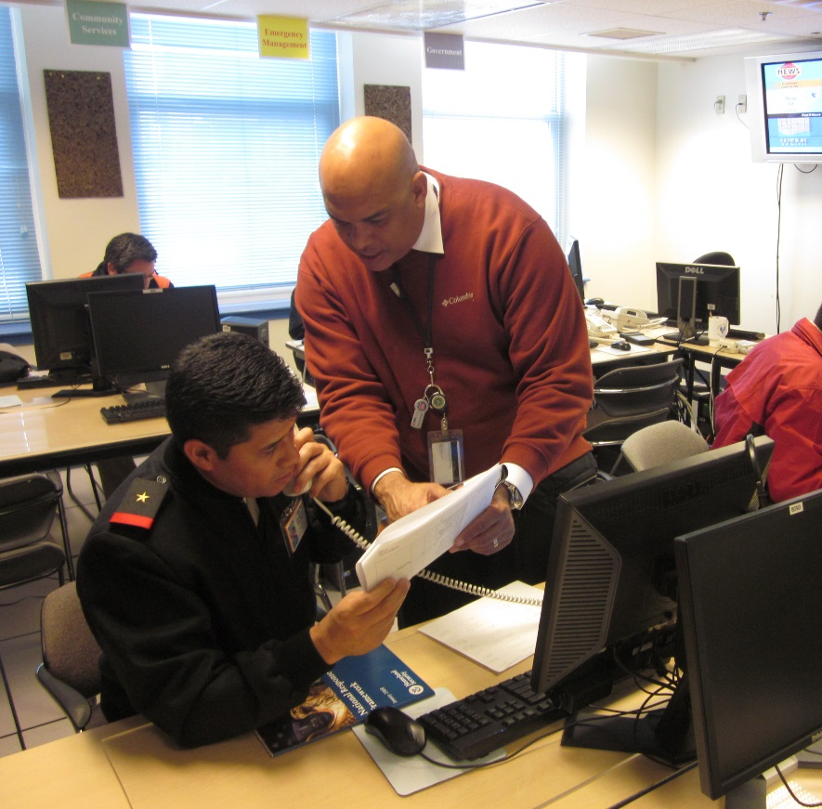
Step 8: Prepare Messages
Messages (injects) are used to communicate detailed events to exercise participants
Messages serve one purpose: to evoke a response
FEMA/Heather Beebe

Slide 59
Participant Feedback Forms
After the exercise is conducted, you’ll need to capture the participants’ feedback on the exercise design
Participant feedback forms
  Ask for input regarding observed strengths and areas for improvement
  Provide players the opportunity to give constructive criticism about the design, control, or logistics of the exercise
All exercises should use participant feedback forms

Slide 60
Participant Feedback Forms (cont’d.)
At a minimum, questions on the Participant Feedback Form should solicit:
  Impressions about exercise conduct and logistics
  Strengths and areas for improvement pertaining to the implementation of participating agencies and organizations’ policies, plans, and SOPs;
  Improvements to future exercises
  Level of satisfaction

Slide 61
Participant Feedback Forms (cont’d.)
It is important to customize the Participant Feedback Form to capture the exact information you need for your specific exercise
There are any number of ways you can customize a participant feedback form

Slide 62
Planning Meetings
Concepts & Objectives (C&O) Meeting*
Initial Planning Meeting (IPM)**
Mid-Term Planning Meeting (MPM)*
Master Scenario Events List (MSEL) Meeting*
Final Planning Meeting (FPM)
* Not necessary or typically not conducted for TTXs or operations-based exercises
** C&O Meeting topics are covered at the IPM when a C&O Meeting is not conducted

Slide 63
Planning Meetings (cont’d.)
Share how you conduct your planning meetings.
  What topics do you discuss?
  What are your outcomes?
Discussion…

Slide 64
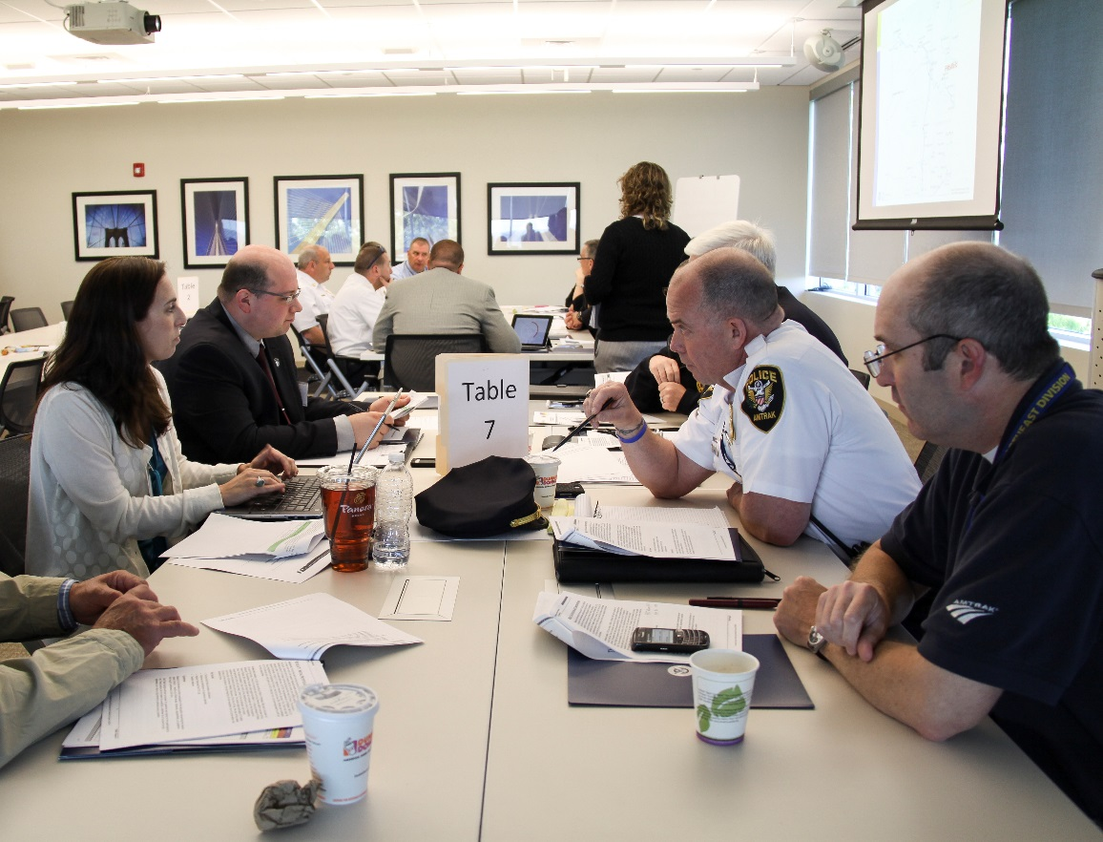
TTX Demonstration Video
FEMA/Eilis Maynard

Slide 65
Unit Summary
In this unit you learned:
  About the four types of discussion-based exercises
  The eight exercise design steps
  The application of the eight exercise design steps to a discussion-based exercise

Slide 66
Questions?

Slide 67
Proficiency Demonstration #2:
Seminar

Slide 68
Proficiency Demonstration #2:
Seminar
Purpose:
  Design, develop, and conduct a seminar about the
  Multi-year TEPs you developed in Proficiency Demonstration #1
Total time: 2 hours 40 minutes
  1 hour to prepare the seminar
  1 hour 10 minutes (two 35-minute rounds, including questions) for the presentations
  20 minutes for peer/instructor feedback
  10 minutes for internal group feedback

Slide 69
Proficiency Demonstration #2:
Seminar (cont’d.)
Deliverables:
  30-minute seminar on your group’s Multi-year TEP (PowerPoint)
  Participant feedback forms (HSEEP template)

Slide 70
Proficiency Demonstration #2:
Seminar (cont’d.)
Scenario:
  The Liberty County Emergency Management Policy Group has requested a seminar on the newly developed Liberty County/State of Columbia
  Multi-year TEP
  Base your seminar on the Multi-year TEPs you developed in Proficiency Demonstration #1

Slide 71
Proficiency Demonstration #2:
Seminar (cont’d.)
Scenario (cont’d):
  You will present your 30-minute seminar to another group who will be acting as the Liberty County Policy Group:
    Group 1 presents to Group 3
    Group 2 presents to Group 4
    Group 3 presents to Group 1
    Group 4 presents to Group 2
  The goal is to sell your Multi-year TEP to the Policy Group and get the group’s approval for the necessary funding

Slide 72
Proficiency Demonstration #3:
Tabletop Exercise (cont’d.)
Scenario (cont’d.):
  Determine which members of the Liberty County Policy Group will be audience members for your seminar
    A list of Policy Group members is provided in the ESSD
    Get name tents from instructor
  Each member of the group that will be acting as the seminar audience must be assigned a Policy Group role
    Refer to the Policy Group Job Descriptions in your Participant Guide

Slide 73
Proficiency Demonstration #2:
Seminar (cont’d.)
Group roles:
Each group must select the following roles:
  Group Leader (at least one)
  Scribe (at least one)
  Presenter/Facilitator (no more than two)

