Slide 1
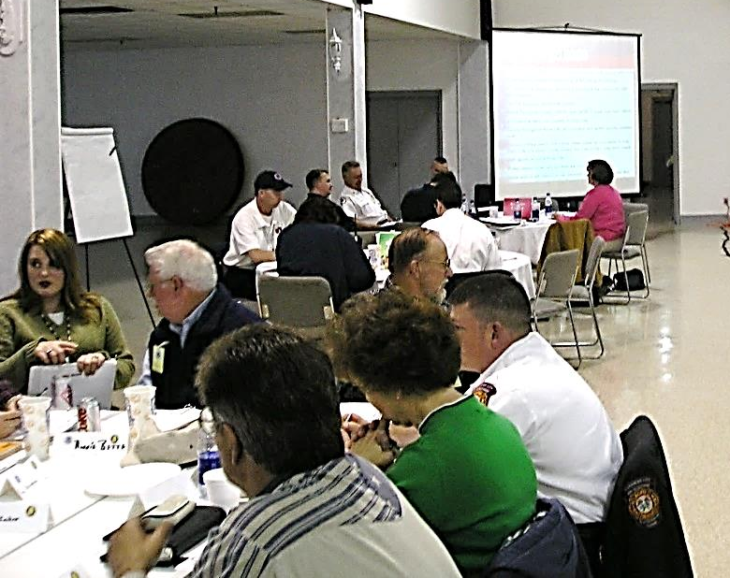
E132: DISCUSSION-BASED EXERCISE DESIGN
AND EVALUATION COURSE
Unit 3: Progressive Exercise Program (PEP) and Proficiency Demonstration #1
FEMA News Photo

Slide 2
Unit Objectives
By the end of this unit you will be able to:
  Describe the policy that is relevant to the MEP Program
  Define “whole community” and the five mission areas of emergency management
  Describe the components of a Progressive Exercise Program (PEP)

Slide 3
Unit Objectives (cont’d.)
  Describe the process for developing and/or updating the Multi-year Training and Exercise Plan (TEP)
  Develop a Multi-year TEP in accordance with Homeland Security Exercise and Evaluation Program (HSEEP), using Central City/Liberty County information from the ESSD

Slide 4
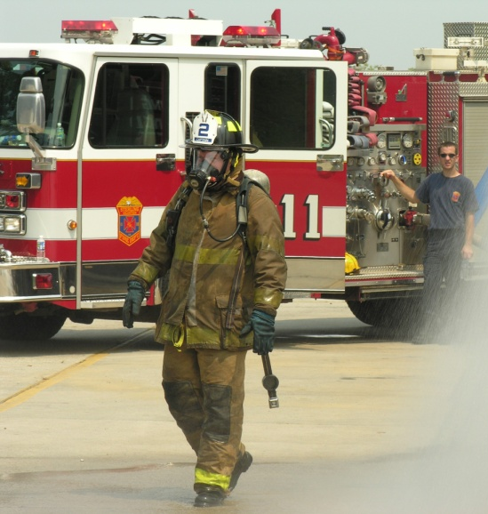
Why Exercise?
Reveal planning weaknesses and gaps
Improve coordination,
collaboration,
and communications
Clarify roles
and responsibilities
Know grant-funded
exercise requirements
(e.g., EMPG, ASPR)
FEMA News Photo

Slide 5
Why Exercise? (cont’d.)
Meet regulatory and statutory exercise requirements
Meet standards requirements (e.g., EMAP)
Foster successful responses to real life disasters—it is not a question of “if” but “when”
Video: Tuscaloosa, AL

Slide 6
Why Exercise? (cont’d.)
How has an exercise led your community to be
better prepared?
Discussion…

Slide 7
Whole Community
PPD-8 emphasizes that national preparedness is the shared responsibility of the whole community
The whole community approach is long term and encompasses all hazards and all levels of government
Don’t develop your exercise in a vacuum

Slide 8
Whole Community (cont’d.)
Strategic themes:
  Understand community complexity
  Recognize community capabilities and needs
  Foster relationships with community leaders
  Build and maintain partnerships
  Empower local action
  Leverage and strengthen social infrastructure, networks, and assets

Slide 9
Whole Community (cont’d.)
Benefits:
  Shared understanding of community needs and capabilities
  Greater empowerment and integration of resources from across the community
  Stronger social infrastructure

Slide 10
Whole Community (cont’d.)
Benefits (cont’d.):
  Establishment of relationships that facilitate more effective prevention, protection, mitigation, response, and recovery activities
  Increase individual and collective preparedness
  Greater resiliency at both the community and national levels

Slide 11
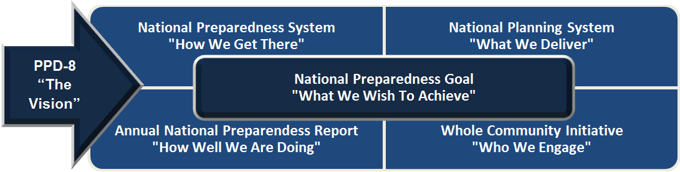
PPD-8
Presidential Policy Directive 8 (PPD-8): National Preparedness describes the nation’s approach to national preparedness

Slide 12
PPD-8
Two of the PPD-8 elements are important for MEP:
  National Preparedness Goal
  National Preparedness System

Slide 13

National Preparedness Goal
The cornerstone for PPD-8 implementation
Describes the goal of our nation’s security:
      “A secure and resilient Nation with the capabilities required across the whole community to prevent, protect against, mitigate, respond to, and recover from the threats and hazards that pose the greatest risk.”

Slide 14
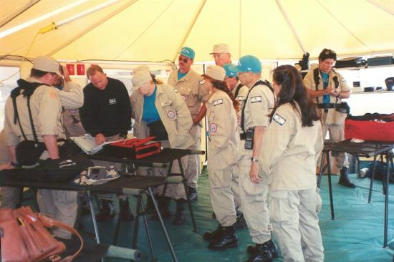
Five Mission Areas of Emergency Management
Identified within the goal are the nation’s core capabilities. These core capabilities are essential for the execution of each of the five mission areas of emergency management:
  Prevention
  Protection
  Mitigation
  Response
  Recovery
FEMA News Photo

Slide 15
Core Capabilities (cont’d.)
Core capabilities are highly interdependent and require us to:
  Use existing preparedness networks and activities
  Improve training and exercise programs
  Promote innovation
  Ensure that the administrative, finance, and logistics systems are in place to support these capabilities
Organizations can use exercises to examine current and required core capability levels

Slide 16

National Preparedness System
The instrument the nation employs to build, sustain, and deliver the core capabilities to achieve the National Preparedness Goal

Slide 17
National Preparedness System (cont’d.)
Six components:
  Identifying and assessing risk
  Estimating capability requirements
  Building and sustaining capabilities
  Planning to deliver capabilities
  Validating capabilities
  Reviewing and updating

Slide 18
National Preparedness System (cont’d.)
Validating Capabilities
  Measuring progress toward achieving the National Preparedness Goal provides the means to decide how and where to allocate scarce resources and prioritize preparedness
    One way this can be achieved is through exercises
    An effective and comprehensive whole community exercise program is essential to the success of the National Preparedness System

Slide 19
National Preparedness System (cont’d.)
Validating Capabilities (cont’d.)
  Exercises are conducted to test and validate plans, policies, procedures, and capabilities
  By highlighting strengths and revealing gaps,
  whole-community-based exercises facilitate the nation’s ability to validate capabilities and evaluate progress toward meeting the National Preparedness Goal

Slide 20
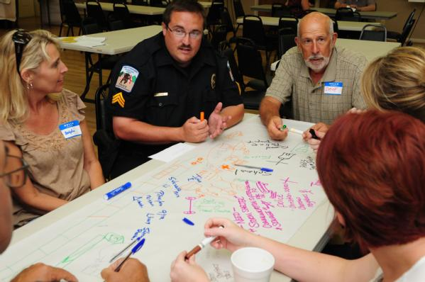
National Exercise Program
The principal exercise mechanism for examining national preparedness and measuring readiness
FEMA News Photo

Slide 21
HSEEP
Supporting NEP
Provides the guidance and tools for the design, implementation, and evaluation of exercises
Developed as guidance to support:
  Common framework for exercise development, conduct, and evaluation
  Common terminology
  Consistent documentation

Slide 22
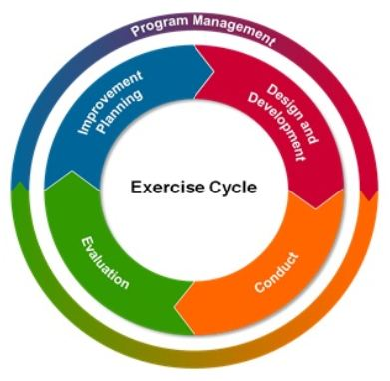
HSEEP (cont’d.)
HSEEP supports the national preparedness mission areas and ensures a consistent and integrated approach to all phases of the exercise cycle.

Slide 23
HSEEP (cont’d.)
Two key elements of HSEEP’s approach:
Using a progressive approach
Developing a Multi-year Training and Exercise Plan (TEP)

Slide 24
HSEEP (cont’d.)
Using a Progressive Approach
  Implementing a Progressive Exercise Program (PEP), a long-term program with long-range goals, in which exercises are:
    Anchored to a common set of objectives
    Built toward an increasing level of complexity
    over time
    Involvement of the participation of multiple entities
  Each exercise is linked to a set of common program priorities and is designed to test associated capabilities

Slide 25
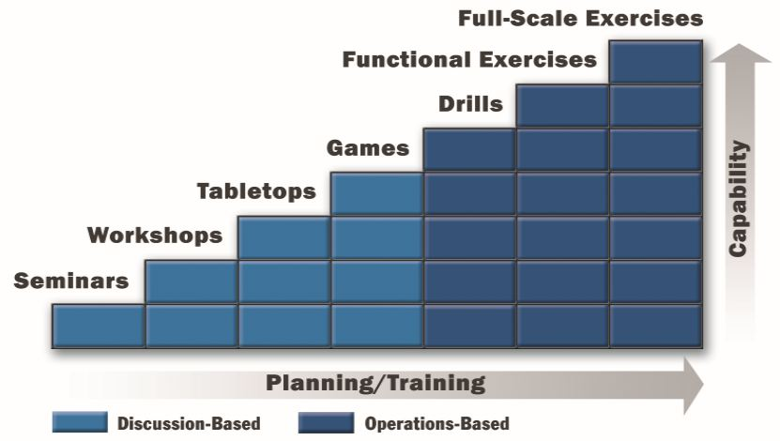
HSEEP (cont’d.)
Using a Progressive Approach (cont’d.)
  Each exercise builds on previous exercises, using more sophisticated simulation techniques or requiring more preparation time, personnel, and planning

Slide 26
HSEEP (cont’d.)
Share an example of a progressive exercise approach in your community:
  What type of exercise did you start with and what did you end with?
Discussion…

Slide 27
HSEEP (cont’d.)
Developing a Multi-year TEP
  Aligns exercise activities and supporting training to exercise program priorities
  The Multi-year TEP outlines:
    Program priorities
    Core capabilities
    A combination of exercises and associated
    training courses
  Also contains the Multi-year TEP schedule

Slide 28
HSEEP (cont’d.)
Developing a Multi-year TEP (cont’d.)
  Developed through a TEP Workshop (TEPW)
  The purposes of the TEPW include:
    Translate priorities into exercise activities and associated training
    Assess capabilities/preparedness levels of participating agencies
    Identify a cycle of exercises that increase
    in complexity
    Prepare Multi-year TEP and schedule

Slide 29
Why Exercise? (cont’d.)
Share your experience with a TEPW:
  Who was involved?
  What were the results/outcomes?
Discussion…

Slide 30
HSEEP (cont’d.)
Developing a Multi-year TEP (cont’d.)
  Purposes of the TEPW (cont’d.):
    Coordinate training of exercise activities
    Track improvement plan actions
    Manage grant coordination
    Coordinate exercise schedules at local, state, regional, and tribal levels to eliminate duplicative efforts

Slide 31
HSEEP (cont’d.)
Developing a Multi-year TEP (cont’d.)
  TEPWs are held on a periodic basis
  When identifying stakeholders, consider individuals from organizations throughout the whole community
  Maintain a manageable number of participants
    You may need to conduct multiple TEPWs

Slide 32
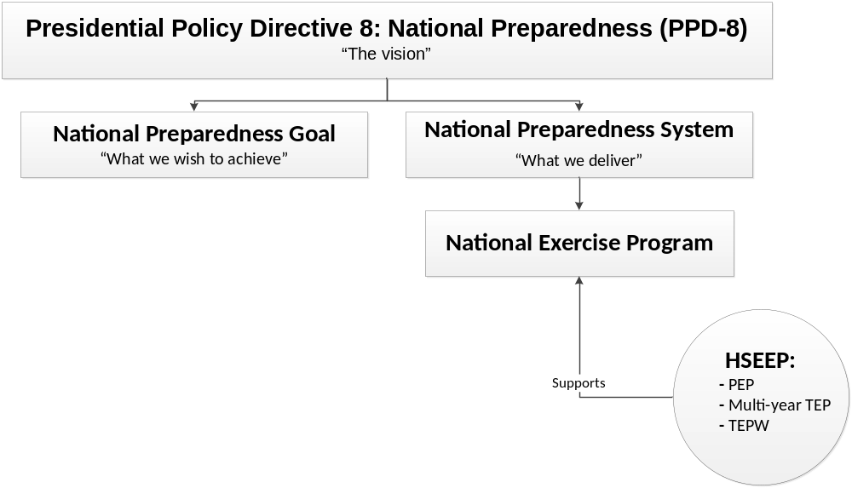
Policy Summary

Slide 33
Creating a Multi-year TEP
Priorities
  Factors in developing exercise program priorities:
    AAR/IPs from previous exercises and real-world incidents
    Summary information from the THIRA
    Areas for improvement/capabilities
    External source information (e.g., surveys, exercise needs assessments)
    Accreditation standards/regulations (e.g., EMAP)

Slide 34
Creating a Multi-year TEP (cont’d.)
Exercises
  For each priority, determine the type of exercise(s) needed to meet the priority and achieve the associated capabilities
    Ensure that a progressive approach is applied to the exercises
    Include the whole community

Slide 35
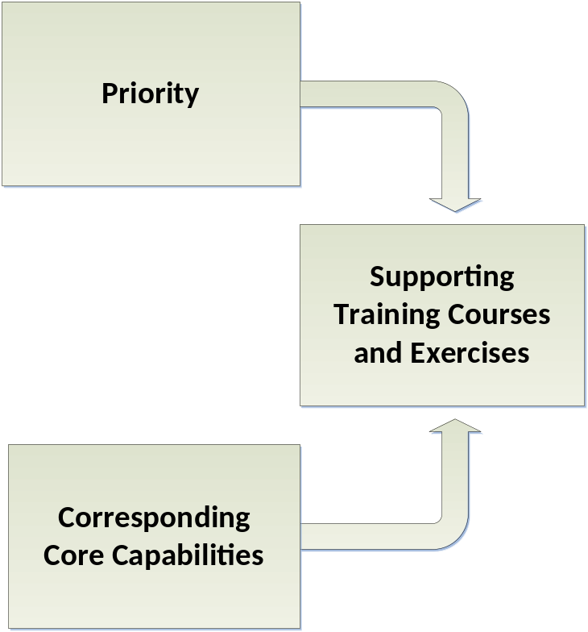
Creating a Multi-year TEP (cont’d.)
Example
  Priority = Strengthen CBRNE detection, response, and decontamination capabilities
  Corresponding Core Capabilities = Environmental Response/Health and Safety; Screening, Search, and Detection
  Supporting Training Courses and Exercises = WMD/HAZMAT awareness-level training,
  TTX, and FSE

Slide 36
Creating a Multi-year TEP (cont’d.)
Is it necessary to exercise worst case? Why or why not?
Discussion…

Slide 37
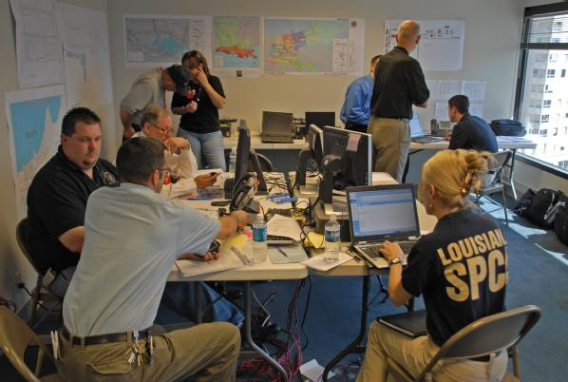
Creating a Multi-year TEP (cont’d.)
Exercising worst case:
  A scenario should not be so overwhelming that it precludes the exercising level of government from being able to function
  The purpose of an
  exercise is to improve
  response, not to
  overwhelm the
  participants to the
  point they give up
FEMA News Photo

Slide 38
Creating a Multi-year TEP (cont’d.)
Evaluation
All exercises activities should be evaluated at an appropriate level of complexity
After-Action Reports (AARs) and Improvement Plans (IPs) should be submitted for all exercise activities and real-world events

Slide 39
Creating a Multi-year TEP (cont’d.)
Multi-year TEP Schedule
  The Multi-year TEP schedule should:
    Graphically illustrate the exercises scheduled in the Multi-year TEP
    Include a combination of training courses and exercise types necessary to accomplish the priorities
    Employ increasing degrees of complexity and ensure a continuous progression/improvement of capabilities
    Emphasize coordination and de-confliction

Slide 40
Creating a Multi-year TEP (cont’d.)
Multi-year TEP Schedule (cont’d.)
  To identify the appropriate type and timeline for exercises, consider:
    Current capabilities
    The jurisdiction’s priorities
    Capabilities-based planning tools
    Personnel training and equipment acquisition schedules
    The jurisdiction’s exercise experience

Slide 41
Creating a Multi-year TEP (cont’d.)
Multi-year TEP Schedule (cont’d.)
  The schedule is broken into quarters and months
    If an exercise or training is “TBD,” enter the information in the appropriate quarter or month
    If the exercise type is not yet known, place an “X” in the appropriate location
  At a minimum, the schedule should reflect a
  three-year period

Slide 42
Unit Summary
In this unit you learned:
  About the policy that guides the creation of the
  Multi-year TEP:
    PPD-8
    National Preparedness Goal and National
    Preparedness System
    National Exercise Program and HSEEP (PEP,
    Multi-year TEP, TEPW)
  Guidance for creating a Multi-year TEP, including determining priorities, exercises, evaluation, and the TEP schedule

Slide 43
Questions?

Slide 44
Proficiency Demonstration #1:
Multi-year TEP

Slide 45
Proficiency Demonstration #1:
Multi-year TEP
Core capabilities:
  In addition to the assigned core capability, your group can choose additional capabilities
  (Choose wisely again, you will stick with these all three weeks)
  Make your selections while working on Proficiency Demonstration #1

Slide 46
Proficiency Demonstration #1:
Multi-year TEP (cont’d.)
Purpose:
  Develop a Multi-year TEP in accordance with HSEEP, using Central City/Liberty County information from the ESSD
Total time: 2 hours 30 minutes
  2 hours 20 minutes to complete all deliverables
  10 minutes for internal group feedback

Slide 47
Proficiency Demonstration #1:
Multi-year TEP (cont’d.)
Deliverables:
  TEPW (HSEEP template)
  Multi-year TEP that includes at least the following exercises over a three-year cycle (HSEEP template):
    One tabletop exercise (TTX) (policy level)
    One functional exercise (FE)
    One full-scale exercise (FSE)
  NOTE: Your TEP schedule should visually display the
  3-year cycle
  Training (Word)

Slide 48
Proficiency Demonstration #1:
Multi-year TEP (cont’d.)
TEP Approval:
  Your TEP lays the groundwork for your future Proficiency Demonstrations; therefore, you must get acceptance from your group and approval from your group instructor to complete this Proficiency Demonstration
    Once completed, have all group members and group instructor review the TEP and provide feedback (you may want to provide a quick briefing to all)
    Ensure the TEP is reviewed early enough to allow time to implement feedback and finalize your TEP
    The TEP must be finalized and accepted by your group instructor by the end of this Proficiency Demonstration

Slide 49
Proficiency Demonstration #1:
Multi-year TEP (cont’d.)
Scenario:
  After analyzing last year’s improvement plans, Liberty County/State of Columbia has decided to develop a Multi-year TEP
  Base the TEP on your group’s disaster category, priority, and core capabilities
  Use the information provided in Section 3.0, Hazard/Vulnerability Analysis (HVA), of the ESSD

Slide 50
Proficiency Demonstration #1:
Multi-year TEP (cont’d.)
Group roles:
Each group must select the following roles:
  Group Leader (at least one)
  Scribe (at least one)
  Presenter/Facilitator (at least two)
These roles will be used for all Proficiency Demonstrations, and each group member must play each role at least once

