Slide 1

E132: DISCUSSION-BASED EXERCISE DESIGN
AND EVALUATION COURSE
Unit 2: Exercise Community Orientation

Slide 2
Unit Objectives
By the end of this unit you will be able to:
  Use the ESSD to identify information about the State of Columbia’s geography, history, facilities, government, and emergency management

Slide 3
Activity #1:
Welcome to the State of Columbia

Slide 4
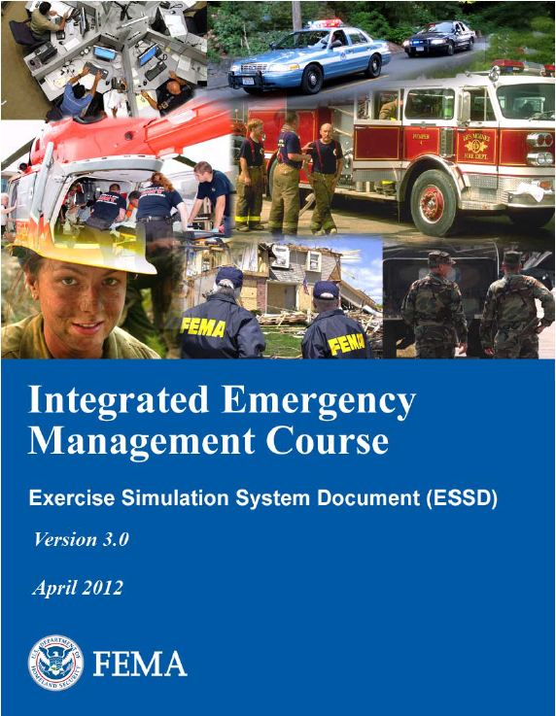
About the ESSD
The ESSD:
  Is a compilation of emergency management information and resources that would typically be available in any community
  Provides support for exercises
Not ALL Communities are set up like the community described in the ESSD

Slide 5
Group Assignments
Group | Assigned Core Capability | Chosen Core Capability
Group 1 | Critical Transportation
Group 2 | Logistics and Supply Chain Management
Group 3 | Mass Care Services
Group 4 | Public Health, Healthcare, and Emergency Medical Services

Slide 6
Section 3.0 – Hazard Vulnerability Analysis
Review the HVA in Section 3.0 (including the After Action Report)
Identify what core capabilities you would consider including in your exercise plan
List and describe why

Slide 7
Section 8.0 – Basic Emergency Plan
Review the EOP for Central City/Liberty County.
Identify what aspects of the basic EOP are relevant to your exercise plan
List and describe why

Slide 8
Appendix K – Private Sector Resources
Review Appendix K.
Identify what private sector resources would be essential to your exercise plan
List and describe why

Slide 9
Appendix N – Mass Care, Housing and Human Services
Appendix P - Shelter Info
Review Appendix N & Appendix P
Identify what mass care and sheltering resources are essential to your exercise plan
List and describe why

Slide 10
Appendix AA – Org Charts, Checklists and Forms
Review Appendix AA
Identify what organization charts, checklists and/or forms are essential to your exercise plan
List and describe why

Slide 11
Unit Summary
In this unit you learned:
  About the Exercise Simulation System Document (ESSD)
  About FEMA’s fictional state, Columbia
  Where in the ESSD specific information is located

Slide 12
Questions?

