Slide 1

E132: DISCUSSION-BASED EXERCISE DESIGN
AND EVALUATION COURSE
Unit 1: MEPP Introduction and
Course Overview

Slide 2
Unit Objectives
By the end of this unit you will be able to:
  Identify requirements for the MEPP certificate
  Describe the agenda for the E132: Discussion-Based Exercise Design and Evaluation Course
  Identify appropriate course conduct policies

Slide 3
Introductions
In 15 seconds or less:
  Name
  Position title and organization
  Work location
  Exercise experience—select all that apply:
    Planner
    Controller
    Player
    Evaluator

Slide 4
Master Exercise Practitioner Program
MEPP is NOT a master’s degree in exercises because EMI is NOT an academic degree-granting institution
EMI awards individuals 2.5 Continuing Education Units (CEUs) (7.5 total CEUs for the MEPP series)

Slide 5
MEPP Requirements
E132 Resident
Course
E133 Resident
Course
and
TTX Proficiency
Demonstration
(Take-Home)
E136 Resident
Course
and
Functional Proficiency
Demonstration
(Take-Home)

Slide 6
The Foundation for MEPP is HSEEP
The foundation for instruction/activities is HSEEP
HSEEP standardizes methodology and terminology for exercise design and development, conduct, evaluation, and improvement planning
HSEEP provides guidelines to support the whole community initiative

Slide 7
Proficiency Demonstrations
  The means to demonstrate mastery of the exercise principles taught in MEPP
The completion of exercise tasks that produce exercise products, activities, and outcomes
Require action and meaningful participation
Must be completed to receive a MEPP certificate of completion

Slide 8
Proficiency Demonstrations (cont’d.)
Following a progressive approach, during MEPP you will develop, conduct, and/or evaluate:
  Multi-Year Training and
  Exercise Program (TEP)
  Seminar
  Tabletop Exercise (TTX)
  SimCell Simulation
  Functional Exercise (FE)
  AAR/IP
  Full-scale exercise (FSE)
E132
E133
E136

Slide 9
Proficiency Demonstrations (cont’d.)
The Proficiency Demonstrations belong to you
A core capability will be provided to each group; the rest is up to you
Each group will create their own exercises/materials based on their core capabilities

Slide 10
Core Capability Assignments
Exercise Planning Team | Assigned Core Capability | Chosen Core Capability
1 | Critical Transportation
2 | Logistics and Supply Chain Management
3 | Mass Care Services
4 | Public Health, Healthcare, and Emergency Medical Services

Slide 11
Proficiency Demonstrations – Take Home
Most Proficiency Demonstrations are completed in group settings in class
Two take-home, between-class Proficiency Demonstrations are completed individually, outside of class
  Between courses E132 and E133, and between courses E133 and E136
The take-home Proficiency Demonstrations are to be submitted 3-weeks prior to the start of the next course

Slide 12
Proficiency Demonstrations
You will be graded using a scored rubric
A passing score is 75
Anything over a 90 qualifies for the Learning Resource Center’s archive

Slide 13
HSEEP Templates
For the purposes of MEPP, all Proficiency Demonstrations and activities should use the current HSEEP templates, when available
  Do not customize
Benefits of using the templates:
  Demonstrates an understanding of the template content
  Ensures that everyone is speaking the same language
  Manages expectations
One exception: Participant Feedback Form
  You may customize this form to capture the exact kind of
  information you need

Slide 14
Peer Review
The MEP Program centers on learning and growing from each other
During the course, you will be given opportunities to provide feedback to your peers
Keep in mind the following ground rules:
  Treat others as you want to be treated
  Be professional in everything you say and do
  Be prepared to provide a possible solution to any item you identify as needing improvement
  Be open to suggestions

Slide 15
Peer Review (cont’d.)
This is a no-fault learning environment where we have an opportunity to expand our knowledge
Remember:
  We are all in this together
  Some of us have more experience and knowledge than others—none of us knows everything
  Share when you can; learn when you can
  A rising tide raises all boats

Slide 16
E132 Course Goals
The goals of this course are for participants
to better:
  Develop a multi-year training and exercise program that coordinates exercise operations with counterparts from the whole community
  Apply the four phases of the exercise cycle—design and development, conduct, evaluation, and improvement planning—to discussion-based exercises

Slide 17
E132 Course Objectives
Upon completion of this course, you will be able to:
  Apply the principles and associated resources of the HSEEP as they relate to discussion-based exercises
  Develop and implement a progressive exercise program for your jurisdiction

Slide 18
E132 Course Materials
Participant Guide
  Course units
  Acronym list
Liberty County/Central City “Exercise Simulation System Document” (ESSD)

Slide 19
E132 Course Agenda
E132 Discussion-Based Exercise Design and Evaluation
  Course units and Proficiency Demonstrations
  Schedule variations may occur

Slide 20

Campus Administration
Class registration
Classrooms
Parking
Meals
Emergency procedures
Walking around campus
Recreation
NETC evaluations
FEMA/Jocelyn Augustino

Slide 21
NETC Evaluation Form: Block #3 – Work Location
NETC EVALUATION FORM: BLOCK #3 - Work Location
54
30
32
27
NH-34
VT-53
55
25
41
46
17
57
26
38
33
16
37
39
42
18
19
50
07
20
28
56
21
51
06
47
MA-23
MD-24
RI-44
CT-08
NJ-35
DE-11
DC-10
40
03
31
05
36
45
29
02
13
49
01
22
15
12
American Samoa-04 Virgin Islands-52
Puerto Rico-43 U.S. Trust Territories- 48
Guam-14 Canal Zone-09 Other-58
1.21

Slide 22
Shared Drive
Resources
Proficiency Demonstration materials
Folder in which to save your Proficiency Demonstration deliverables
Shared Drive Quick Reference in Participant Guide
  “How To” instructions
Saving files and naming conventions

Slide 23
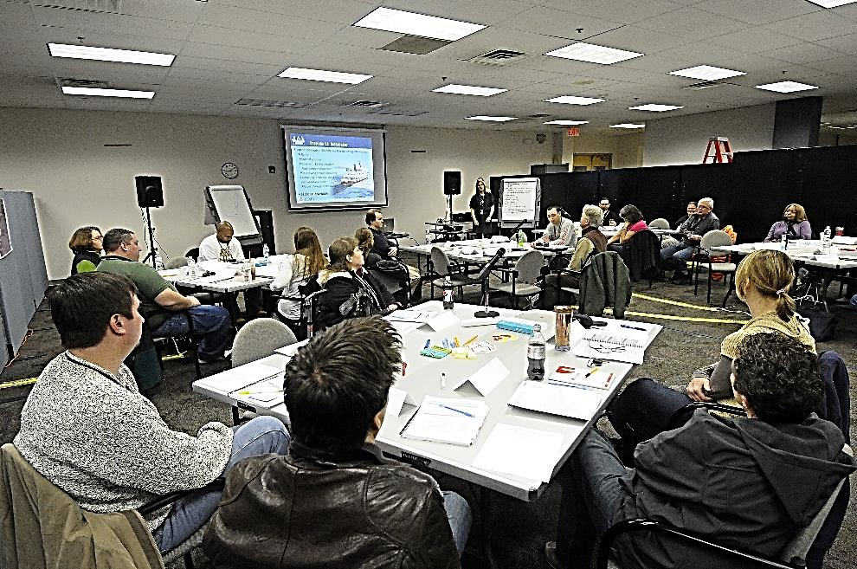
Course Conduct
Attendance
Technology courtesy
Sharing knowledge
Lunch and breaks
FEMA/Hans Pennink

Slide 24
Unit Summary
In this unit you learned:
  About each other and the importance of
  sharing knowledge
  The requirements for the MEP certificate title
  About the objectives, materials, and agenda for the E132 course
  About the campus administration, including parking, meals, and recreation
  About the course conduct, including attendance, technology courtesy, and lunch/breaks

Slide 25
Questions?

