Slide 1
Directions for this Template
Use the Slide Master to make universal changes to the presentation, including inserting your organization’s logo
“View” tab > “Slide Master”
Replace placeholders (indicated by brackets [ ]) with information specific to your exercise
Delete any slides that are not relevant for your exercise
Font size should not be smaller than 22pt
Rev. April 2013
HSEEP-C01
Notes:
Jurisdictions can modify and augment this briefing as needed.

Slide 2
[Exercise Name]
Controller/Evaluator Briefing
[Date]

Slide 3
Welcome and Introductions
Name
Organization

Slide 4
Meeting Agenda
[Time] [Meeting agenda item]

Slide 5
Exercise Overview
[General description]

Slide 6
Objectives and Core Capabilities
[Exercise objective]
[Linked core capabilities]
[Exercise objective]
[Linked core capabilities]
[Exercise objective]
[Linked core capabilities]
Notes:
Core capabilities are the distinct critical elements necessary to achieve the National Preparedness Goal. During the exercise design process, the Elected Officials and the Exercise Planning Team selected exercise objectives, and aligned each objective to core capabilities, as shown here. Evaluators will observe and document how exercise objectives and capabilities are met through capability targets and critical tasks based on the participating organizations plans, procedures, and corrective actions from past exercises and real-world events.

Slide 7
Scenario
[Scenario description]

Slide 8
Exercise Participants
[Exercise participants; identify those with limited extent of play (e.g. XXX hospital extent of play is 8 AM to 12 noon)]

Slide 9
Exercise Artificialities
Artificialities and constraints, such as the exercise assembly area, may detract from realism. Some other artificialities include the following:
Exercise communication and coordination will be limited to participating exercise organizations, venues, and the SimCell
Only communication methods listed in the Communications Plan will be available for players to use during the exercise
Participating agencies may need to balance exercise play with real-world emergencies. Real-world emergencies will take priority
[List others, as appropriate]

Slide 10
Exercise Play
[Start and anticipated end timelines]
[Venue sites]
[Play will be restricted to the delineated areas surrounding exercise site]

Slide 11
Safety
Safety is EVERYONE’S concern
Safety concerns override exercise execution
Be aware of your environment and the responders’ activities
Controllers and evaluators must immediately inform the Safety Controller or Senior Controller of safety concerns
Actual emergencies will be identified by the phrase [“real-world emergency”]

Slide 12
Exercise Schedule
Controller/Evaluator briefing: [Date/time]
[Date]
Participant registration: [Time]
Player briefing: [Time]
Start of exercise (StartEx): [Time]
End of exercise (EndEx): [Time]
Hot Wash: Immediately after EndEx
[Date]
Controller/Evaluator debriefing: [Time]

Slide 13
Exercise Location and Area
[Maps]

Slide 14
Exercise Identification
Controllers [color] badges
Evaluators [color] badges
Support staff [color] badges
Players [color] badges
Observers [color] badges
Media [color] badges
Actors [color] badges
Notes:
Some jurisdictions use vests and hats, in addition to or in lieu of badges. Modify this slide accordingly.

Slide 15
Exercise Communications
The controller/evaluator communications network enables controllers and evaluators to:
Report emergencies or safety issues
Report major timeline events
Acknowledge communication checks for timeline status
The primary means of communications will be [communications methods, e.g. radio, cellular phone, etc.]
A list of [phone numbers or radio call signs] can be found in the C/E Handbook
Notes:
Add a note about: For real emergencies, clearly state, “This is a real-world emergency.”

Slide 16
Player Deployment
[For a drill or full-scale exercise, insert deployment information, as appropriate]
Emergency equipment located in and dispatched from the exercise assembly area will be released according to Incident Command
The deployment timetable is an estimate based on a real-time response to [incident site]
The deployment timetable can be found in the C/E Handbook

Slide 17
Weapons Policy
[Description of weapons policy as needed]

Slide 18
Documentation
C/E Handbook
Exercise Evaluation Guides (EEGs)
Communications Plan
MSEL
Timeline
Injects

Slide 19
Master Scenario Events List (MSEL) Timeline
[High-level MSEL timeline information]

Slide 20
Administrative Details
[Restroom locations]
[Food and water]
[Others as necessary]
After the Hot Wash, please return:
All badges
All documentation (EEGs and any notes/logs)
Participant feedback form

Slide 21
Controller Responsibilities
Senior Controller
Monitor exercise progress and make decisions regarding any deviations or changes
Coordinate any required modifications
Controller
Introduce, maintain, and coordinate exercise events in accordance with the MSEL
Observe and report exercise artificialities that interfere with realism
Additional information is listed in the Controller and Evaluator (C/E) Handbook

Slide 22
Controller Guidelines
DO:
Deliver injects promptly as listed in the MSEL or directed by the Senior Controller or Exercise Director
Coordinate activities with the Exercise Director, Senior Controller, SimCell, and other controllers in your area
Notify the Senior Controller of events or need for changes
Notify the Exercise Director and/or Senior Controller of ANY problems related to safety or scenario play
Begin and end all exercise communications with the statement, [“This is an exercise”]

Slide 23
Controller Guidelines (cont’d)
DO NOT:
Hold personal conversations with players
Provide extra or advance information to players
Prompt players (unless directed by the Exercise Director or Senior Controller)

Slide 24
Evaluation Overview
The goal of exercise evaluation is to assess an organization’s capabilities to accomplish a mission, function, or objective
Evaluation is accomplished by:
Observing the event and collecting supporting data
Analyzing the data to compare performance against expected outcomes
Reporting exercise outcomes in the AAR

Slide 25
Evaluator Responsibilities
Understand the exercise objectives, core capabilities, concept, and scenario
Be familiar with the plans, policies, and procedures for the function or organization being evaluated
Use EEGs to document performance relative to exercise objectives, core capabilities, capability targets, and critical tasks
Inform the Senior Controller of problems related to exercise design
Collect and submit all evaluation data, EEGs, and materials to the Lead Evaluator after the exercise
Additional information is listed in the C/E Handbook

Slide 26
Evaluator Guidelines
DO:
Observe and record player activities
Focus on critical tasks and capability targets
Assign EEG capability target ratings
Document strengths and areas for improvement
Complete your EEGs either during or immediately after the exercise
DO NOT:
Leave your post at key times
Prompt players
Answer questions for players
Interfere with player actions

Slide 27
Evaluation Requirements
Evaluation requirements specify what will be evaluated during the exercise and how exercise play will be assessed
Evaluation requirements are documented in the EEGs
Core capabilities
Capability targets
Critical tasks
Performance ratings
Notes:
Core capabilities are distinct critical elements necessary for success and describe the efforts needed to achieve the mission (e.g. response) activities. To assess both capacity and gaps, each core capability includes capability targets.
Capability target(s) serves as the strategic target(s) for the performance and is typically written as a quantitative or qualitative statement.
Critical tasks identify the activities, resources, and responsibilities required to fulfill capability targets; in other words, “how” the capability target will be met. Capability targets and critical tasks are based on operational plans, policies, and procedures to be exercised and tested during the exercise.
Performance ratings are quantifiable and provide a clear measure how end-state expectations (capability targets) were met.

Slide 28
Exercise Evaluation Guides
EEGs will be used to track evaluation of the objectives
The following evaluation requirements have been selected for this exercise:
Objective | Core Capability | Capability Target(s) | Critical Task(s)
[Insert exercise objective] | [Insert core capability] | [Insert target(s)] | [Insert critical task(s)]
[Insert exercise objective] | [Insert core capability] | [Insert target(s)] | [Insert critical task(s)]
[Insert exercise objective] | [Insert core capability] | [Insert target(s)] | [Insert critical task(s)]

Slide 29
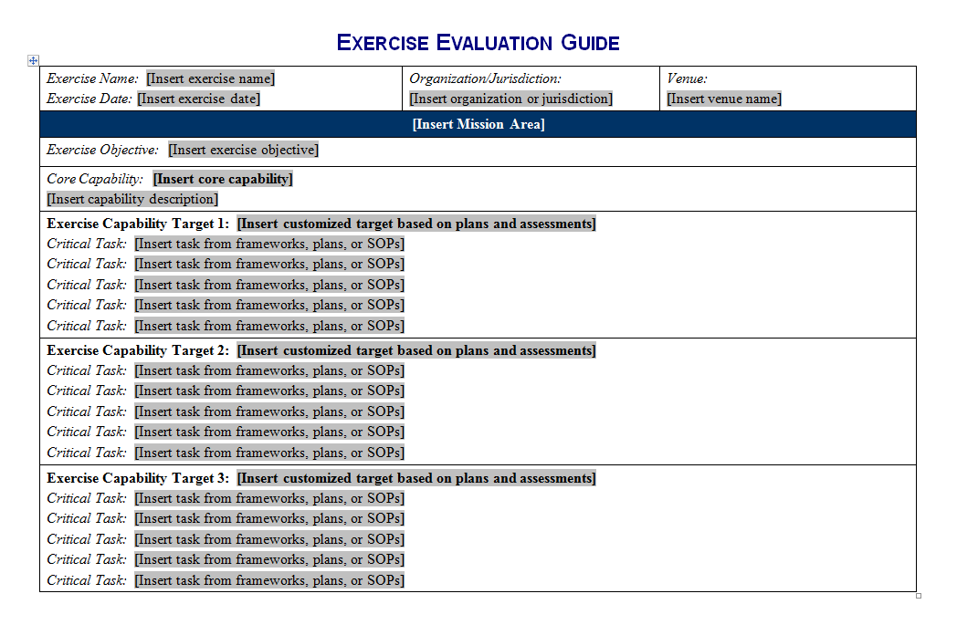
EEGs (cont’d)
Notes:
Page one of the EEG shows the exercise objective, core capability, capability targets, and associated critical tasks. The exercise design team develops this information for use by the evaluators during the exercise.

Slide 30
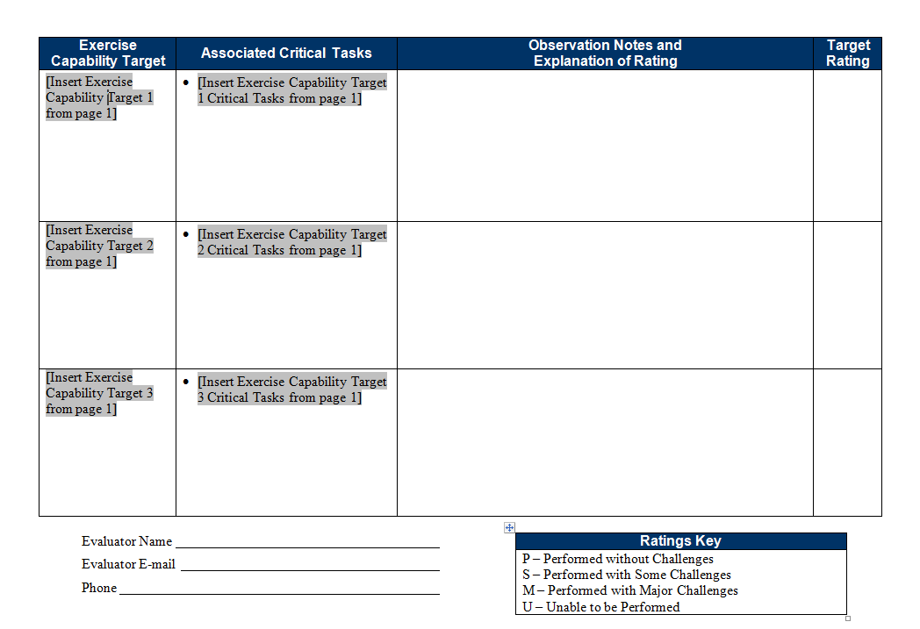
EEGs (cont’d)
Notes:
Page two of the EEG shows the capability targets and critical tasks. On this page, evaluators assign a target rating and fill in the observation notes and explanation of the target rating. This page also includes a ratings key.

Slide 31
Capability Target Ratings
Evaluators assign ratings for each capability target listed on the EEG
Review notes and observations relating to EEG critical tasks, and assign one of four ratings for the capability target:
Performed without Challenges (P)
Performed with some Challenges (S)
Performed with Major Challenges (M)
Unable to be Performed (U)
Consult the ratings definitions page in the EEG to determine the correct rating for the capability target

Slide 32
Final Reminders
Safety comes first. Use the phrase [“real-world emergency”] when an emergency occurs
Know your role and responsibilities
Understand the scenario
Do not prompt or get in the way of players
Contact the Exercise Director and/or Senior Controller with any problems or questions

Slide 33
Questions?

